Slide 1
PTL-UH RVP TOPS Training
PTL RVP Team
WW02Y2025

Slide 2
Contents
Introduction
SKU Offerings
High level RVP overview
Memory
Display
Modular TCSS
Type C TBT
MODPHY mapping & Storage
UFS & Camera
Connectivity
Sensors
Audio
LPSS and LSIO
Embedded Controllers
15. Chrome Support
16. Debug and Validation
17. Power Delivery
18. Quick Start
19. PTL-UH SOC & Memory Retention Solution
20. Jumper, Switch & LED details
21. PTL-UH SOC straps
22. RVP DAC
23. UCP-SQUID
24. RVP NEST
25. Back-up
Notes:
RVP NEST
UCP - backup

Slide 3
PTL-UH RVP Key Contacts
Program Management Team
Mani, Suresh
Korishettar, Aishwarya
Design/Engineering Manager
Agrawal, Archana
RVP Architect:
N, Anilkumar
PD Architect:
Srighakollapu, N V S Kumar
DE Lead:
Ismail Sherif, Khader Shareef
Rao, Archana
Dixit, Mayank
PD Lead:
P, Manas
DE Team:
Rao, Archana
C M, Aparna
George, Priyan
Jadhav, Aniket
K, Vishnu
M K, Muhammed Naseef
Prabha, Abhijith
Sahu, Shubham Kumar
Usha
Vidaya, Divya
Mechanical Team:
Kadadevaramath, Akarsha
Kaja, Ajmeer
Layout Team
V, Singaravelan
J, Diana Kumari
Selvaraj, Balaji
Elayaraj, David
Validation Team:
V, Manjunatha (CSF)
Jha, Nisha Kumari (Chrome)
M, Ramesh S (Validation Manager)
MPM/ME/Factory Team:
Binti Jalaluddin, Adnin Falina (MPM)
Nagaraju, Elawarasi (ME)
Khor, Wei Sin (ME)
Raman, Letchumanan (OPM)
Chua, Alex Chong Beng (Factory test lead)

Slide 4
Important Links [goto/rvp]
PTL RVP SharePoint link:
https://intel.sharepoint.com/sites/ccgptlplatformpdtprogrammanagement/SitePages/PTL-UPH-RVP-Engineering-Documents.aspx
PTL-UH Architecture document link:
https://intel.sharepoint.com/:f:/r/sites/ccgptlplatformpdtprogrammanagement/PTLUPH%20RVP%20documents/PTL-UPH%20RVP%20Architecture%20documents?csf=1&web=1&e=TabDgC
PTL-UH RVP SOC and EC GPIO mapping link:
https://intel.sharepoint.com/:f:/r/sites/ccgptlplatformpdtprogrammanagement/PTLUPH%20RVP%20documents/Misc_Docs/Platform_GPIO_Map?csf=1&web=1&e=ECyLFI
PTL-UH RVP Schematics link:
https://intel.sharepoint.com/:f:/r/sites/ccgptlplatformpdtprogrammanagement/PTLUPH%20RVP%20documents/Schematics?csf=1&web=1&e=3TacQ4
PTL-UH RVP Layout link:
https://intel.sharepoint.com/:f:/r/sites/ccgptlplatformpdtprogrammanagement/PTLUPH%20RVP%20documents/Layout?csf=1&web=1&e=YEv5Dd
PTL-UH TOPS File:
https://intel.sharepoint.com/:f:/r/sites/ccgptlplatformpdtprogrammanagement/PTLUPH%20RVP%20documents/TOPS?csf=1&web=1&e=BSOdhi

Slide 5
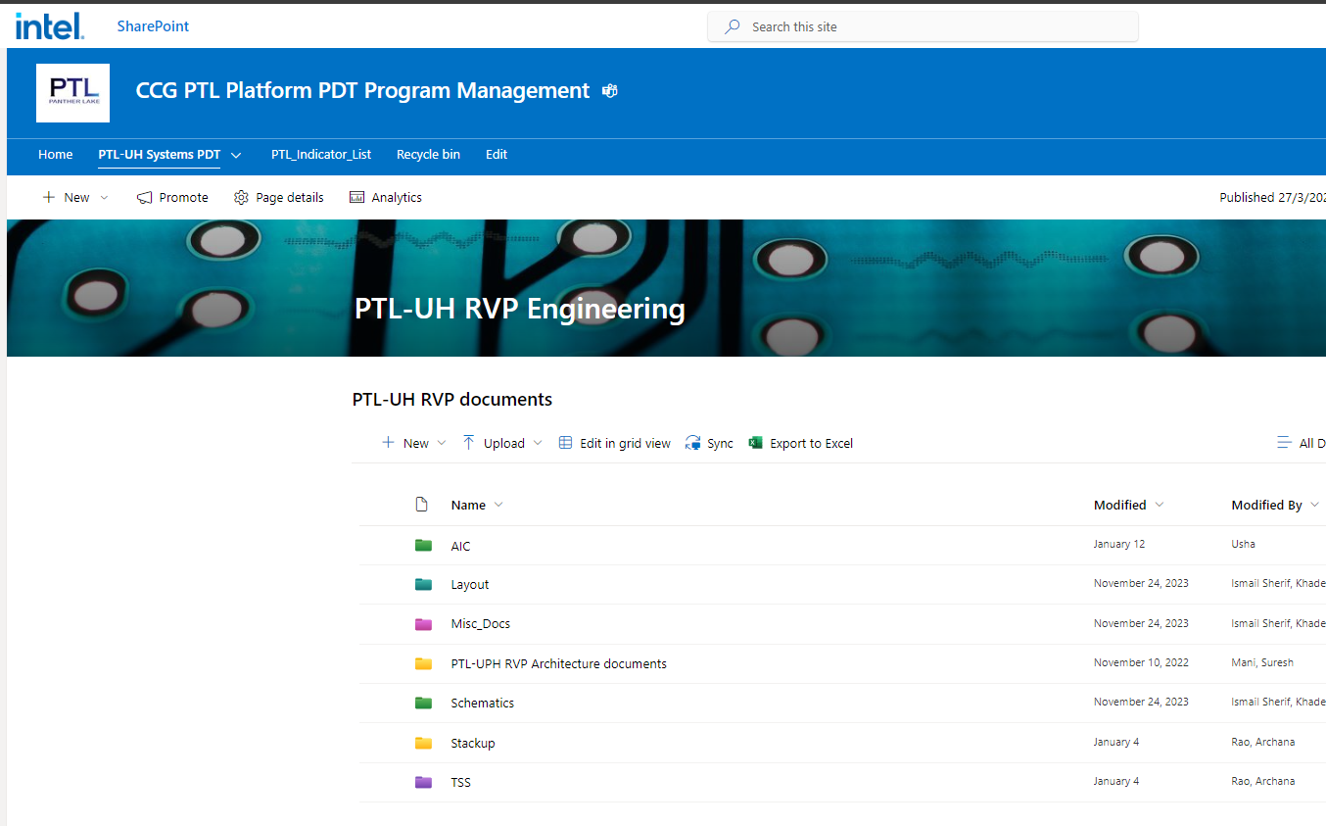
PTL-UH RVP SharePoint
Feature List for PTL-UH RVP is available in architecture document as well as in Landing Zone(LZ).
Architecture document is available at PTL-UH RVP SharePoint at following mention link.
Link: https://intel.sharepoint.com/sites/ccgptlplatformpdtprogrammanagement/SitePages/PTL-UPH-RVP-Engineering-Documents.aspx

Slide 6
SKU Offerings
Ismail Sherif, Khader Shareef

Slide 7
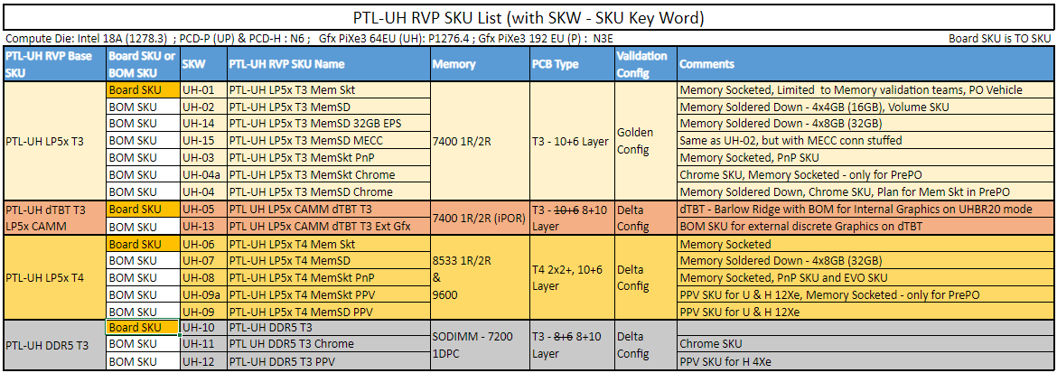
PTL-UH RVP SKU Offering
Link: PTL-UH-RVP-Offerings
Notes:
Add IPNs for the PB/PBA/AA/TA

Slide 8
Boot KIT: PTL-UH RVP1 LP5x T3 RVP MEM SKT
Sr. No. | Item Type | IPN | Item Description | Qty
1 | NEW_BIZ_RDV | N35911-001 | BK, PTL-UH RVP1 LP5XT3 M/M SKT, | 1
2 | ISC Socket | N34281-001 | SOCKET, 2540BGA, NSP ELASTOMER,BENCHTOP, RVP/MDV, PTL-H/U | 1
3 | Socket Retention HW | N30664-002 | RETENTION HW, INJECTED KIT,ELASTOMER, RVP, PTL-U/H | 1
4 | MEMORY | M93232-004 | N/A,IC,MEM,BL,LPDDR5X,N/A,N/A,FBGA,315, | 4
5 | Mem Socket | M15275-001 | SOCKET,315BGA, LPDDR5,,ELASTOMER | 4
6 | Mem Retention HW | M16851-001 | RETENTION,LPDDR5,4X ARRAY,20MM,SPACE,HORIZONTAL,M3,ALTERNAT | 1

Slide 9
Boot KIT: PTL-UH RVP2 LPCAMM dTBT RVP
Sr. No. | Item Type | IPN | Item Description | Qty
1 | NEW_BIZ_RDV | N38323-001 | BK, PTL-UH RVP2 LP5X CAMM T3, | 1
2 | ISC Socket | N34281-001 | SOCKET, 2540BGA, NSP ELASTOMER,BENCHTOP, RVP/MDV, PTL-H/U | 1
3 | Socket Retention HW | N30664-002 | RETENTION HW, INJECTED KIT,ELASTOMER, RVP, PTL-U/H | 1
4 | MEMORY | N50146-001 | AIMM,MOD,1RX16,5.00V,7500MHZ, | 1
5 | Mem Retention HW | N50207-001 | RETENTION HW, LP5 CAMM 1.0,POGOPIN CONNECTOR, RVP | 1

Slide 10
Boot KIT’s for PTL-UH RVP3 LP5x T4 RVP MEM SKT
Sr. No. | Item Type | IPN | Item Description | Qty
1 | NEW_BIZ_RDV | N40170-001 | BK, PTL-UH RVP3 LP5XT4 M/M SKT, | 1
2 | ISC Socket | N34281-001 | SOCKET, 2540BGA, NSP ELASTOMER,BENCHTOP, RVP/MDV, PTL-H/U | 1
3 | Socket Retention HW | N30664-002 | RETENTION HW, INJECTED KIT,ELASTOMER, RVP, PTL-U/H | 1
4 | MEMORY | N35527-001 | MEMORY IC,N/A,MEM,BL,LPDDR5,N/A,N/A,FBGA,315, | 4
5 | Mem Socket | M15275-001 | SOCKET,315BGA, LPDDR5,,ELASTOMER | 4
6 | Mem Retention HW | M16851-001 | RETENTION,LPDDR5,4X ARRAY,20MM,SPACE,HORIZONTAL,M3,ALTERNAT | 1
Note:
Please note that memory retention assembly will be same for LP5x T3 and LP5x T4 RVP.

Slide 11
Boot KIT’s for PTL-UH RVP4 T3 DDR5 SODIMM 1DPC RVP
Sr. No. | Item Type | IPN | Item Description | Qty
1 | NEW_BIZ_RDV | N32253-001 | BK, PTL-UH-10 RVP4 DDR5 T3, | 1
2 | ISC Socket | N34281-001 | SOCKET, 2540BGA, NSP ELASTOMER,BENCHTOP, RVP/MDV, PTL-H/U | 1
3 | Socket Retention HW | N30664-002 | RETENTION HW, INJECTED KIT,ELASTOMER, RVP, PTL-U/H | 1
4 | MEMORY | N39757-002 | DDR5SODIMM,MOD,1RX16NE,1.1V,6400Mbps, | 2

Slide 12
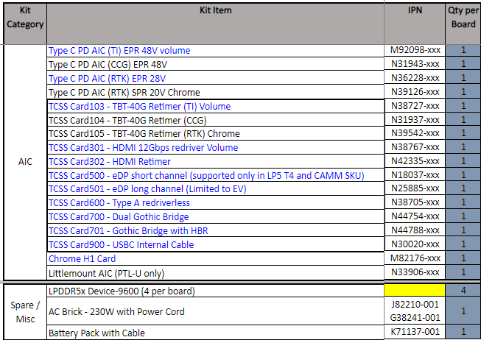
AIC’s/ KIT supported along with PTL-UH RVP
PTL-UH AIC and Kit item offering.xlsx

Slide 13
High Level RVP Overview
Ismail Sherif, Khader Shareef

Slide 14
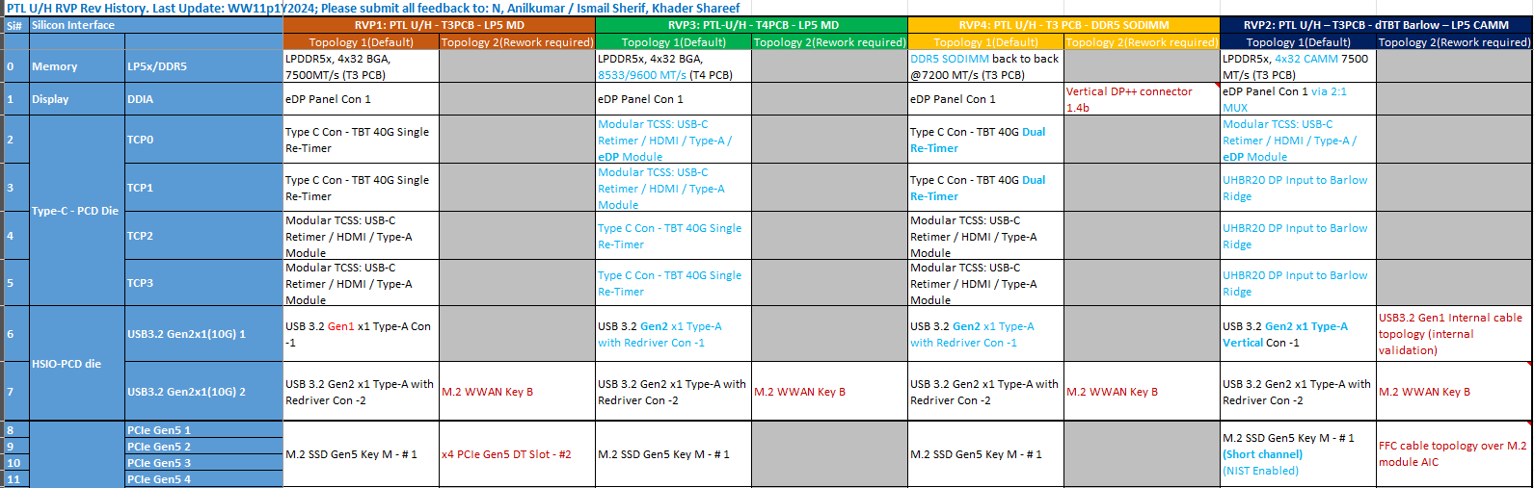
Difference across PTL-UH RVP SKUs
Changes wrt. SKU highlighted in blue color and BOM SKU difference
Link:
PTL-UH_RVP_LZ_Rev1p1

Slide 15
PTL-UH RVP (LP5x T3) Block Diagram
- Golden Config
Link:
Block Diagram

Slide 16
Board Layout
Rao, Archana
Dixit, Mayank
Ismail Sherif, Khader Shareef

Slide 17
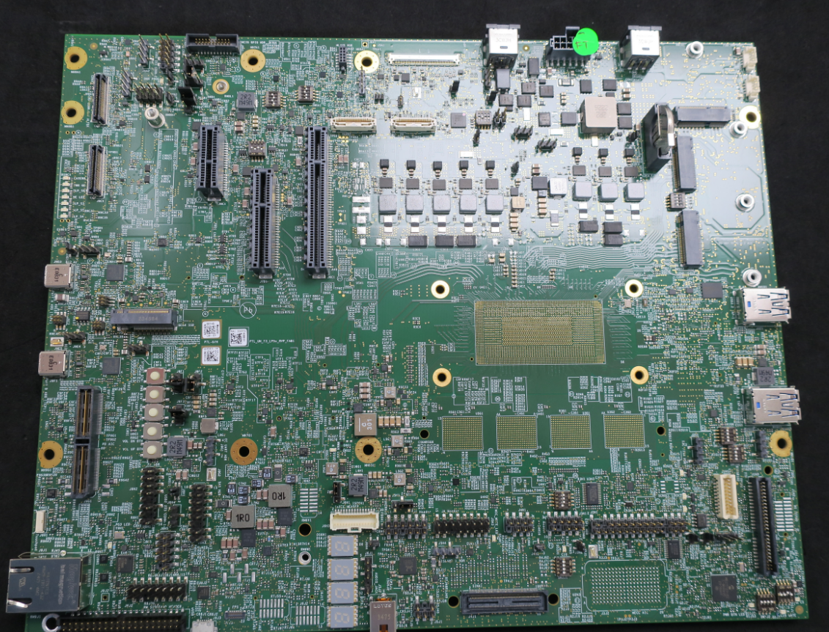
PTL UH LP5x T3 RVP-Board Layout – TOP
AC BRICK-
Power Adapter
(Secondary)-J4A1
Battery
Connector
(J3A1)
Main AC BRICK-
Power Adapter
(Primary)-J2A1
WLAN module- J1B1
Mlink
HDR
eDP conn (J5A1)
FAN HDR (PWM control)-J1A1
CRD conn-1 (J9B1)
FAN HDR (Always ON)-J1A2
THC 0 Conn
J6B2
THC 1 Conn
J5B2
RTC Coin Cell
XJ2B2
Modular TCSS AIC 1 (J2C1)
TCP2 port
x1PCIE Slot (J8C1)
CRD conn-2 (J9C1)
x8 PCIE Slot (J6C1)
x4 PCIE Slot (J7D1)
Modular TCSS AIC 2 (J2D1)
TCP3 port
TCP port 0 (with debug capability (J9D3)
Gen4 M.2 SSD Conn (J8E1)
USB 3.2 Gen1 x1 Type-A Con - # 1 (J1E1)
PTL-UH SOC
TCP port 1 (J9F1)
Reset (SW8F1) and power button (SW8F2)
LP5x memory
Type-A Con USB 3.2 Gen2 x1 10G with redriver (J1G1)
Type C PD AIC conn (J9G1)
DediProg
Conn (SF600)-J1H1
Touch pad (J9H1)
H1 SERVO Conn (J1H2)
TTK3 Conn (J1H3)
RJ 45 LAN conn(J9J1)
PORT 80
MECC Conn(J3J2)
SINAI2/NEVO Conn(J4J1)
FPS
(J7J3)
uAB Debug
port (J8J3)
3.5mm AUDIO JACK (J5J2)
PM sideband header (J8J2)

Slide 18
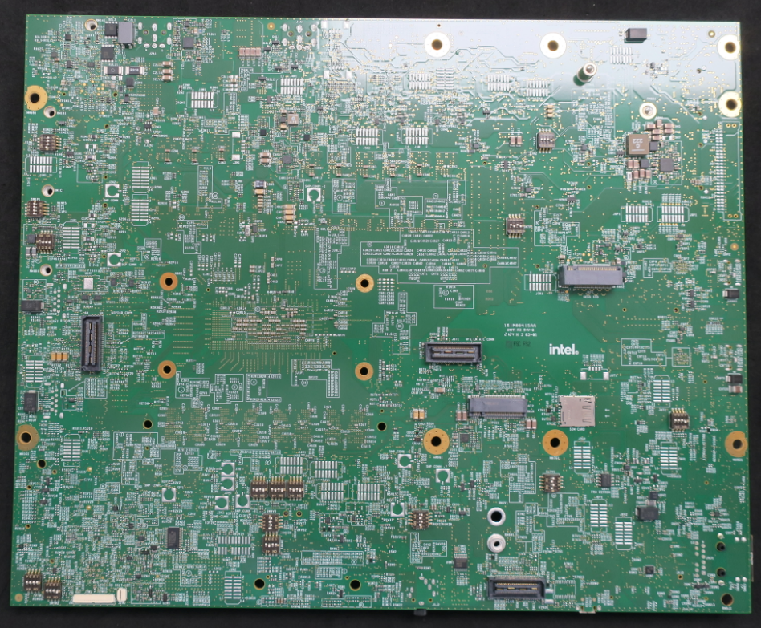
PTL-UH LP5x T3 RVP-Board Layout – BOTTOM (Flipped)
PnP HDR (J5L1)
PnP HDR (J6L2)
PnP HDR (J8L1)
PnP HDR (J9L2)
PnP HDR (J3M1)
PnP HDR (J4M1)
PnP HDR (J6L1)
PnP HDR (J7M1)
PnP HDR (J5M2)
PnP HDR (J5M1)
PnP HDR (J1N1)
PnP HDR (J2N1)
PD validation header (J9N1)
PnP HDR (J8P1)
PnP HDR (J9P1)
PnP HDR (J2P1)
PnP HDR (J1P1)
PnP HDR (J7R1)
M.2 SSD Gen5 Conn (J8F2)
MIPI 60 Conn (J1T1)
Little mount UFS AIC (J6T1)
PnP HDR (J1T2)
PnP HDR (J8T2)
M.2 WWAN(J6T2)
SIM Slot-1 (J7U1)
PnP HDR (J1U1)
PnP HDR (J4U1)
PnP HDR (J4U2)
PnP HDR (J7U2)
PnP HDR (J9U1)
PnP HDR (J5V1)
PnP HDR (J4V1)
PnP HDR (J8V1)
PnP HDR (J8V2)
PnP HDR (J3W2)
Sensor HDR (J7W1)
Scan Matrix Conn (J2W2)

Slide 19
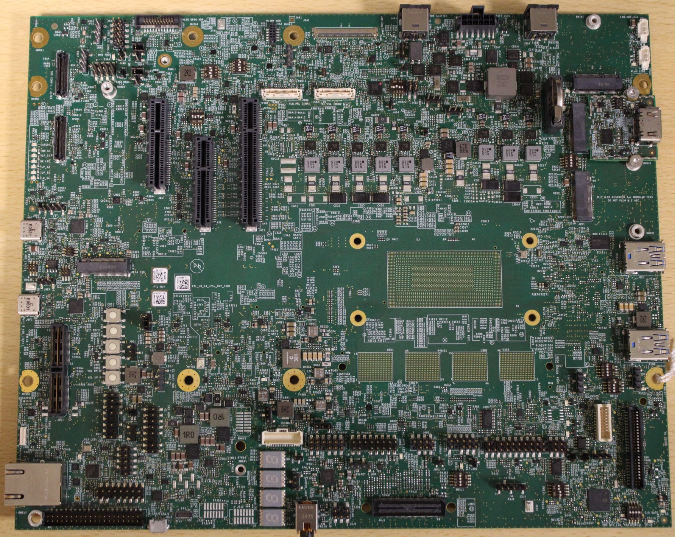
PTL UH LP5x T4 RVP-Board Layout – TOP
AC BRICK-
Power Adapter
(Secondary)-J4A1
Battery
Connector
(J3A1)
Main AC BRICK-
Power Adapter
(Primary)-J2A1
WLAN module- J1B1
eDP conn (J5A1)
FAN HDR (PWM control)-J1A1
Mlink
HDR
FAN HDR (Always ON)-J1A2
CRD conn-1 (J9B1)
THC 0 Conn
J6B2
THC 1 Conn
J5B2
RTC Coin Cell
XJ2B2
Modular TCSS AIC 1 (J2C1)
TCP1 port
CRD conn-2 (J9C1)
x4PCIE Slot (J8C1)
x8 PCIE Slot (J6C1)
Modular TCSS AIC 2 (J2D1)
TCP0 port with debug capability
x4 PCIE Slot (J7D1)
TCP port 3 (J9D3)
PTL-UH SOC
USB 3.2 Gen1 x1 Type-A Con - # 1 (J1E1)
M.2 SSD Gen4 Conn (J8E1)
TCP port 2 (J9F1)
Reset (SW8F1) and power button (SW8F2)
LP5x memory
Type-A Con USB 3.2 Gen2 x1 10G with redriver (J1G1)
Type C PD AIC conn (J9G1)
DediProg
Conn (SF600)-J1H1
Touch pad (J9H1)
TTK3 Conn (J1H2)
RJ 45 LAN conn(J9J1)
PORT 80
SINAI2/NEVO Conn(J4J1)
FPS
(J7J3)
PM sideband header (J8J2)
uAB Debug
port (J8J3)
3.5mm AUDIO JACK (J5J2)

Slide 20
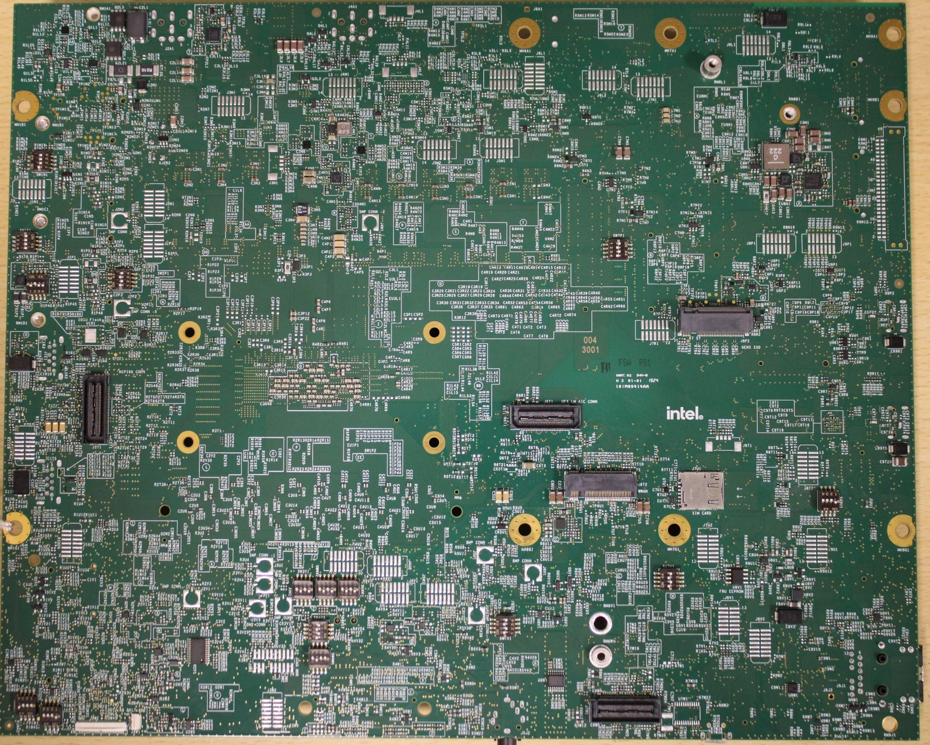
PTL-UH LP5x T4 RVP-Board Layout – BOTTOM (Flipped)
PnP HDR (J5L1)
PnP HDR (J8L1)
PnP HDR (J4M1)
PnP HDR (J6L1)
PnP HDR (J6L2)
PnP HDR (J7M1)
PnP HDR (J3M1)
PnP HDR (J5M2)
PnP HDR (J5M1)
PnP HDR (J1N1)
PD validation header (J9N1)
PnP HDR (J2N1)
PnP HDR (J8P1)
PnP HDR (J9P1)
PnP HDR (J2P1)
PnP HDR (J1P1)
PnP HDR (J7R1)
M.2 SSD Gen5 Conn (J8P2)
MIPI 60 Conn (J1T1)
Little mount UFS AIC (J6T1)
PnP HDR (J1T2)
PnP HDR (J8T2)
M.2 WWAN(J6T2)
SIM Slot-1 (J7U1)
PnP HDR (J1U1)
PnP HDR (J4U1)
PnP HDR (J4U2)
PnP HDR (J7U2)
PnP HDR (J9U1)
PnP HDR (J5V1)
PnP HDR (J4V1)
PnP HDR (J8V1)
PnP HDR (J8V2)
PnP HDR (J3W2)
Sensor HDR (J7W1)
Scan Matrix Conn (J2W2)

Slide 21
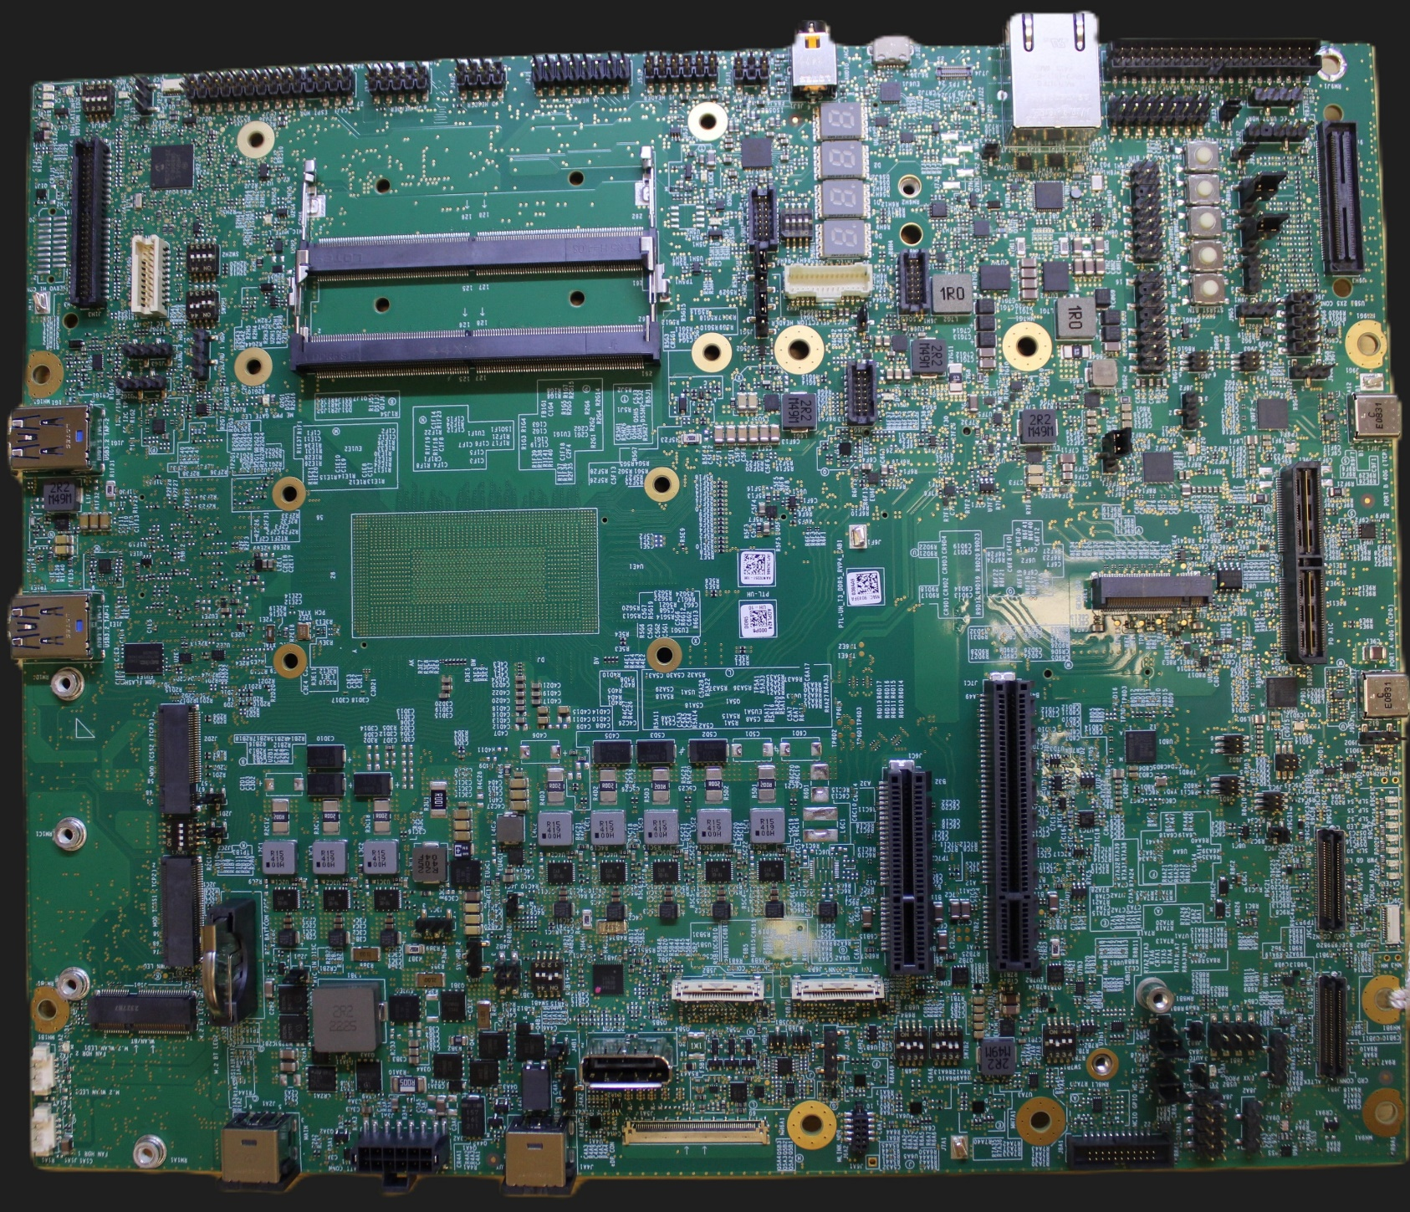
PTL UH DDR5 SODIMM T3 RVP-Board Layout – TOP
AC BRICK-
Power Adapter
(Secondary)-J4A1
Battery
Connector
(J3A1)
Main AC BRICK-
Power Adapter
(Primary)-J2A1
WLAN module- J1B1
Mlink
HDR
eDP conn (J5A1)
FAN HDR (PWM control)-J1A1
FAN HDR (Always ON)-J1A2
CRD conn-1 (J9B1)
THC 0 Conn
J6B2
THC 1 Conn
J5B2
Touch pad (J9H1)
RTC Coin Cell
XJ2B2
Modular TCSS AIC 1 (J2C1)
TCP2 port
CRD conn-2 (J9C1)
x8 PCIE Slot (J6C1)
x4 PCIE Slot (J7D1)
Modular TCSS AIC 2 (J2D1)
TCP3 port
TCP port 0 (with debug capability (J9D3)
PTL-UH SOC
USB 3.2 Gen1 x1 Type-A Con - # 1 (J1E1)
Type C PD AIC conn (J9G1)
M.2 SSD Gen4 Conn (J8E1)
TCP port 1 (J9F1)
Type-A Con USB 3.2 Gen2 x1 10G with redriver (J1G1)
DDR5 SODIMM – 1 (J4G1)
Reset (SW8F1) and power button (SW8F2)
DDR5 SODIMM – 2 (J4H1)
DediProg
Conn (SF600)-J1H1
SINAI2/NEVO Conn(J4J1)
PORT 80
TTK3 Conn (J1H2)
PM sideband header (J8J2)
FPS
(J7J3)
RJ 45 LAN conn(J9J1)
uAB Debug
port (J8J3)
3.5mm AUDIO JACK (J5J2)

Slide 22
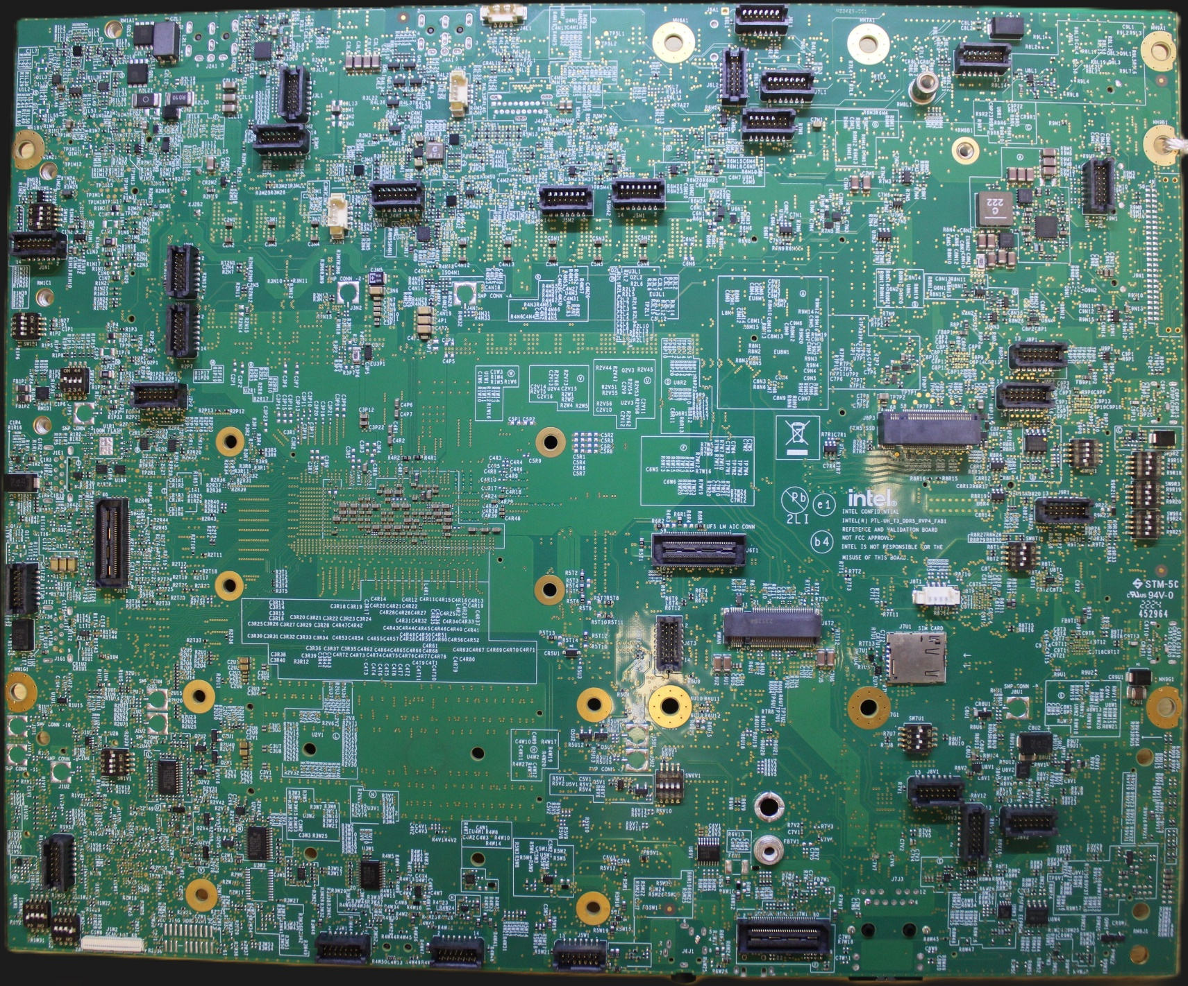
PTL-UH DDR5 SODIMM T3 RVP-Board Layout –BOTTOM (Flipped)
PnP HDR (J6L1)
PnP HDR (J3L1)
PnP HDR (J6L2)
PnP HDR (J7L1)
PnP HDR (J8L1)
PnP HDR (J3M1)
PnP HDR (J6M1)
PnP HDR (J4M1)
PnP HDR (J5M2)
PnP HDR (J5M1)
PnP HDR (J9M1)
PnP HDR (J1N1)
PD validation header (J9N1)
PnP HDR (J2N1)
PnP HDR (J2P1)
PnP HDR (J8P1)
PnP HDR (J2P2)
PnP HDR (J8P2)
M.2 SSD Gen5 Conn (J8P3)
PnP HDR (J9R1)
MIPI 60 Conn (J1T1)
Little mount UFS AIC (J6T1)
PnP HDR (J1T2)
PnP HDR (J6T3)
M.2 WWAN(J6T2)
SIM Slot-1 (J7U1)
PnP HDR (J8V1)
PnP HDR (J8V3)
PnP HDR (J8V2)
PnP HDR (J1W1)
PnP HDR (J3W1)
PnP HDR (J4W1)
PnP HDR (J5W1)
Sensor HDR (J7W1)
Scan Matrix Conn (J1W2)

Slide 23
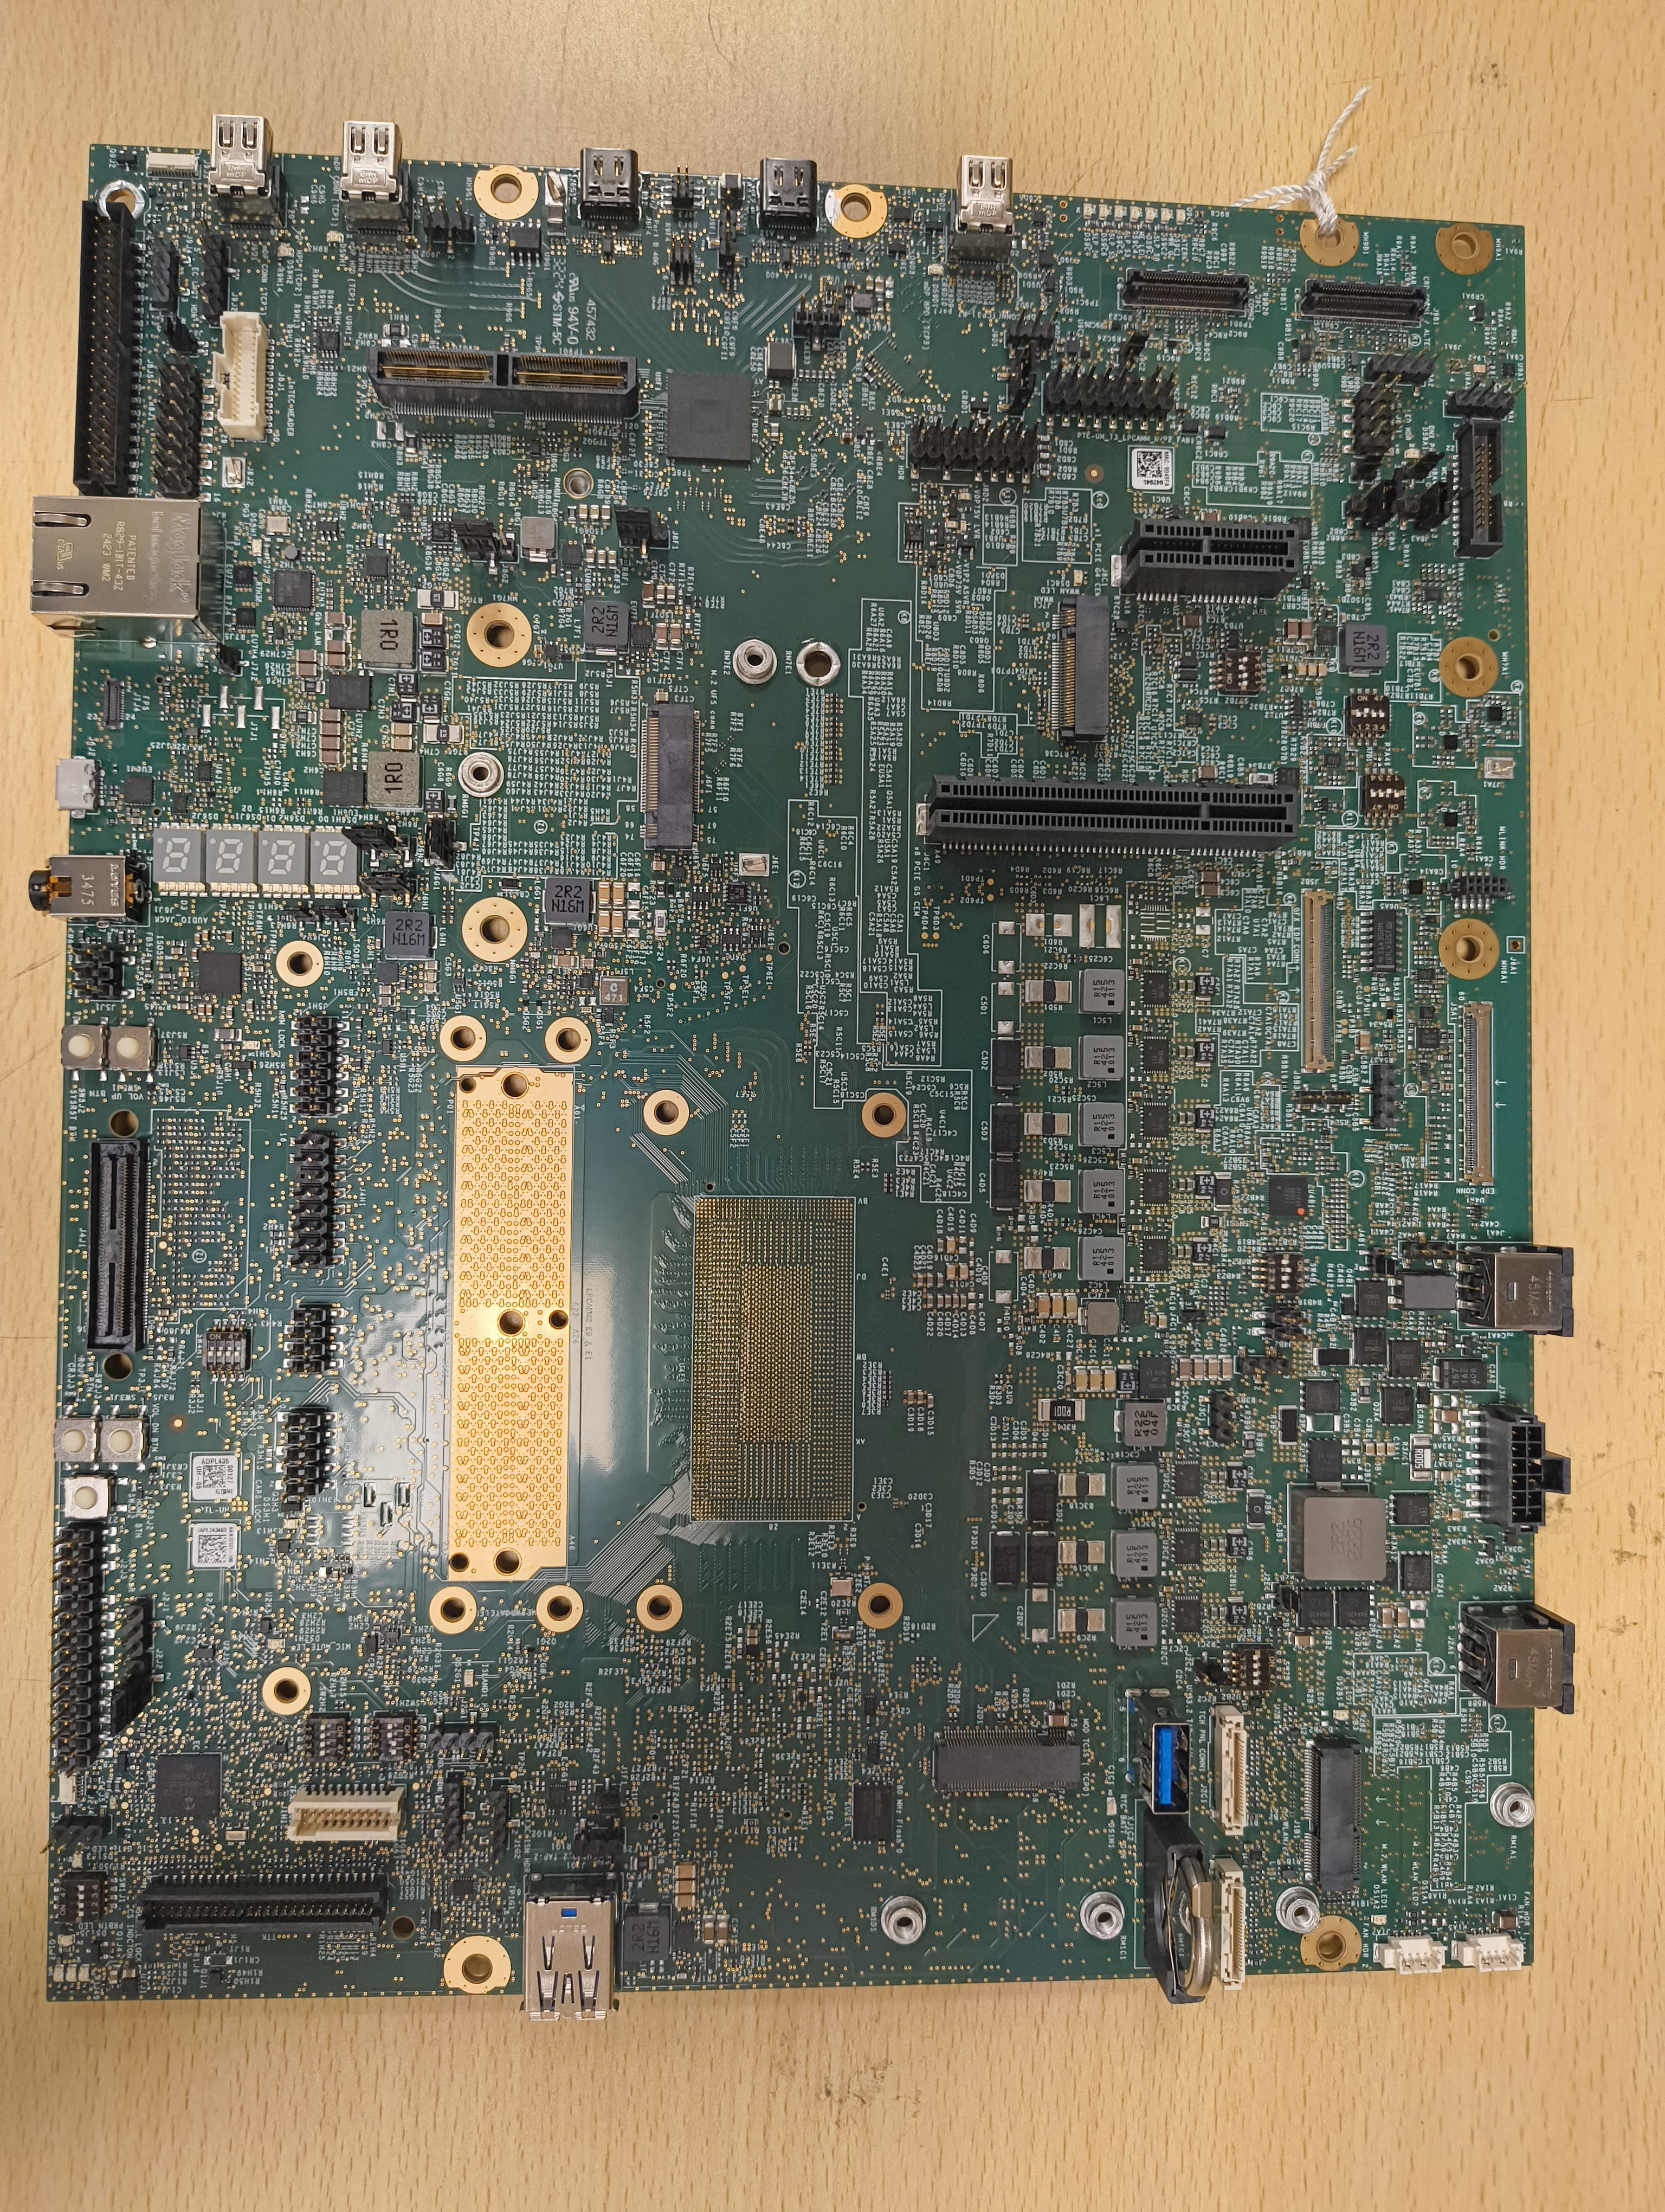
PTL UH LP5 CAMM T3 RVP-Board Layout – TOP
AC BRICK-
Power Adapter
(Secondary)-J4A1
Battery
Connector
(J3A1)
Main AC BRICK-
Power Adapter
(Primary)-J2A1
WLAN module- J1B1
Mlink
HDR
eDP conn (J5A1)
FAN HDR (PWM control)-J1A1
FAN HDR (Always ON)-J1A2
CRD conn-1 (J9B1)
eGfx eDP conn (J5A2)
Touch pad (J9H1)
x1 PCIE Slot (J8C1)
CRD conn-2 (J9C1)
RTC Coin Cell
XJ2B2
X8 PCIE Slot (J6C1)
USB 3.2 Gen2 x1 Vertical Type-A Con - # 1 (J2C3)
Modular TCSS AIC 1 (J2D1)
TCP0 port
mDP2.1 ext DP In
Port-A (J9D2)
Type C PD AIC conn (J9G1)
M.2 SSD Gen4 Conn (J8E1)
80G dTBT Port 1 (J9E2)
PTL-UH SOC
80G dTBT Port 2 (J9F4)
Type-A Con USB 3.2 Gen2 x1 10G with redriver (J1G1)
LP5 CAMM Module (J4G1)
mDP2.1 ext DP In
Port-B (J9H1)
DediProg
Conn (SF600) (J1H1)
PORT 80
mDP2.1 ext DP In
Port-C (J9J1)
TTK3 Conn (J1H2)
PM sideband header (J8J5)
SINAI2/NEVO Conn(J4J1)
FPS
(J7J4)
RJ 45 LAN conn(J7J3)
uAB Debug
port (J6J2)
3.5mm AUDIO JACK (J6J1)
Reset (SW8F1) and power button (SW8F2)

Slide 24
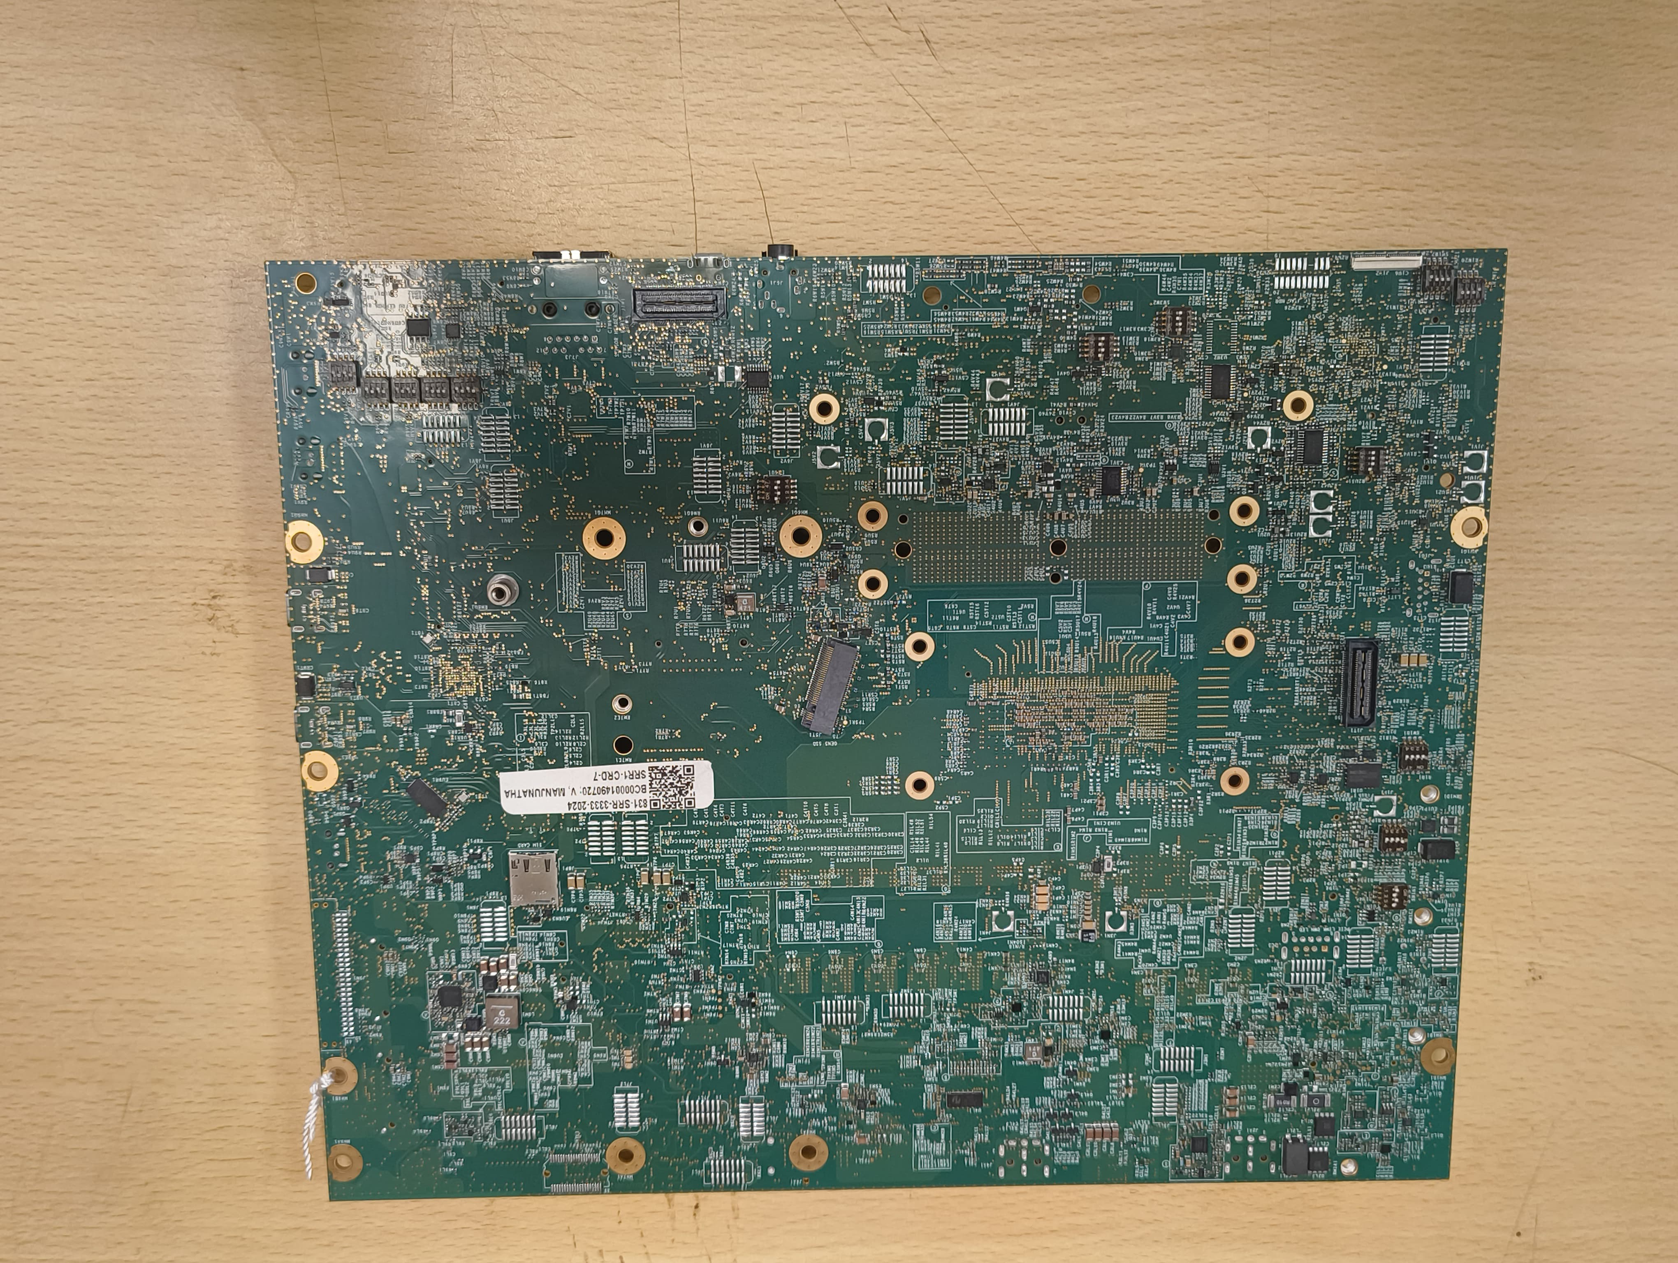
PTL UH LP5 CAMM T3 RVP-Board Layout–BOTTOM (Flipped)
PnP HDR (J6L1)
PnP HDR (J3L1)
PnP HDR (J6L2)
PnP HDR (J7L1)
PnP HDR (J8L1)
PnP HDR (J3M1)
PnP HDR (J6M1)
PnP HDR (J4M1)
PnP HDR (J5M2)
PnP HDR (J5M1)
PnP HDR (J9M1)
PnP HDR (J1N1)
PD validation header (J9N1)
PnP HDR (J2N1)
PnP HDR (J2P1)
PnP HDR (J2P2)
PnP HDR (J7P1/2)
M.2 SSD Gen5 Conn (J5T1)
MIPI 60 Conn (J1T1)
PnP HDR (J1T2)
PnP HDR (J8V1)
PnP HDR (J8V3)
PnP HDR (J8V2)
PnP HDR (J1W1)
PnP HDR (J3W1)
PnP HDR (J5W1)
Sensor HDR (J7W1)
Scan Matrix Conn (J1W2)

Slide 25
Memory
Prabha, Abhijith

Slide 26
POR Memory Configurations
RVP SKU # | Config | Internal POR Transfer Rate (MT/s) | External POR Transfer Rate (MT/s) | Memory Device | Routing Topology | Supported Memory density |  | PCB Stack-Up / Routing Layer
 |  |  |  |  |  | Default | Max
RVP1 T3 | LPDDR5/x Memory Down x32 315 BGA | 2R 8533 | 2R 7467 | DDP QDP ODP | Point to Point | 16GB | 64GB | T3/10L 3 Layers;
RVP2 T3 | LPDDR5x CAMM | 2R 8533 | 2R 7467 (PTL H) 2R 6800 (PTL U) | LPCAMM2 | Point to Point | 16GB | 64GB | T3/8L 3 Layers.
RVP3 T4 | LPDDR5x Memory Down x32 315 BGA | 2R 9600 | 2R 8533 | DDP QDP ODP | Point to Point | 16GB | 64GB | T4/10L 4 Layers;
RVP4 T3 | DDR5 SODIMM 1DPC | 2R 7200 | 2R 7200 | CSODIMM/ SODIMM | B2B | 16GB | 96GB (24Gb, 2R x8) 128GB (32Gb, 2R x8) | T3/8L 3 Layers;

Slide 27
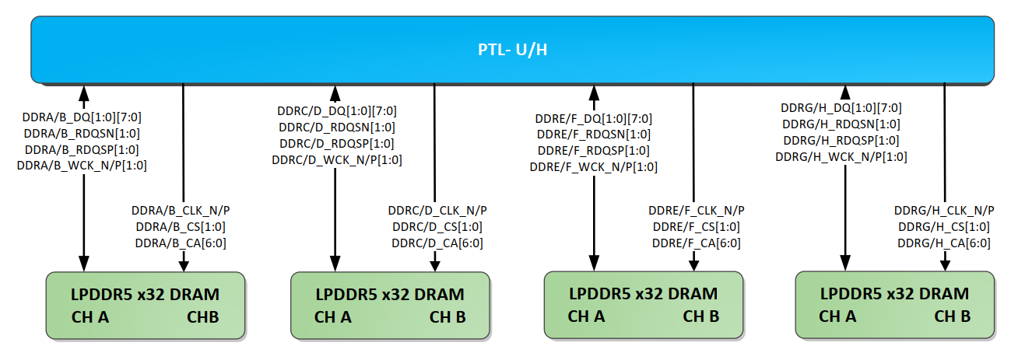
LPDDR5x Memory topology
The Address & command signals are routed with point-to-point topology along with Data and Strobe signals. The topology for x32 devices is illustrated in the figures below which is supported on PTL LP5x T3 and LP5x T4 RVP. In PTL, WCK topology changed from T-topology to point to point, this will avoid the stub effect and improve SI.
LPDDR5x with x32 devices routing on PTL-UH

Slide 28
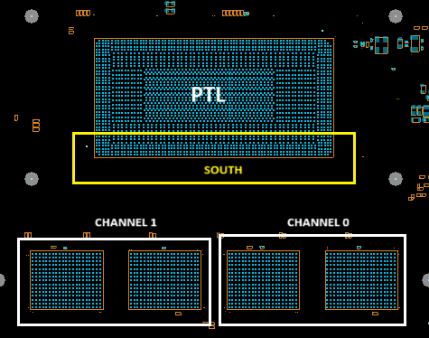
PTL UH LPDDR5x T3 and LPDDR5x T4 Memory specification
PTL UH LP5x T3 memory details
Type | LPDDR5x 4x32, 2 DRAMs per channel
Topology | Non-Interleaved routing
Size | Total Boot kit support 16GB (4GB per DRAM). Max System Capacity 64GB
Placement | Device down / Socketed
POR SPEED | 7500 MT/s – T3 10L
MPN | Refer to later foil
PTL UH LP5x T4 memory details
Type | LPDDR5x 4x32, 2 Devices channel
Topology | Non-Interleaved routing
Size | Total Boot kit support 16GB (4GB per x32 channel), Max System Capacity 64GB
Placement | Device down / Socketed
POR SPEED | 8533MT/s -T4/10L 2x2+
MPN | Refer to later foil
PTL UH LP5x T3/T4 RVP

Slide 29
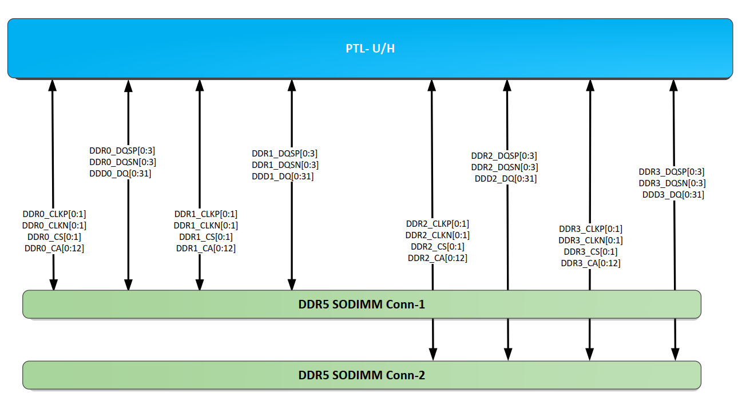
DDR5 SODIMM B2B Memory topology
DDR5 routing on PTL-UH will be point-to-point routing for all the DDR5 signals. DDR5 SODIMMs will be placed back-to-back as shown in the figure given.
DDR5 Routing topology for PTL UH DDR5 SODIMM HSIO RVP

Slide 30
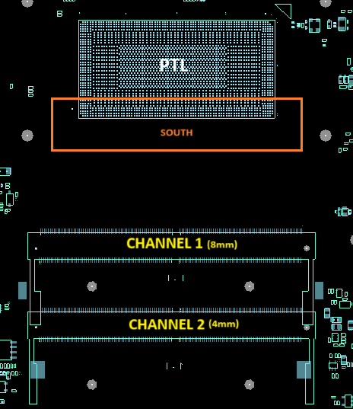
PTL UH DDR5 SODIMM Memory specification
Default DDR5 memory details
Type | DDR5 SODIMM, 1 DIMM/Channel
Topology | Non-Interleaved routing
Size | Total Boot kit support 16GB (8GB per DIMM)
Placement | PTL UH DDR5 SODIMM RVP supports back-to-back (stacked) placement
POR SPEED | 7200MT/s
MPN | HMCG66AHBVA (6400), TBD* (7200)
*7200 parts are not qualified by MIO team; pls contact Gabe
PTL UH DDR5 SODIMM Back-to-Back (B2B) RVP
30

Slide 31
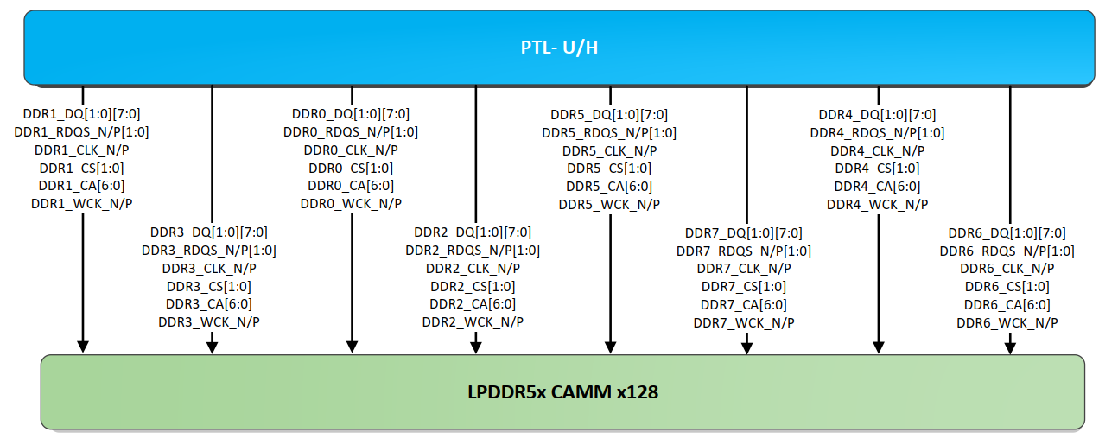
LPCAMM2 Memory topology
LPCAMM2 routing on PTL-UH will be point-to-point routing for all the memory signals.
LPCAMM2 Routing topology for PTL UH LPCAMM RVP

Slide 32
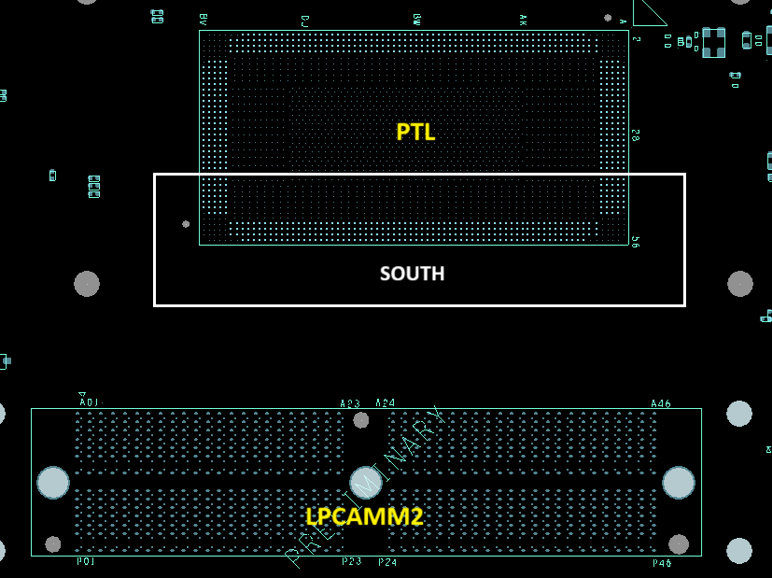
PTL UH LPCAMM2 Memory specification
Default LPCAMM memory details
Type | LPCAMM
Topology | Mixed CAC routing, point to point
Size | Total Boot kit support 16GB
JEDEDC Version | 1.08
POR SPEED | 7500MT/s
MPN | MTD8C10324N2FN026CY (7500)
PTL UH LPCAMM2
32

Slide 33
PTL UH Memory devices supported with RVP + Boot Kit
SKU | Memory | Size | Speed | MPN | IPN | MFG | Remark
RVP3 | LP5x 315b | 4GB | 8533 | H58G56BK8BX068 | N35527-001 | SK Hynix | Primary Part
RVP3 | LP5x 315b | 4GB | 8533 | ​K3KL8L80DM-MGCU | N48871-001 | Samsung | Alternate Part
RVP1 | LP5x 315b | 4GB | 7500 | H58G56BK7BX068 | M93232-004 | SK Hynix | Primary Part
RVP1 | LP5x 315b | 4GB | 7500 | K3KL8L80CM-MGCT | M93232-003 | Samsung | Alternate Part
RVP1 | LP5x 315b | 8GB | 7500 | H58G66BK7BX067 | K56055-011 | SK Hynix | Primary Part
RVP1 | LP5x 315b | 8GB | 7500 | K3KL9L90CM-MGCT | M93232-002 | Samsung | Alternate Part
RVP4 | DDR5 CSODIMM 16Gb 1Rx16 | 8GB | 6400 | HMCG66AHBVA | N39757-002 | SK Hynix
RVP2 | LPCAMM | 16GB | 7500 | MTD8C10324N2FN026CY |  | Micron | Primary Part
RVP3 | LP5x 315b | 4GB | 9600 | MT62F1G32D2DS-020 WT ES:F | TBD | Micron
Above Memory Devices would be supported with each Board + Boot Kit demand received - any other devices needs to be procured by individual validation teams
Memory part may vary depending upon availability. For latest details refer to RVP SharePoint link
MIO link: https://intel.sharepoint.com/sites/PMOmemory/SitePages/Home.aspx

Slide 34
DISPLAY
Sahu, Shubham Kumar

Slide 35
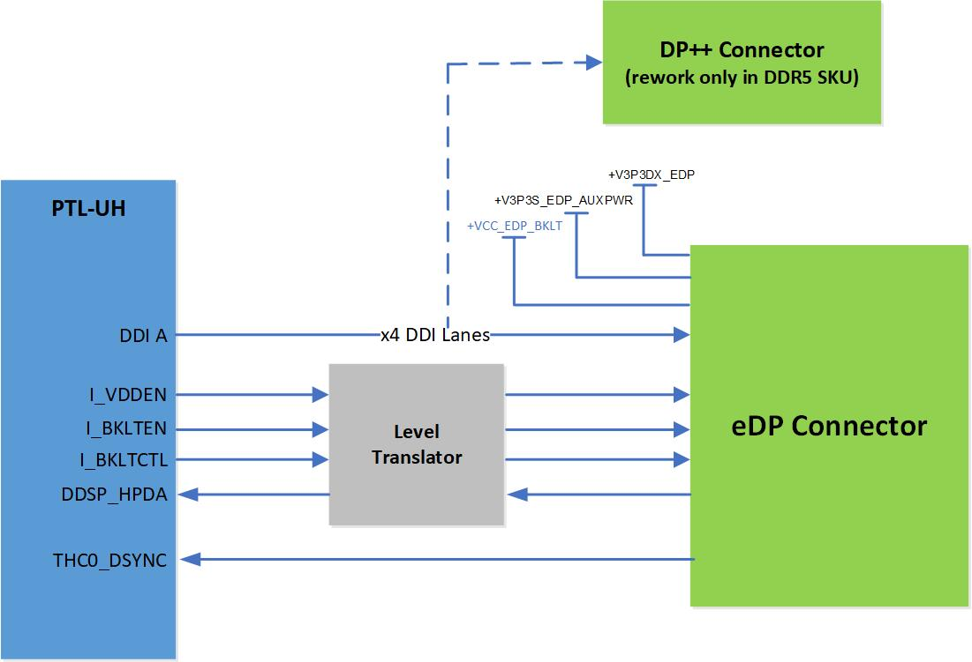
PTL-UH RVP - Display Mapping
PTL-UH RVP Display mapping for different SKUs is as follow:
Silicon Interface | PTL-UH RVP1 LP5x T3 RVP MEM SKT |  | PTL-UH RVP2 DTBT CAMM RVP |  | PTL-UH RVP3 LP5x T4 RVP MEM SKT |  | PTL-UH RVP4 T3 DDR5 SODIMM 1DPC RVP
 | Option 1 (Default) | Option 2 (Unstuffed) | Option 1 (Default) | Option 2 (Unstuffed) | Option 1 (Default) | Option 2 (Unstuffed) | Option 1 (Default) | Option 2 (Unstuffed)
DDIA | eDP Connector | NA | eDP Connector (Passive MUX) | NA | eDP Connector | NA | eDP Connector | DP++

Slide 36
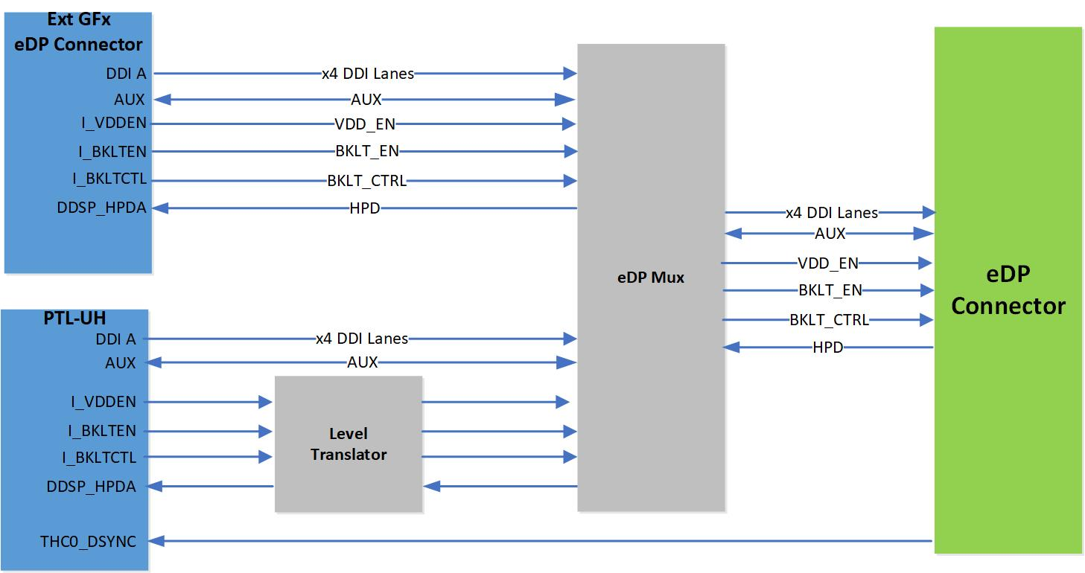
PTL-UH RVP – Switchable Gfx support
eDP MUX Solder Down:
eDP MUX solder down supported only on PTL-UH RVP2 DTBT CAMM SKU.
MUX Part: Diodes PI3WVR13612ZLEX

Slide 37
Modular TCSS Intro
Usha
Naseef

Slide 38
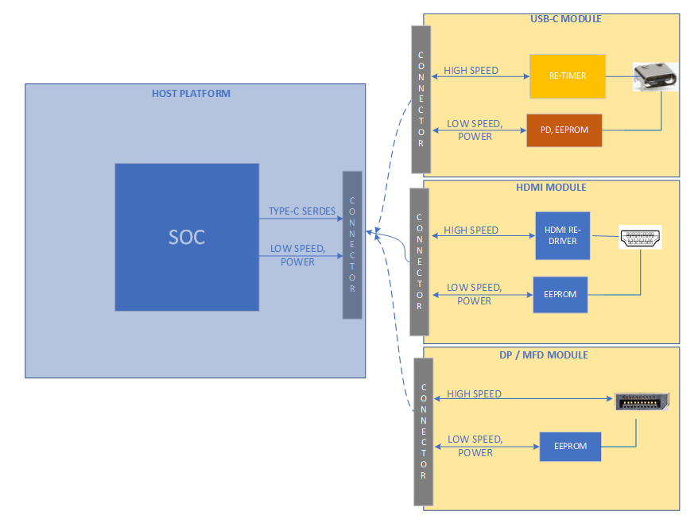
Modular TCSS on PTL-UH RVP
Modular TCSS enable multiple Type-C configuration on Modular TCSS connector.
Instead of using multiple RVPs for Type-C validation, this new concept provide option to use the same RVP for different IO personality/connector enabling.
No rework or IFWI re-flashing on RVP needed for enabling the different modules.
PTL-UH RVP supports Modular TCSS connector on which multiple IO modules [HDMI/Type-A] can be plugged.
Modules designed based on the defined pinout to support all IO modules without rework.
Module routing is taken care to meet the PDG limit.
TCSS Modules are not hot pluggable. Module can be plugged/swapped in G3 only.
Note : Do not plug TCSS module on legacy M.2 SSD slot and vice versa

Slide 39
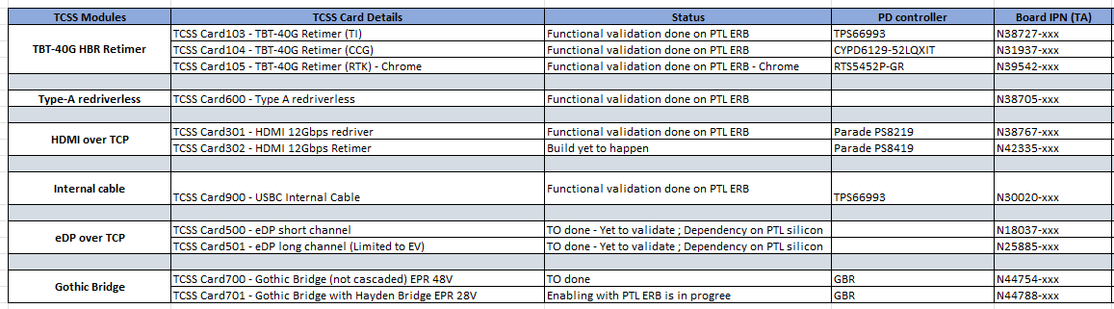
POR Module List for PTL-UH RVP
Individual module block diagrams , schematics and layout files are available in goto/tcssmodule wiki link.
Each module can be identified using the TCSS Card# label provided on the module.
eDP module can be validated on RVP3 (LP5 T4) and RVP2 (LP5x LPCAMM dTBT) on TCP0 port only with PTL silicon.
List includes the IPN for modules and PD AIC provided in below table.

Slide 40
Modular TCSS on PTL RVP
Two modular TCSS connectors are provided on RVP and the below table shows the TCP mapping for modules
TCP Port | PTL-UH LP5x T3 RVP | PTL-UH dTBT CAMM T3 RVP | PTL-UH DDR5 SODIMM T3 RVP | PTL-UH LP5x T4 RVP
 | Default | Default | Default | Default
TCP0 | Single HB Retimer (On-board type-C) | Modular TCSS AIC | Cascaded HB Retimer (On-board type-C) | Modular TCSS AIC
TCP1 | Single HB Retimer (On-board type-C) | DP UHBR20 input to Barlow Ridge | Cascaded HB Retimer (On-board type-C) | Modular TCSS AIC
TCP2 | Modular TCSS AIC | DP UHBR20 input to Barlow Ridge | Modular TCSS AIC | Single HB Retimer (On-board type-C)
TCP3 | Modular TCSS AIC | DP UHBR20 input to DP MUX Retimer | Modular TCSS AIC | Single HB Retimer (On-board type-C)

Slide 41
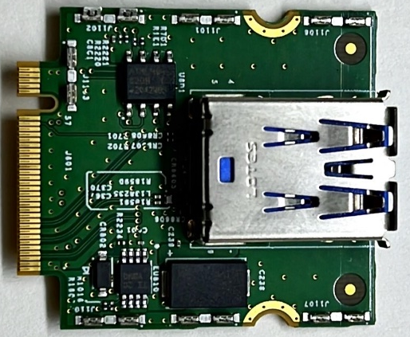
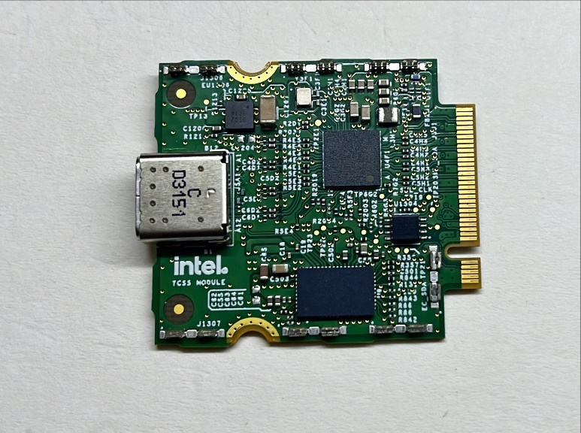
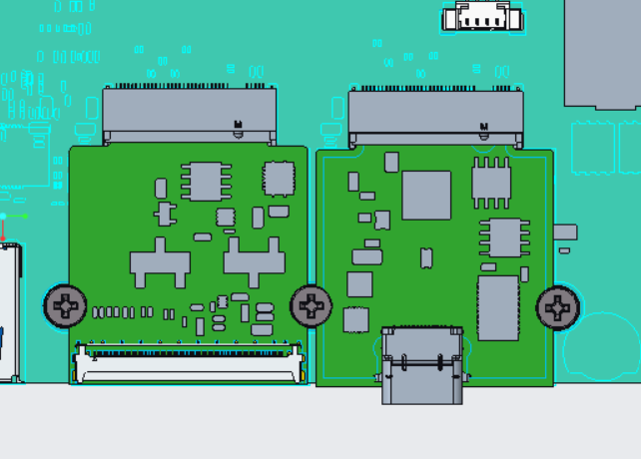
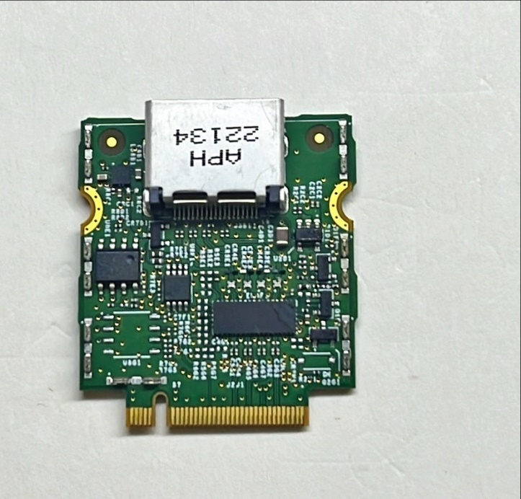
Modules Assembly on RVP
Modules are connected on TCSS Key-M connector (IPN# N23242-001) and recommended to screw the modules to avoid removal of module due to cables being plugged.
Module gets mounted to the M.2 stud and M3 screw. Card has a half-moon mounting hole which is shared over the modules. Middle Mounting hole is shared with both the cards.

Slide 42
TCSS Modules – Programmable Devices
EEPROM , HBR/GBR retimer SPI Flash and PD controller on TCSS module need to be programmed.
EEPROM and HBR retimer flash is pre-programmed at factory. In case if user requires re-flashing, the procedure is provided in back up foils.[EEPROM] , [Retimer Flash]
If TBT modules with blank PD controller part (without PD FW being flashed) is plugged, it will avoid RVP boot sequence. Once PD controller is programmed, RVP can be booted to windows.
PD controller can be used using Aadvark I2C/SPI Host adapter and PD FW capsule update.
Bootloader WA FW to be flashed for TI PD controller if it is blank PD controller. This is one time flashing and after that normal BKC PD FW need to be flashed.
PD controller EC-PD I2C1 address need to be set from RVP. Switches provided on RVP to select the specific vendor I2C1 address. Please refer the switch setting in feature rework document in portal. By default, switch setting is set for TI PD controller.
PD controller detailed programming procedure document is available in sharepoint link

Slide 43
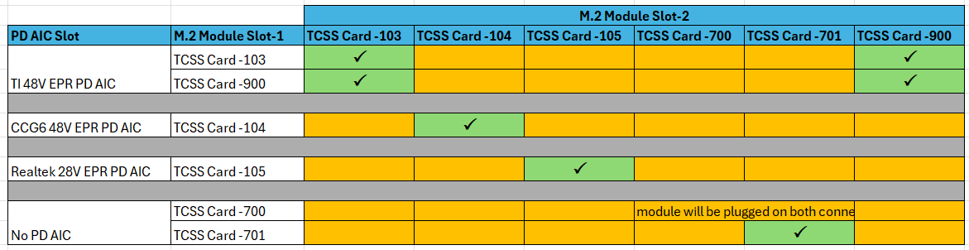
TBT Modules - Compatibility Matrix
Once the dynamic module detection is enabled with EC/BIOS/CSME changes, any PoR module can be plugged on Modular TCSS slot.
For TBT modules, BKC PD FW release is considering the SiV config. Incase, any new vendor support which is different from SiV config, need to get the PD FW from PSE team separately. (RCR)
eDP module can be validated only on TCP0 port. Not recommended to plug on other slots.
Till the common EC-PD Host interface is enabled, the mix of two different PD controller vendor card are not recommended to plug. If PD AIC used is TI 48V EPR AIC, then TI TBT modules(103/900) need to be used.

Slide 44
Modular TCSS - Switching
Modular TCSS Port Switching ports within the same SKU
PD FW flashed for TBT modules on a particular SKU (ex: LP5x T3 SKU) can be used with either of the M.2 slots in the same RVP SKU.
Modular TCSS Port Switching ports between the RVPs
PD FW need to be re-flashed if same module to be used on other SKU.
In Summary, this will not affect the TBT Modules switching functionality within the same SKU, but different FWs are required to be re-flashed for different RVP SKU.
Notes:
With TI , the I2C2 and I2C3 addresses are not based on ADCIN directly, but programmed in the PD FW
With Tomcat, even though we can create multiple configurations, the number of configurations are limited to 3 and cannot be mapped to the ADCIN values. These values are taken sequentially.
TI has no commit to increase the number of configurations from 3 to 4 to target to have single PD FW for TCP0, TCP1, TCP2 and TCP3 (This can support different RVP configurations)

Slide 45
TBT Type-C Interface
Rao, Archana

Slide 46
Type C Port mapping on PTL-UH RVP
PTL-UH SOC will support max 4 Type-C TBT ports. Below is the RVP wise Type C port mapping.
Hayden Bridge B1 TBT Re-timer is soldered down on LP5x T3, LP5x T4 and DDR5 T3 RVPs, while Barlow Ridge B2 dTBT controller is soldered down on LPCAMM T3 RVP, which is the POR.
Reworks (in the form of switch settings) are applicable only in case of usage of IFX / RTK based PD AIC and modular TCSS AICs across TCPx ports on RVP
Switch setting defaults to TI vendor for PD AIC and modular TCSS AIC (TBT40G module).
No mix and match allowed between PD controller vendors on the platform.
If PD AIC is TI based, then modular TCSS TBT40G AIC should also be from TI.
TCP Port | RVP1 - PTL-UH LP5x T3 RVP | RVP2 - PTL-UH dTBT CAMM T3 RVP | RVP3 - PTL-UH LP5x T4 RVP | RVP4 - PTL-UH DDR5 SODIMM T3 RVP
 | Default | Default | Default | Default
TCP0 | Single HB Retimer (On-board type-C) | Modular TCSS AIC | Modular TCSS AIC | Cascaded HB Retimer (On-board type-C)
TCP1 | Single HB Retimer (On-board type-C) | DP UHBR20 input to Barlow Ridge | Modular TCSS AIC | Cascaded HB Retimer (On-board type-C)
TCP2 | Modular TCSS AIC | DP UHBR20 input to Barlow Ridge | Single HB Retimer (On-board type-C) | Modular TCSS AIC
TCP3 | Modular TCSS AIC | DP UHBR20 input to DP MUX Retimer | Single HB Retimer (On-board type-C) | Modular TCSS AIC

Slide 47
TCPx routing lengths on the PTL-UH RVP
For more details on specific routing lengths for each of the TCPx ports (EV validation), please refer to below link,
Routing lengths on the PTL-UH RVP

Slide 48
PTL-UH LP5x T3 Type-C block diagram

Slide 49
PTL-UH dTBT LPCAMM T3 Type-C block diagram

Slide 50
PTL-UH LP5x T4 Type-C block diagram

Slide 51
PTL-UH DDR5 SODIMM T3 Type-C block diagram

Slide 52
PTL-UH Retimer Flash Sharing
TCP Port | PTL-UH LP5x T3 RVP | PTL-UH dTBT CAMM T3 RVP | PTL-UH LP5x T4 RVP | PTL-UH DDR5 SODIMM T3 RVP
TCP0 | HBR Shared Flash | HBR Individual Flash (on Modular TCSS AIC) | HBR Individual Flash (on Modular TCSS AIC) | HBR Shared Flash (TCP0 RT1 and TCP1 RT1) (TCP0 RT2 and TCP1 RT2)
TCP1 |  | BR Individual Flash (dTBT controller mother board down) | HBR Individual Flash (on Modular TCSS AIC)
TCP2 | HBR Individual Flash (on Modular TCSS AIC) |  | HBR Shared Flash | HBR Individual Flash (on Modular TCSS AIC)
TCP3 | HBR Individual Flash (on Modular TCSS AIC) |  |  | HBR Individual Flash (on Modular TCSS AIC)
Hayden Bridge Retimer (HBR) has an option to share the Flash between 2 Retimers for BOM cost saving.
At a time only one Retimer have the access for flash. This is controlled by the FLASH Busy signal connected between the Re-timers. Flash share setting is done in Hardware.
Barlow Ridge (BR) has dedicated flash on PTL-UH dTBT CAMM T3 RVP.

Slide 53
DnX Support
DnX –Download and execute is a feature that allows updating the system FW from a host through USB2 port.
DnX is supported on TCP0 port of PTL-UH RVPs.
DnX could be triggered
- By pressing VOL_UP and VOL_DOWN button together during early boot
Using DnX jumper on board( this is validation option only).
DnX LED indicates if the FW download / execution is in progress, once DnX is triggered during bootup.

Slide 54
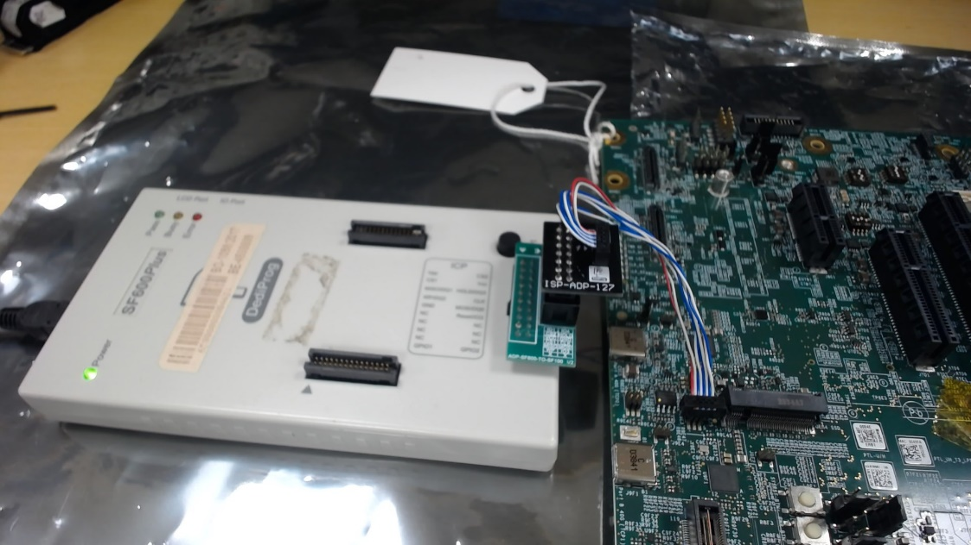
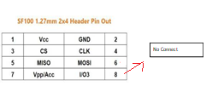
Retimer Flash Programing
Dediprog SF100 2x3 header with 1.27mm pitch has been provided for each of the shared Flash for programming.
Need SF100 along with Universal Adapter board and cable for programming
https://www.dediprog.com/product/ISP-ADP-127
Cable has 2x4 header and Last two pins are NC in it. Hence leave last two pins unconnected and connect just 6 pins as below.
Flash to be programmed in RVP powered OFF state – G3 state, Dediprog will be Master and will supply above1.8V for HBR Flash
Using Dediprog SF600/SF100 with crocodile clips is not recommended

Slide 55
PD controller
All the PTL-UH RVP SKUs have support for Modular Power Delivery Add In Card (PD AIC).
PD AIC pinouts comply with PD AIC specification rev2.05.
TI994 48V CFP PD AIC is supported by default on all RVPs.
To enable other vendors such as IFX or RTK on platform, reworks (switch settings) are needed.
There is no support for motherboard down PD controller on RVPs.
PD controller down is supported only on modular TCSS TBT AICs.
TCP Port | PTL-UH LP5x T3 RVP |  | PTL-UH dTBT CAMM T3 RVP |  | PTL-UH LP5x T4 RVP |  | PTL-UH DDR5 SODIMM T3 RVP
 | PD-AIC | PD fw programming header | PD-AIC | PD fw programming header | PD-AIC | PD fw programming header | PD-AIC | PD fw programming header
TCP0 | J9G1 | J1H4 | - | J1H4 (Subjected to change) | - | J1H3 | J9E1 | J1J1
TCP1 | J9G1 |  | J9G1 (dTBT support, two ports) |  | - |  | J9E1
TCP2 | - |  |  |  | J9G1 |  | -
TCP3 | - |  |  |  | J9G1 |  | -

Slide 56
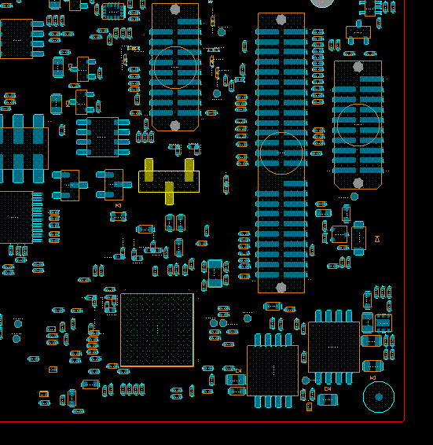
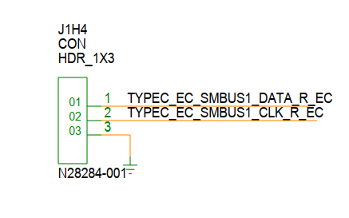
PD controller programming
PD controller can be programmed in three ways,
Through 1x3 header on RVP using Aardvark programmer
Capsule update via BIOS
CC line programming (applicable only for Realtek PD AIC on Chrome SKUs)
Programming guidelines:
Please refer below link for PD controller programming guide,
PD FW flashing guide
TOP (PTL-UH LP5x T3 RVP)

Slide 57
Retimer Flash Programing - Contd
Below is the list of Flash and FW programming header details across PTL-UH SKUs.
Note: Retimer Flash will be factory programmed by default. Only FW upgrade is required through Dediprog.
Chrome / Windows SKUs
TCP Port | PTL-UH LP5x T3 RVP |  | MTL-P DDR5 SBS | PTL-UH dTBT CAMM T3 RVP |  | MTL-P LP5x T3 RVP | PTL-UH LP5x T4 RVP |  |  | PTL-UH DDR5 SODIMM T3 RVP
 | Flash option | Programming Header Ref.Des | SPI Flash device Ref.Des | Flash option | Programming Header Ref.Des | SPI Flash device Ref.Des | Flash option | Programming Header Ref.Des | SPI Flash device Ref.Des | Flash option | Programming Header Ref.Des | SPI Flash device Ref.Des
TCP0 | Shared Flash (HBR) | J9E3 | U9E2 | Individual Flash (HBR) | - | U8G1 | Individual Flash (HBR) | - | U8G1 | Shared Flash (TCP0 RT1 and TCP1 RT1 - HBR) | J9D1 | U8R2
TCP1
 |  |  |  | Individual Flash (Barlow Ridge) | J9E3 (Subjected to change) | U9E2 (Subjected to change) | Individual Flash (HBR) | - | U8G1 | Shared Flash (TCP0 RT2 and TCP1 RT2 - HBR) | J8D2 | U8E3
TCP2 | Individual Flash (HBR) | - | U8G1 |  |  |  | Shared Flash (HBR) | J9E3 | U9E2 | Individual Flash (HBR) | - | U8G1
TCP3 | Individual Flash (HBR) | - | U8G1 |  |  |  |  |  |  | Individual Flash (HBR) | - | U8G1

Slide 58
PD AIC details
Below table provides details for CFP based PD AICs from multiple PD vendors,
CFP PD AIC | Description | PD controller part # | IPN | Remarks
TI994 CFP | Type C PD AIC (TI) EPR 48V | PTPS66994AAREPR | M92098-xxx | Windows SKU
CCG6 CFP | Type C PD AIC (CCG) EPR 48V | CYPD6229-52LQXIT | N31943-xxx | Windows SKU
RTK CFP | Type C PD AIC (RTK) EPR 28V | RTS5453P-28-GR | N36228-xxx | Windows SKU
 | Type C PD AIC (RTK) SPR 20V Chrome | RTS5453P-GR | N39126-xxx | Specific to Chrome

Slide 59
MODPHY mapping
Vidaya, Divya

Slide 60
PTL UH RVP – PCIE port mapping
 |  |  | LP5x T3 |  | LP5x dTBT CAMM T3 | LP5x T4 |  | DDR5 SODIMM T3
 |  |  | RVP-1 (default) | RVP-1a (rework) | RVP-2 (default) | RVP-3 (default) | RVP-3a (rework) | RVP-4 (default) | RVP-4a (rework)
PCIe Gen4 Bifurcation | PXPA | P1 | Gbe LAN Jacksonville | - | Gbe LAN Jacksonville | Gbe LAN Jacksonville | - | Gbe LAN Jacksonville | x4 gen4 DT CEM - LR
 |  | P2 | M.2 WWAN Key-B |  | M.2 WWAN Key-B | M.2 WWAN Key-B |  | M.2 WWAN Key-B
 |  | P3 | x1 gen3 DT CEM |  | x1 gen3 DT CEM | x2 gen3 DT CEM (x2 over x4) - LR |  | x2 gen4 DT CEM (x2 over x4) - LR
 |  | P4 | M.2 WLAN Key-E |  | M.2 WLAN Key-E
 |  |  |  |  |  |  |  |  | CEM to MCIO AOB FURCATION
 | PXPB | P5-8 | M.2 Gen4 SSD Key-M (NIST) | - | x4 Gen4 dTBT BR | M.2 Gen4 SSD Key-M (NIST) | - | M.2 Gen4 SSD Key-M (NIST) | -
 |  |  | M.2 to MCIO AOB FURCATION
PCIe Gen5 Bifurcation | PXPC | P1-4 | M.2 Gen5 SSD Key-M | x4 Gen5 DT CEM | M.2 short channel 1A Gen5 SSD Key-M (NIST) | M.2 Gen5 SSD Key-M | - | M.2 Gen5 SSD Key-M | -
 |  |  | M.2 to MCIO AOB FURCATION | CEM to MCIO AOB FURCATION | M.2 to MCIO AOB FURCATION
 | PXPD | P5-8 | x8 Gen5 DT CEM | - | x8 Gen5 DT CEM | x8 Gen5 DT CEM | x4 Gen5 DT CEM (x4 over x8) | x8 Gen5 DT CEM - LR+PI | -
 | PXPE | P9-12 |  |  |  |  | x4 Gen5 DT CEM
Note: PXPD & PXPE are present only in PTL-H 4Xe silicon
TOP PLACEMENT
BOTTOM PLACEMENT

Slide 61
PTL UH RVP – SRC CLKOUT & CLKREQ port mapping
 |  | LP5x T3 |  | LP5x dTBT CAMM T3 |  | LP5x T4 | DDR5 SBS SODIMM T3
 |  | RVP-1 (default) | RVP-1a (rework) | RVP-2 (default) | RVP-2a (rework) | RVP-3 (default) | RVP-4 (default) | RVP-4a (rework)
CLKOUT Bifurcation | P0 | x8 Gen5 DT CEM | - | x8 Gen5 DT CEM | - | x8 Gen5 DT CEM | x8 Gen5 DT CEM - LR+PI | -
 | P1 | M.2 Gen5 SSD Key-M | x4 Gen5 DT CEM | M.2 short channel 1A Gen5 SSD Key-M (NIST) |  | M.2 Gen5 SSD Key-M | M.2 Gen5 SSD Key-M
 | P2 | x1 gen3 DT CEM | - | x1 gen3 DT CEM |  | x2 gen3 DT CEM (x2 over x4) - LR | x2 gen4 DT CEM (x2 over x4) - LR
 | P3 | Gbe LAN Jacksonville |  | Gbe LAN Jacksonville |  | Gbe LAN Jacksonville | Gbe LAN Jacksonville
 | P4 | M.2 WLAN Key-E |  | M.2 WLAN Key-E |  | - | -
 | P5 | M.2 WWAN Key-B |  | M.2 WWAN Key-B |  | M.2 WWAN Key-B | M.2 WWAN Key-B
 | P6 | M.2 Gen4 SSD Key-M (NIST) |  | x4 Gen4 dTBT BR |  | M.2 Gen4 SSD Key-M (NIST) | M.2 Gen4 SSD Key-M (NIST)
 | P7 | - |  | - |  | x4 DT CEM Gen5 | -
 | P8 |  |  |  |  | -
CLKREQ Bifurcation | P0 | x8 Gen5 DT CEM | - | x8 Gen5 DT CEM | - | x8 Gen5 DT CEM | x8 Gen5 DT CEM - LR+PI | MCIO AOB HDR P4
 | P1 | M.2 Gen5 SSD Key-M | x4 Gen5 DT CEM | M.2 short channel 1A Gen5 SSD Key-M (NIST) |  | M.2 Gen5 SSD Key-M | M.2 Gen5 SSD Key-M | -
 | P2 | x1 gen3 DT CEM | MCIO AOB HDR P2 | x1 gen3 DT CEM | MCIO AOB HDR P2 | x2 gen3 DT CEM (x2 over x4) - LR | x2 gen4 DT CEM (x2 over x4) - LR
 | P3 | Gbe LAN Jacksonville | - | Gbe LAN Jacksonville | - | Gbe LAN Jacksonville | Gbe LAN Jacksonville
 | P4 | M.2 WLAN Key-E | MCIO AOB HDR P1 | M.2 WLAN Key-E | MCIO AOB HDR P1 | - | - | MCIO AOB HDR P1
 | P5 | M.2 WWAN Key-B | - | M.2 WWAN Key-B | - | M.2 WWAN Key-B | M.2 WWAN Key-B | MCIO AOB HDR P3
 | P6 | M.2 Gen4 SSD Key-M (NIST) |  | x4 Gen4 dTBT BR |  | M.2 Gen4 SSD Key-M (NIST) | M.2 Gen4 SSD Key-M (NIST) | -
 | P7 | - |  | - |  | x4 DT CEM Gen5 | - | MCIO AOB HDR P2
 | P8 (UFS REFCLK) | UFS AIC |  |  |  | UFS AIC | UFS AIC | -
Note: MFIT will expose only 7 CLKOUT[0:6] for CCG'S U/P & for all 9 CLKOUT[0:8] for CCG’S H.
NEX/IOTG must have different MFIT to expose P7,8 if they intend to use the same CCG'S U/P package for their platforms.
TOP PLACEMENT
BOTTOM PLACEMENT

Slide 62
PTL UH RVP – USB2.0 & USB3.2 port mapping
PTL UH supports 8 USB2.0 ports and 2 USB3.2 Gen 2x1 ports
 |  |  | LP5x T3 |  | LP5x dTBT CAMM T3 |  | LP5x T4 |  | DDR5 SBS SODIMM T3
 |  |  | RVP-1 (default) | RVP-1a (rework) | RVP-2 (default) | RVP-2a (rework) | RVP-3 (default) | RVP-3a (rework) | RVP-4 (default) | RVP-4a (rework)
USB3.2 Gen2x1 (10G) Bifurcation |  | P1 | USB3.2 gen1 TAP-1 | - | USB3.2 gen2 TAP-1 (vertical) | - | USB3.2 gen2 TAP-1 with RDRVR | - | USB3.2 gen2 TAP-1 with RDRVR | -
 |  | P2 | USB3.2 gen2 TAP-2 with RDRVR | M.2 WWAN Key-B | USB3.2 gen2 TAP-2 with RDRVR | M.2 WWAN Key-B | USB3.2 gen2 TAP-2 with RDRVR | M.2 WWAN Key-B | USB3.2 gen2 TAP-2 with RDRVR | M.2 WWAN Key-B
USB2.0 Bifurcation |  | P1 | TCP-0 (ONBOARD TBT PORT-1) | 2x5 PPV HDR | TCP-0 (M.2 MODULAR TCSS AIC-1) | - | TCP-0 (M.2 MODULAR TCSS AIC-1) | 2x5 PPV HDR | TCP-0 (ONBOARD TBT PORT-1) | 2x5 PPV HDR
 |  | P2 | TCP-1 (ONBOARD TBT PORT-2) | - | TCP-1 (dTBT BR) |  | TCP-1 (M.2 MODULAR TCSS AIC-2) | - | TCP-1 (ONBOARD TBT PORT-2) | -
 |  | P3 | TCP-2 (M.2 MODULAR TCSS AIC-1) | CRD -1 (ALTEK SUNNY A1) | M.2 WLAN Key-E | CRD -1 (ALTEK SUNNY A1) | TCP-2 (ONBOARD TBT PORT-1) |  | TCP-2 (M.2 MODULAR TCSS AIC-1) | CRD -1 (ALTEK SUNNY A1)
 |  | P4 | TCP-3 (M.2 MODULAR TCSS AIC-2) | - | - | - | TCP-3 (ONBOARD TBT PORT-2) |  | TCP-3 (M.2 MODULAR TCSS AIC-2) | -
 |  | P5 | USB3.2 gen1 TAP-1 |  | USB3.2 gen2 TAP-1 (vertical) |  | USB3.2 gen2 TAP-1 with RDRVR |  | USB3.2 gen2 TAP-1 with RDRVR
 |  | P6 | USB3.2 gen2 TAP-2 with RDRVR | M.2 WWAN Key-B | USB3.2 gen2 TAP-2 with RDRVR | M.2 WWAN Key-B | USB3.2 gen2 TAP-2 with RDRVR | M.2 WWAN Key-B | USB3.2 gen2 TAP-2 with RDRVR | M.2 WWAN Key-B
 |  | P7 | FPS | 2x5 PPV HDR | FPS | - | FPS | 2x5 PPV HDR | FPS | 2x5 PPV HDR
 |  | P8 | M.2 WLAN Key-E |  | TCP-2 (dTBT BR) |  | M.2 WLAN Key-E |  | M.2 WLAN Key-E
TOP PLACEMENT
BOTTOM PLACEMENT

Slide 63
STORAGE
Vidaya, Divya

Slide 64
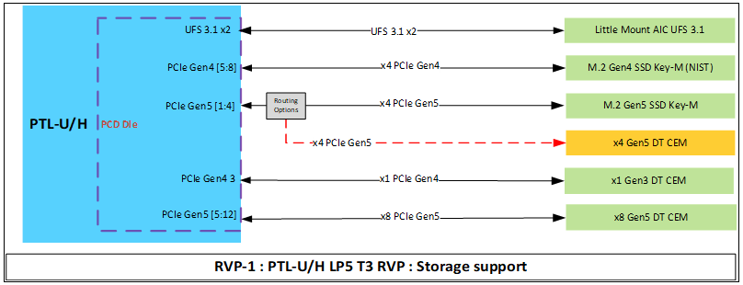
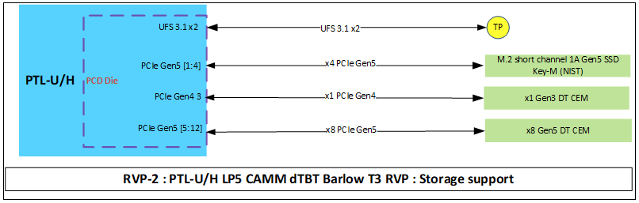
PTL UH RVP – Storage support

Slide 65
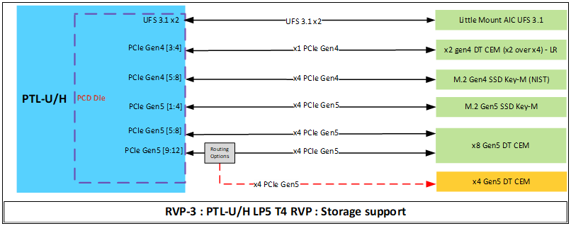
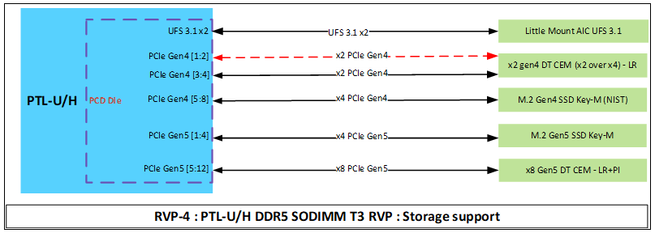
PTL UH RVP – Storage support

Slide 66
UFS
K, Vishnu

Slide 67
PTL UH RVP – UFS Support
PTL UH RVP supports UFS3.1 interface on RVP1, RVP3 and RVP4 SKUs.
PTL RVP2 LP5x CAMM SKU does not support UFS interface.
The RVP supports only UFS Little Mount AIC. No other AICs are supported
The LM AIC uses 256GB Samsung UFS3.1 device.
T3 LP5x RVP1 | T4 LP5x RVP3 | T3 DDR5 RVP4 | T3 LP5x CAMM RVP2
UFS LM AIC | UFS LM AIC | UFS LM AIC | NA
Notes:
SKU strategy similar like LNL –One SKU C-PHY rest all are D-PHY

Slide 68
CAMERA
K, Vishnu

Slide 69
PTL UH RVP – Camera support & configurations
On PTL-UH RVP, camera support will be same across all RVP SKUs except for one SKU.
LP5x T4 RVP3 SKU supports only C-PHY camera Sensors.
Similar like LNL where one SKU is maintained for C-PHY based sensors
PTL-UH RVP will have two CRD 60 pin connector to support MIPI Based Cameras.
GPIOs supported for the Camera AICs will vary from SKU to SKU.
The CRD 60 Pinout in RVP3 is different from legacy pinouts followed in RVP1,2 & 4.
T3 LP5x RVP1 | T4 LP5x RVP3 | T3 DDR5 RVP4 | T3 LP5x CAMM RVP2
D-PHY | C-PHY | D-PHY | D-PHY
Notes:
SKU strategy similar like LNL –One SKU C-PHY rest all are D-PHY

Slide 70
PTL UH RVP – Camera support & configurations
Below are the supported Camera AICs for RVP1,RVP2 and RVP4 SKUs
Camera AICs supported by RVP3-T4 LP5x SKU,
CRD D1 C-PHY is a newly designed AIC to support C-PHY based camera sensors
Note : Kindly do not swap the CRD AICs between RVP3 and RVP1,2,4. This may ground the HSIO signals from SoC. This is because different CRD-60 pinout followed in RVP3.
RVP connector | ALTEK AIC | CRD-D1 | CRD-G3
CRD Conn 1 | 1 x4 lane | 1 x4 lane | 2 x2 lane
CRD Conn 2 | NA | 1 x2 lane | 1 x2 lane
RVP3 connector | CRD D1 C-PHY
CRD Conn 1 | 3 Trio lane
CRD Conn 1 | 2 Trio lane
Notes:
SKU strategy similar like LNL –One SKU C-PHY rest all are D-PHY

Slide 71
PTL UH RVP – Camera support & configurations
CRD CON2
CRD CON1
2x Data
1xCLK
4x Data
2xCLK
GPIOs in RVP1, RVP2 & RVP4 | Discrete G1 or PMIC G3/ or ALTEK | Discrete G1 or PMIC G3/ or ALTEK
1X PWREN | ✓ | ✓
1X RST | ✓ | ✓
1X Flash Trigger | ✓ | (optional path from con2)
1X Privacy LED | ✓ | ✓
1X CLK Enable | (optional path from con1) | ✓
VSYNC | Option from VSync1 | VSync1
I2C | I2C2 | I2C1

Slide 72
PTL UH RVP – Camera support & configurations C-PHY
CRD CON2
CRD CON1
2Trios
3Trios
GPIOs in RVP3 SKU | Discrete CRD D1 C-PHY | Discrete CRD D1 C-PHY
1X PWREN | ✓ | ✓
1X RST | ✓ | ✓
1X Flash Trigger | ✓ | (optional path from con2)
1X Privacy LED | ✓ | ✓
1X CLK Enable | (optional path from con1) | ✓
VSYNC | Option from VSync1 | VSync1
I2C | I2C2 | I2C1

Slide 73
PTL UH POR Camera Sensors
Below are the current set of POR camera sensor/Modules defined for PTL-UH.
Note that RVP team does not work on the module list and the adapters (Transfer cards) for these modules on the CRD card.
Vendor | Sensor | Module p/n | Details
Omni Vision | OV13B | NA | 13MP MIPI Camera Module
Omni Vision | OV01AS | NA | 1MP MIPI Camera Module
Omni Vision | OG0VA1B | NA | 640 x 480 MIPI IR Camera Module
Omni Vision | OV08X40 | NA | 9.2MP MIPI Camera Module
SONY | IMX688 | NA | 14.5MP C-PHY MIPI Camera Module

Slide 74
ALTEK / Synaptic Sabre AIC Support on PTL-UH RVP
ALTEK M1 is supported on PTL-UH RVP through ALTEK AIC.
ALTEK AIC / Synaptic Sabre AIC is only supported in CRD-1 connector
ALTEK AIC is by default enabled and no reworks required on PTL UH RVP.
USB D21 Lajolla cove AIC is utilized to connect ALTEK AIC to the RVP
USB2 interface over CRD AIC is mandatory for Synaptic Sabre AIC & for Altek M1 AIC it can be connected from Type-A port to D21 card.
Below Table lists the GPIOs for the ALTEK-AIC across all the PTL-UH (Except RVP3) for BIOS settings if required
ALTEK SOC | Direction w.r.t ALTEK | Signal Activity | PTL-UH GPIO
HOST_WAKE | Input | 0: No Wake 1: Wake | GPP_F20
HOST_RST_N | Input | 1: Out of Reset 0: In Reset | GPP_E10
ISH Slave Interrupt | Output– Open drain | Active Low | ISH_GP_11
ALTEK_I2C0 | I2C bus | For sensor Metadata communication | ISH_I2C0
ALTEK_I2C1 | I2C bus | For camera communication | LPSS_I2C1
USB2_DP/DN | USB Bus | For Host-MCF communication | Any TYPE A Port

Slide 75
Connectivity
C M, Aparna

Slide 76
Overview- Connectivity
The PTL UH chipset supports Integrated Connectivity CNVio and discrete WLAN+BT
The other connectivity options are Gbe LAN and WWAN.
The below table gives the list of modules supported on PTL UH RVP as connectivity solutions.
Interface Name | Module Name | Remarks
Integrated CNVIo | Whale Peak2, Spider Peak 2, Filmore peak 2, Garfield Peak 2 | M.2 Key E Socket 1
Discrete WLAN+BT | Gale Peak 2 | M.2 Key E Socket 1
WWAN | Maple spring FM350-GL (5G Module) | M.2 Key B Socket 2
Gbe LAN | Jackson Ville (Device down) | RJ-45 Jack
Gbe LAN | Fox Ville Add-In Card | x1 PCIe AIC

Slide 77
Overview- Connectivity

Slide 78
Overview- Connectivity

Slide 79
Connectivity WLAN – Modules supported
PTL UH RVP supports M.2 CNVi modules and Discrete modules on a single M.2 Key-E (socket-1) connector.
PTL UH RVP M.2 2230 Module support:
Sr. No. | M.2 Module | Module names | Host Interfaces | Supported RVP Sku’s
1 | CNVi | Whale Peak2, Spider Peak 2, Filmore peak 2, Garfield Peak 2 | CNVi DPHY TX/RX, Step (Wi-Fi) BRI/RGI (BT) | All Sku’s
2 | Discrete | Gale Peak 2 | PCIe TX/RX (Wi-Fi) USB2.0 (BT) | PTL UH LP5x T3 SKU & PTL UH LP5 CAMM dTBT Barlow T3 RVP

Slide 80
Block Diagram -Connectivity WLAN
Description | Interface Name/ Signal Name | Support on PTL UH RVP
WIFI | PCIe CNVi, STEP CLINK | Yes
BT DATA | USB2.0, STEP BRI/RGI | Yes
WLAN M.2 Control | RF_RESET# WIFI_RFKILL# BT_RFKILL#1 WLAN_LED# BT_LED# | Yes
BT AUDIO | PCM/I2S | Yes
RF Coexistence | UART_RX UART_TX UART supports Real-Time Coexistence | Yes
IPN | Description | Refdes
M88859-001 | WLAN M.2 SLOT PCIE_75P_KEY_E_2M | J1B1 (RVP1/RVP3/RVP4)

Slide 81
Block Diagram - WWAN
Description | Interface Name/ Signal Name | Support on PTL-UH RVP
Inter-processor Communications | PCIe USB 2.0 | Yes
USIM with Card Detect | SIM_CLK, SIM_RESET, SIM_IO, SIM_PWR, SIM_DETECT | Yes
WWAN M.2 Control | FULL_CARD_POWER_OFF# RESET# PERST# W_DISABLE# LED#1 DPR (Body SAR) | Yes
IPN | Description | Refdes
M88860-001 | M2_75P_KEYB_2EM | J6T2 (RVP1/RVP3/RVP4)

Slide 82
Sensors
K, Vishnu

Slide 83
Block Diagram – Sensors and Sensor AIC
PTL UH
Sensor Header
PTL UH
ISH I2C0/I3C0
ISH I2C1/I3C1
ISH I2C2
ISH UART0
ISH UART1
Used as GPIOs
ISH SPI
ISH GPIOs
(0-7)
ISH GPIO4
ALTEK
SAR_NIRQ
ISH GPIO11
M.2 WWAN
Note:
Solid line indicate default support on the board. Dotted lines indicate the need for rework.
ISH_UART1 is used as GPIOs, ISH_UART0 is rework option to Sensor HDR

Slide 84
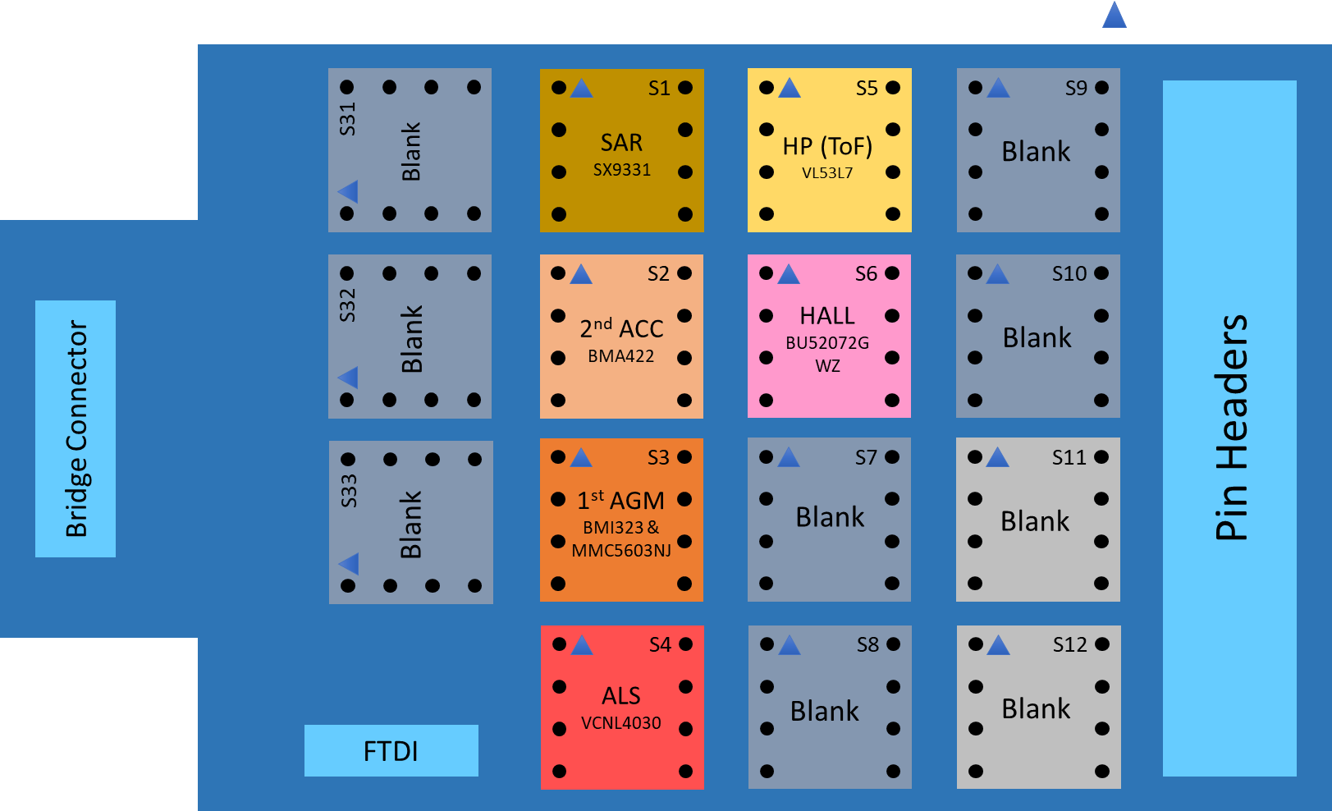
Sensor BOM1 details
Note: MOSAIC Gen 2 AIC will be used for sensor validation.

Slide 85
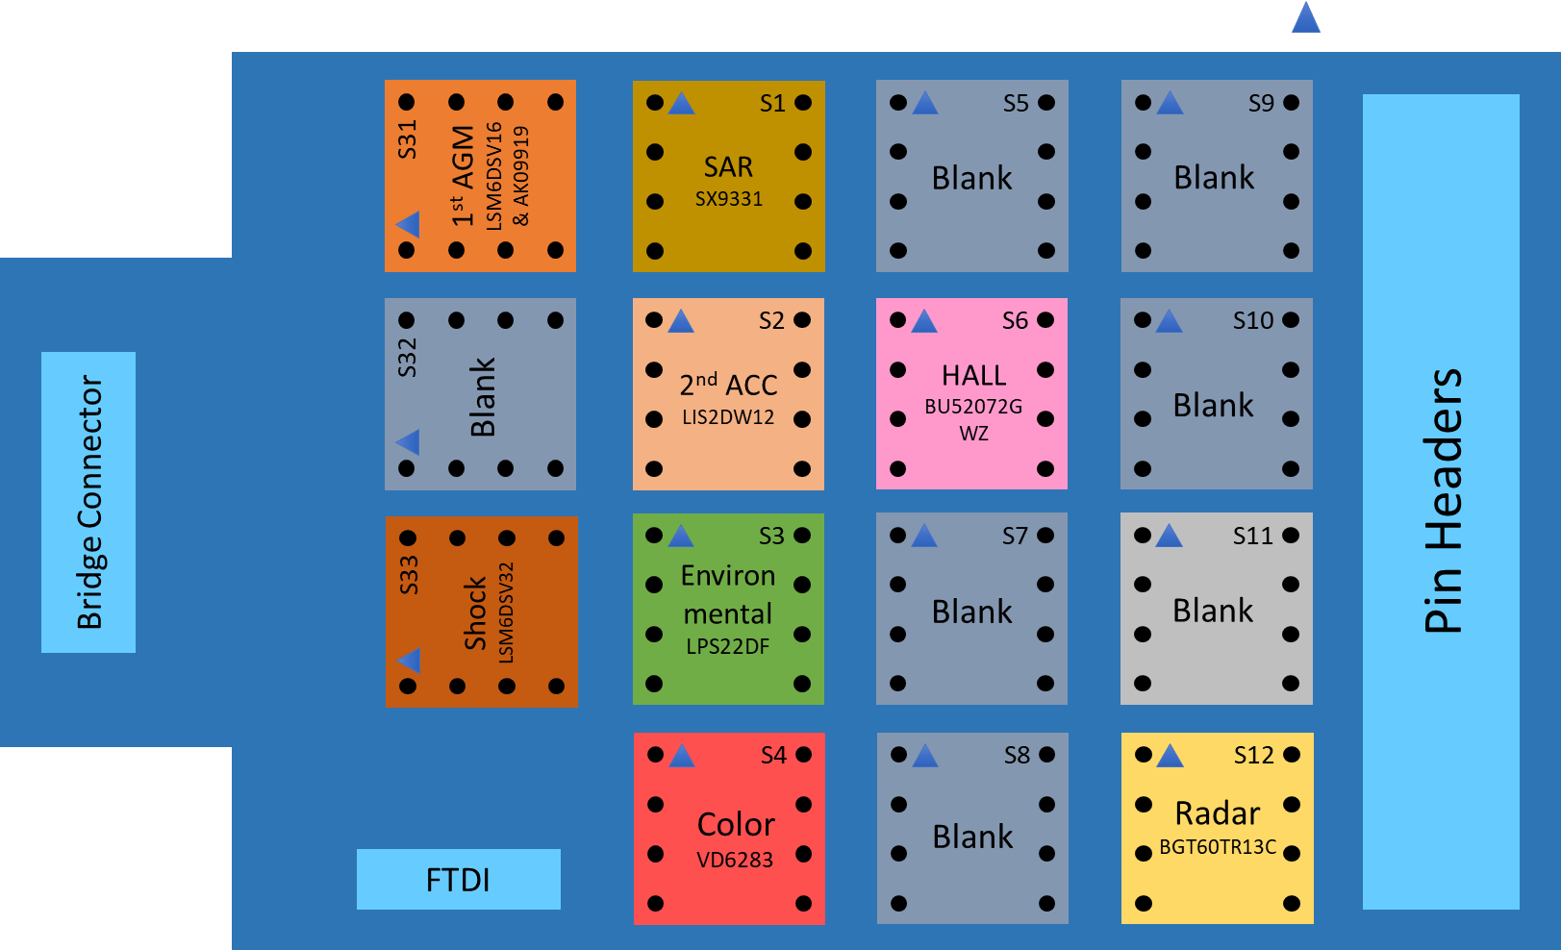
Sensor BOM2 details
Note: MOSAIC Gen 2 AIC will be used for sensor validation.

Slide 86
ISH interface mapping
Bus | Device Mapping
ISH SPI | Sensor Header
ISH GPIOs | Sensor Header
Bus | Device Mapping
ISH I2C0 / I3C0 | CRD Connector 1, Sensor Header, TTK3 Header
ISH I2C1 / I3C1 | Sensor Header
ISH I2C2 | Sensor Header
Bus | Device Mapping
ISH UART0 | Sensor Header

Slide 87
Block Diagram – Fingerprint Sensor
PTL UH
Goodix Fingerprint sensor Connector
( Mounted on Top side)
IPN: G90173-001
USB 2.0 P7
Note:
Only USB2.0 based sensor is POR for PTL for FPS connectivity.
The connector pinout only USB2.0.

Slide 88
Block Diagram – PTL UH RVP Touch Panel & Touch Pad
PTL-UH
THC/LPSS I2C4
Touch Panel-1 Connector (Default)
THC0 SPI1
THC1 SPI2
Touch Panel-2 Connector
THC/LPSS I2C5
LPSS I2C3
Touch Pad Connector
Note:
Solid line indicate default support on the board. Dotted lines indicate the need for rework.
Rework details will be provided in feature enabling documents.
THC SPI is provided as default for touch panel 1. THC I2C is POR for touchpad

Slide 89
AUDIO
Jadhav, Aniket

Slide 90
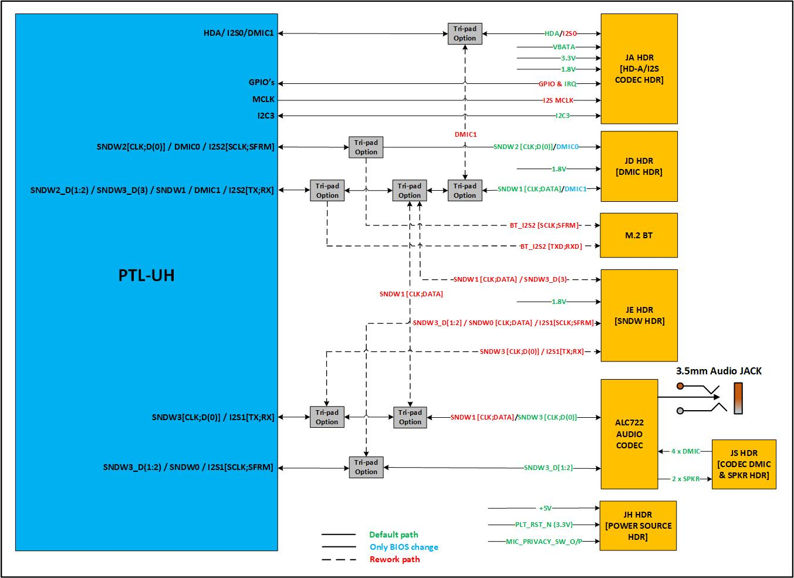
PTL-UH RVP- Audio block diagram
Notes:
CCB link : 15013691587 - Include support for SDCA 0.8/1.0 compliant audio components on PTL RVP & Audio Add-In-Cards from major vendors (Realtek, Cirrus) (intel.com)

Slide 91
PTL-UH RVP Audio overview
PTL-UH RVP enables value system with single-chip audio solution. On board codec upgraded to ALC722-CG [SDCA 0.8] compliant soundwire based codec default configured using SNDW3 multilane port across all the RVP sku’s.
RVP supports different audio codecs validation through add-in-card solution. Realtek AIOC GEN6 is the POR AIC for PTL-UH & Cirrus AIC v3 will support delta validation configuration along with existing Realtek AIOC GEN3 to support HDA [ALC245] validation.
Notes:
Reference :
Gen 6 Audio Add-In-Card - Reference Validation Platform Design Wiki - Intel Enterprise Wiki
Cirrus AIOC v3 - Reference Validation Platform Design Wiki - Intel Enterprise Wiki
Gen3 Audio Add-In-Card - Reference Validation Platform Design Wiki - Intel Enterprise Wiki
Gen4 Audio Add-In-Card - Reference Validation Platform Design Wiki - Intel Enterprise Wiki

Slide 92
Audio links supported in PTL-UH RVP sku’s
Audio links include:
1x HD-A link for HD-A compatible peripherals
4 Sound wire ports for platform peripherals
Two dual-channel PDM directly attached microphone interfaces
3x I2S ports for platform peripherals
Audio Interface | Default Configuration | Rework option | RVP-1 : PTL UH LP5x T3 RVP-2 : PTL UH T3 LP5 CAMM | RVP-3 : PTL UH LP5x T4 RVP-4 : PTL UH DDR5 T3 | Remarks
H-DA | JA – HDA/I2S0 Header | - | ✓ | ✓ | -
SNDW0 | - | - | ✓ | ✓ | SNDW0 is muxed with SNDW3 multilane
SNDW1 | JD - SNDW/DMIC Header | - | ✓ | ✓ | -
SNDW2 | JD - SNDW/DMIC Header | - | ✓ | ✓ | -
SNDW3 Multilane | On-board ALC722 Codec | JE – SNDW/I2S1 Header | ✓ | ✓ | -
DMIC0 | JD - SNDW/DMIC Header | - | ✓ | ✓ | Only BIOS change
DMIC1 | JD - SNDW/DMIC Header | - | ✓ | ✓ | Only BIOS change
I2S0 | JA – HDA/I2S0 Header | - | ✓ | ✓ | -
I2S1 | - | JE – SNDW/I2S1 Header | ✓ | ✓ | -
I2S2 | - | M.2 WLAN Connector | ✓ | ✗ | No Discrete WLAN support in RVP3 & RVP4

Slide 93
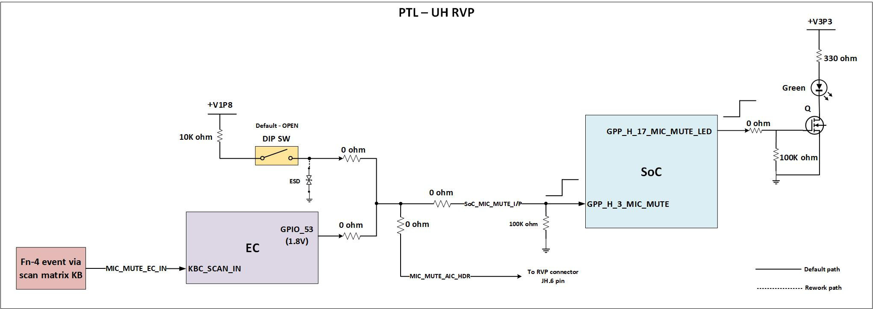
Audio Privacy Microphone Protection
Privacy microphone protection feature is POR in PTL-UH RVP.
The HW will take in a privacy signaling input from the GPIO pin (which typically connects to a mic disable switch), indicating the current user privacy mode setting on the system. It also turns on a privacy indicator output through the GPIO pin (which typically connects to a privacy LED).
PTL-UH RVP uses SoC pins MIC_MUTE and MIC_MUTE_LED to support microphone privacy protection. HW Disable switch [SWxx] is to control the MIC privacy operation. Alternately, MIC mute can also be controlled via EC using scan matric Fn key. The below diagram represents RVP implementation.
Note : HW DIP switch is available on all the RVP sku’s[TOP/Bottom placed].
Notes:
Reference : ACE3.x Integration HAS (intel.com)

Slide 94
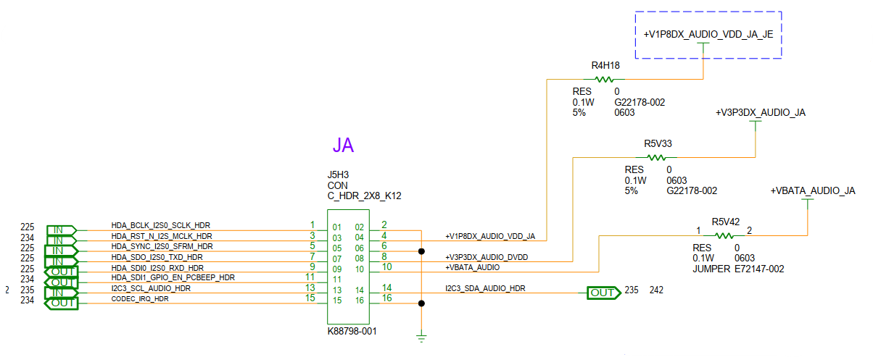
Audio Headers Definition
JA - Header [HDA/I2S0] :
JA header is used to provide clock & data transmission in HDA mode & I2S mode.
For HDA mode, Realtek GEN3 AIC (ALC245) will be used along with the transducer card.
In SNDW mode, it will be used as power source for AIC. Refer below snap for the header pinout details.

Slide 95
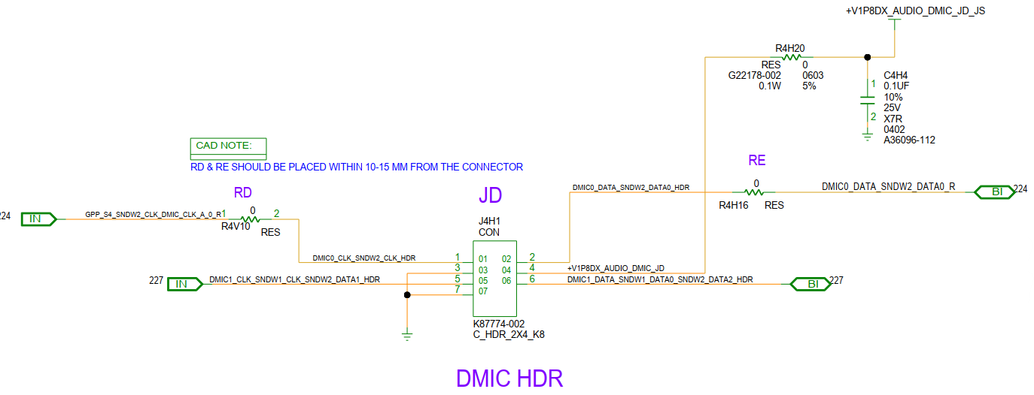
JD – Header [SNDW/DMIC] :
The JD header is default configured in SNDW mode to drive 2-SPKR/4-SPKR using ALC1320 stereo amplifier codecs on Realtek GEN6 AIC or it can drive 6-SPKR using 6x Jamerson CS35L56 smart amplifiers on cirrus v3 AIC.
Also, it can be configured to connect 4xDMIC’s directly (via Transducer card) with BIOS settings enabled. Refer below snap for the header pinout details.

Slide 96
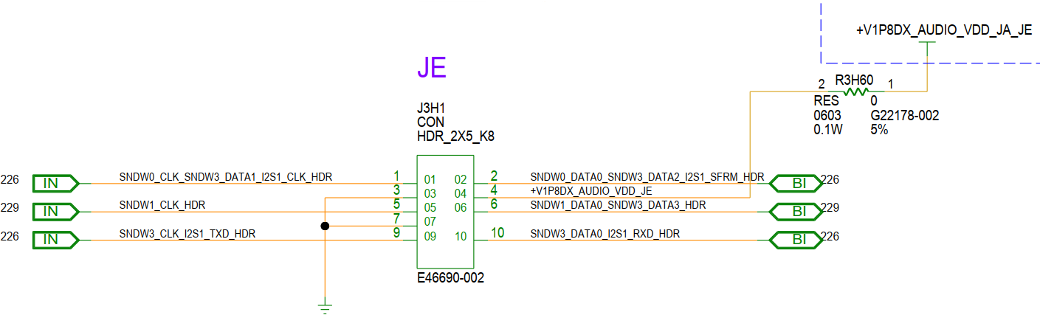
JE Header [SNDW/I2S1] :
The JE header can be used to drive ALC712-VB full function codec or ALC713-VB UAJ codec using SNDW3 multilane port on Realtek GEN6 AIC.
It can also drive Cohen CS42L43 jack codec on Cirrus v3 AIC.
It also connects IS21 CLK & DATA lines to I2S codec present on chrome specific AIC. Refer below snap for the header pinout details.

Slide 97
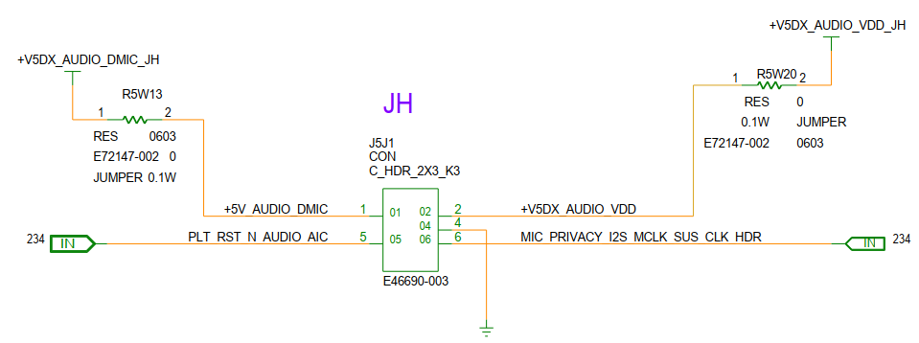
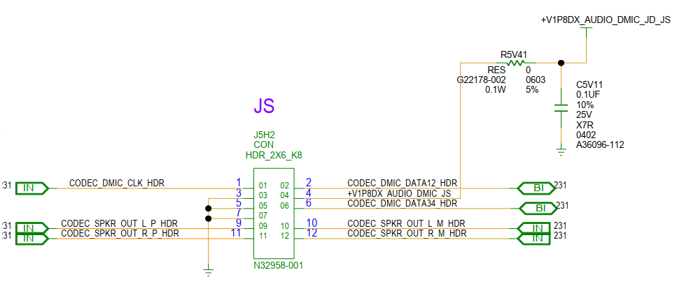
JH – Header :
JH header will be used as 5V power source in 4-SPKR/6-SPKR configuration.
PLT_RST_N is routed additionally so that when AIOC is powered from external supply and power recycle is done for RVP, PLT_RST_N can be used to ensure AIOC power recycle in such cases.
It also provides, SUS_CLK connection as always-on-clock for future use (Smart DMIC use-cases).
JS – Header :
JS header is used to connect on-board ALC722 codec DMIC and SPKR load using Y-cable on transducer AIC. It can drive 4xDMIC & 2 SPKR’s.
Notes:
HSD : 16020811151 - PTL-UH : Audio Header Pinout modification as per new pin assignment in PTL SoC (intel.com)

Slide 98

Audio HDR’s Board Placement
JS
JA
JD
JE
MIC Disable DIP SW
3.5mm Jack
JH
Note: Board snapshot is shown for LP5x T4 RVP.

Slide 99
Audio reference links
PTL RVP Audio CCB link :
15013691587 - Include support for SDCA 0.8/1.0 compliant audio components on PTL RVP & Audio Add-In-Cards from major vendors (Realtek, Cirrus) (intel.com)
RVP HAS link :
PTL_UH_RVP_HAS_Rev1p0_WW05p5_2024.pdf
Gen 6 Audio Add-In-Card - Reference Validation Platform Design Wiki - Intel Enterprise Wiki
Cirrus AIOC v3 - Reference Validation Platform Design Wiki - Intel Enterprise Wiki
Gen3 Audio Add-In-Card - Reference Validation Platform Design Wiki - Intel Enterprise Wiki
Gen4 Audio Add-In-Card - Reference Validation Platform Design Wiki - Intel Enterprise Wiki
ACE3.x Integration HAS (intel.com)
HSD : 16020811151 - PTL-UH : Audio Header Pinout modification as per new pin assignment in PTL SoC (intel.com)

Slide 100
LPSS & LSIO
C M, Aparna

Slide 101
PTL UH RVP : LPSS I2C Block Diagram

Slide 102
PTL UH RVP : LPSS I2C Devices Mapping
INTERFACE | Devices in LP5x T3 RVP | Devices in LP5CAMM dTBT T3 RVP | Devices in LP5x T4 RVP | Devices in DDR5 SODIMM RVP
LPSS I2C0/I3C0 | 1x4 HDR (as I3C0) | 1x4 HDR (as I3C0) | 1x4 HDR (as I3C0) | 1x4 HDR (as I3C0)
 | SPD | Memory SPD | SPD | Memory SPD
 | MECC AIC (as I3C0) | DP MUX
LPSS I2C1/I3C1 | CRD CONN-1 (as I2C1) | CRD CONN-1 (as I2C1) | CRD CONN-1 (as I2C1) | CRD CONN -1 (as I2C1)
 | SV HDR | SV HDR | SV HDR | SV HDR
 | 1x4 HDR (as I3C1) | 1X4 HDR | 1X4 HDR | 1X4 HDR
 | MECC AIC (as I3C1)
LPSS I2C2 | CRD CONN-2 (as I2C2) | CRD CONN-2 (as I2C2) | CRD CONN-2 (as I2C2) | CRD CONN-2 (as I2C2)
 | M.2 WLAN (as CNV_MFUART2) | M.2 WLAN (as CNV_MFUART2) | M.2 WLAN (as CNV_MFUART2) | M.2 WLAN (as CNV_MFUART2)
 | Mod TCSS AIC TCP2/3,PD AIC TCP0 & TCP1 (For Chrome) |  |  | Mod TCSS AIC TCP2/3,PD AIC TCP0 & TCP1 (For Chrome)
LPSS I2C3 | PSS | PSS | PSS | PSS
 | Audio HDR | Audio HDR | Audio HDR | Audio HDR
 | Power Meter | Power Meter | Power Meter | Power Meter
 | MIPI 60 | MIPI 60 | MIPI 60 | MIPI 60
 | Touch Pad | Touch Pad | Touch Pad | Touch Pad
LPSS I2C4 | Used as THC0_SPI1/THC_I2C0
LPSS I2C5 | Used as THC1_SPI2/THC_I2C1

Slide 103
PTL UH RVP : LSIO Device Address details
Device | Speed | 7 Bit address Set | 7 Bit Address Options | I2C IO Voltage
Touch Pad | 400KHz / 1MHz | 0x2C | NA | 3.3V
Touch Panel-2 | 400KHz/ 1MHz | 0x16 | 0x5C | 1.8V
Touch Panel-1 | 400KHz/ 1MHz | 0x16 | 0x5C | 1.8V
Cam_Connector-1 | 400KHz | 0x4D | 0x4D | 1.8V
Cam_Connector-2 | 400KHz | 0x49 | 0x49 | 1.8V
PSS | 400KHz | 0x5D (Read) , 0x5C (Write) | 0X68 or 0x6A or 0X6C or 0X6E | 1.8V
Power meter Chip#1 | 400KHz | 0x18 | Configurable through resistor | 1.8V
Power meter Chip#2 | 400KHz | 0x12 | Configurable through resistor | 1.8V
Power meter Chip#3 | 400KHz | 0x1E | Configurable through resistor | 1.8V
Power meter Chip#4 | 400KHz | 0x1D | Configurable through resistor | 1.8V
Power meter Chip#5 | 400KHz | 0x11 | Configurable through resistor | 1.8V
Power meter Chip#6 | 400KHz | 0x15 | Configurable through resistor | 1.8V
Power meter Chip#7 | 400KHz | 0x19 | Configurable through resistor | 1.8V
Power meter Chip#8 | 400KHz | 0x14 | Configurable through resistor | 1.8V
Power meter Chip#9 | 400KHz | 0x17 | Configurable through resistor | 1.8V
CONNECTIVITY - GBIT LAN - JACKSONVILLE LAN PHY CHIP | 100KHz/ 400KHz/1MHz | 0xC8 (Read) , 0xC7 (Write) | 0xC8 (Read) , 0xC7 (Write) | 3.3V
FRU EEPROM | 100KHz/400KHz | 0xAD(Read), 0xAC (Write) | Configurable through resistor | 3.3V

Slide 104
PTL UH RVP: SMBUS, SMLINK, MLINK Block Diagram

Slide 105
PTL UH RVP LSIO : SMBUS, SMLINK, MLINK Mapping
INTERFACE | RVP1:Devices in LP5x T3 RVP | RVP2:Devices in CAMM DTBT T3 RVP | RVP3:Devices in LP5x T4 RVP | RVP4:Devices in DDR5 SODIMM RVP
SMBUS (ALERT line is used as GPIO) | PCIE x1 Slot | PCIE x1 Slot | PCIE X2 Slot | PCIE x2 Slot
 | PCIE X4 Slot |  | PCIE X4 Slot
 | PCIE x8 Slot | PCIE x8 Slot | PCIE x8 Slot | PCIE x8 Slot
 | FRU EEPROM | FRU EEPROM | FRU EEPROM | FRU EEPROM
 | ESPI bus Header | ESPI bus Header [S-3] | ESPI bus Header | ESPI bus Header
 | SPD EEPROM | DDR5 Memory | SPD EEPROM | DDR5 SODIMM
 | PM Side Band Header | PM Side Band Header | PM Side Band Header | PM Side Band Header
 | CPU/PCH Merged MIPI 60 Connector | CPU/PCH Merged MIPI 60 Connector | CPU/PCH Merged MIPI 60 Connector | CPU/PCH Merged MIPI 60 Connector
 | TTK3 Header | TTK3 Header | TTK3 Header | TTK3 Header
 | M.2 WWAN | M.2 WWAN | M.2 WWAN | M.2 WWAN
SMLINK0 (ALERT line is used as GPIO) | TBT retimer Chip#0 ( for TCP-0 SV Validation) & 1x3 Header | Barlow Ridge | TBT retimer Chip#0 ( for TCP-0 SV Validation) & 1x3 Header | TBT retimer Chip#0 ( for TCP-0 SV Validation) & 1x3 Header
 | TBT retimer Chip#1 ( for TCP-1 SV Validation) |  | TBT retimer Chip#1 ( for TCP-1 SV Validation) | TBT retimer Chip#1 ( for TCP-1 SV Validation)
 | Modular TCSS AIC CONN1 | Modular TCSS AIC CONN1 | Modular TCSS AIC CONN1 | Modular TCSS AIC CONN1
 | Modular TCSS AIC CONN2 |  | Modular TCSS AIC CONN2 | Modular TCSS AIC CONN2
 | 1x3 Header | 1x3 Header | 1x3 Header | 1x3 Header
 | Jacksonville | Jacksonville | Jacksonville | Jacksonville
 | PCIE x1 Slot | PCIE x1 Slot | PCIE x1 Slot | PCIE x1 Slot
SMLINK0B (default used as GPIOs) | Sensor Header (as ISH SPI/ISH UART) | Sensor Header (as ISH) | Sensor Header (as ISH) | Sensor Header (as ISH)
 | TTK3 Header | MECC AIC Connector (as ISH) | TTK3 Header | MECC AIC Connector (as ISH)
SMLINK1 (ALERT line is used as GPIO) | Modular TCSS AIC CONN1 | Modular TCSS AIC CONN1 | Modular TCSS AIC CONN1 | Modular TCSS AIC CONN1
 | Modular TCSS AIC CONN2 | Modular TCSS AIC CONN2 | Modular TCSS AIC CONN2 | Modular TCSS AIC CONN2
 | PD AIC | PD AIC | PD AIC | PD AIC
 | PM SIDEBAND HEADER | PM SIDEBAND HEADER | PM SIDEBAND HEADER | PM SIDEBAND HEADER
MLINK | M.2 KEY-E CONNECTOR - WLAN/BT | M.2 KEY-E CONNECTOR - WLAN/BT | M.2 KEY-E CONNECTOR - WLAN/BT | M.2 KEY-E CONNECTOR - WLAN/BT
 | MLink HEADER | MLink HEADER | MLink HEADER | MLink HEADER

Slide 106
PTL UH P RVP LSIO : SPI ,THC, eSPI Mapping and LPSS : UART Mapping
INTERFACE | Devices in LP5x T3 RVP | Devices in CAMM DTBT T3 RVP | Devices in LP5x T4 RVP | Devices in DDR5 SODIMM RVP
SPI-0 FLASH | 80 MHz 64MB Flash | 80/50 MHz 64MB Flash | 80 MHz 64MB Flash | 80 MHz 64MB Flash
 | 100MHz 64MB Flash | 50 MHz 64MB Flash | 100MHz 64MB Flash | 100MHz 64MB Flash
 | TPM Header | TPM Header | TPM Header | TPM Header
 | TTK3 Header | TTK3 Header | TTK3 Header | TTK3 Header
 | MECC AIC Connector
THC-0 SPI-1 muxed with GSPI-0 | Touch Panel 1(as THC SPI1) | Touch Panel 1(as THC SPI1) | Touch Panel 1(as THC SPI1) | Touch Panel 1(as THC SPI1)
THC-1 SPI-2 muxed with GSPI1/THC_I2C1 | Touch Panel 2 (as THC_I2C1) | Touch Panel 2 (as THC_I2C1) | Touch Panel 2 (as THC_I2C1) | Touch Panel 2 (as THC_I2C1)
 | Touch Pad (as THC_I2C1) | Touch Pad (as THC_I2C1) | Touch Pad (as THC_I2C1) | Touch Pad (as THC_I2C1)
eSPI | EC | EC | EC | EC
 | eSPI Bus Header | eSPI Bus Header | eSPI Bus Header | eSPI Bus Header
 | MECC AIC
INTERFACE | Devices in LP5x T3 RVP | Devices in CAMM DTBT T3 RVP | Devices in LP5x T4 RVP | Devices in DDR5 SODIMM RVP
UART-0 | USB to Dual UART (only RX and TX lines) | USB to Dual UART (only RX and TX lines) | USB to Dual UART (only RX and TX lines) | USB to Dual UART (only RX and TX lines)
 | TTK3 Header | TTK3 Header | TTK3 Header | TTK3 Header
UART-1 | Default Used as I2C3
UART-2 | Default used as CNVi BRI/RGI Signals to M.2 KEY-E CONNECTOR - WLAN/BT

Slide 107
SPI Flash & TPM
Prabha, Abhijith

Slide 108
Block Diagram - SPI Flash & TPM
POR frequency for SPI flash: 80MHz (vs 50MHz in MTL/ARL)
SPI Flash part : single 64MB RPMC (Macronix MPN –MX77U51250FZ4I42), WSON-8, 1.8V
Dual Flash Topology as 1x 64MB (default) + 1x64MB (rework) option will be provided only in LPCAMM SKU.
MAF topology supported by default. SAF and G3 can be enabled with reworks.
Reworks for enabling SAF and G3 are minimized wrt previous platforms. (Max 8 Resistor Reworks + DIP switch in ARL/MTL → max 3 Resistor Reworks + DIP switch in PTL)
100MHz Flash is supported in all SKUs (except the LPCAMM SKU).
dTPM is supported in all SKUs via TPM header.
Notes:
TTK3 version to be used -> have this info backup

Slide 109
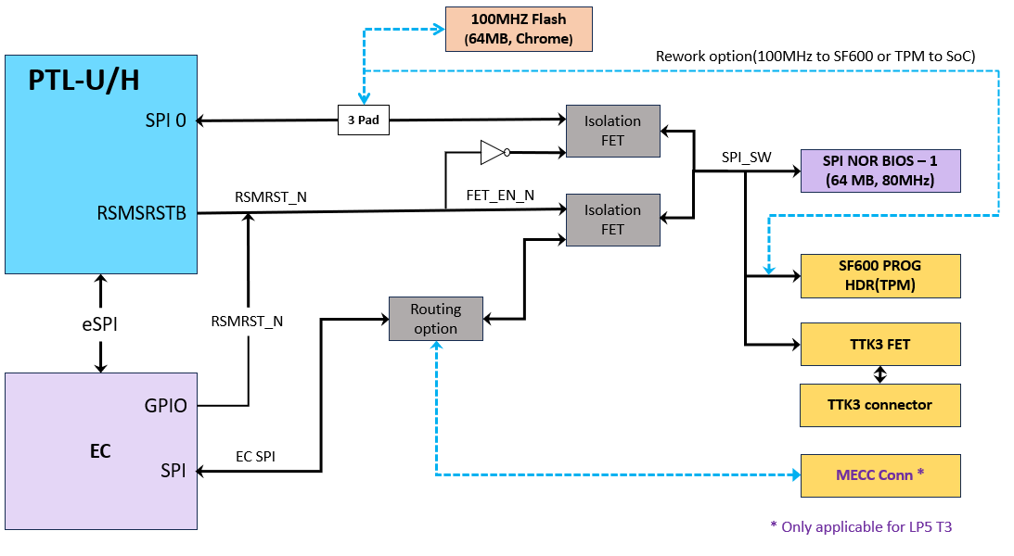
Block Diagram in PTL UH RVP (LP5x T3/T4 & DDR5 SKU)

Slide 110
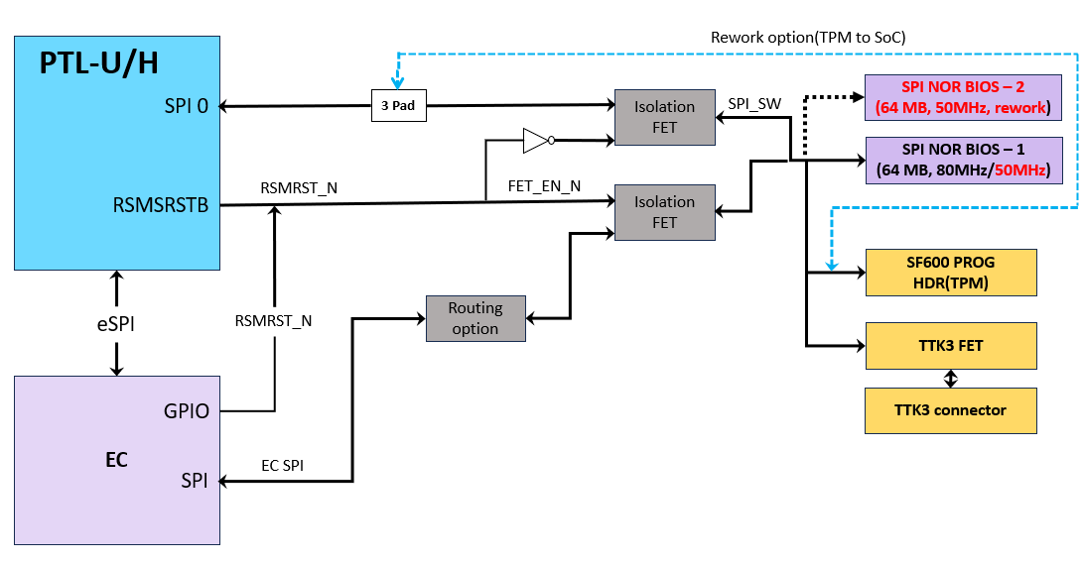
Block Diagram in PTL UH LPCAMM SKU

Slide 111
Embedded Controller
Sahu, Shubham Kumar

Slide 112
Embedded controller - Overview
PTL-UH RVP will support MEC1723NB0-I/SZ (144-pin WFBGA package) Microchip Embedded Controller (EC) onboard. MEC1723 supports ESPI mode of operation. LPC mode is not supported in PTL SOC. EC controls the preliminary platform power sequencing and does system and power management. EC is the platform thermal controller that monitors and throttles CPU or controls CPU Fan.
200 pin MECC AIC Connector (MPN : 84535-191LF, AFCI) is provided in PTL-UH – 15 (RVP1 LP5x T3 MECC SKU) to support EC AIC from different vendors.
MECC connector is also supported in RVP1 LP5x T3 Pre-PO chrome boards (UH-04A). Other than these, no other SKU of PTL-UH RVP support MECC connector.
The Key functionalities of EC on the platform are listed below,
Thermal Management like CPU Fan control, Chassis Fan control, PECI, DIMM temperature etc.
PECI over eSPI is default. Physical PECI pin from EC is a rework option.
Platform Power management like Power sequencing and Sx entry/exits.
Modern Standby requirements to be implemented inside EC.
Handles the Board-ID, Fab-ID, BOM SKU-ID, messages to the BIOS.
RVP supports all three i.e., MAF, SAF, G3 Flash configuration, default will be MAF in all the SKUs.
In addition to MECC AIC support, 2x14 pin eSPI header is also be supported over rework option.
Separate PMR resistors are added for 1.8V and 3.3V rails going to EC.
PS2 KB connector is unstuffed by default in all the RVP SKUs. (PS2 mouse is not supported in any of the SKUs)

Slide 113
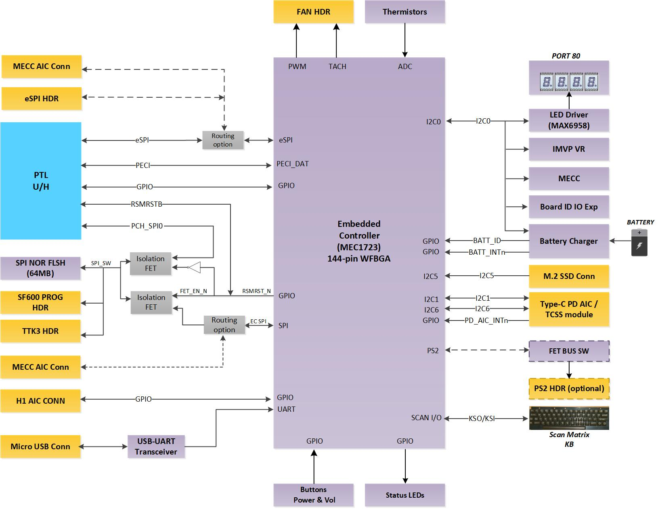
Embedded controller - Block diagram

Slide 114
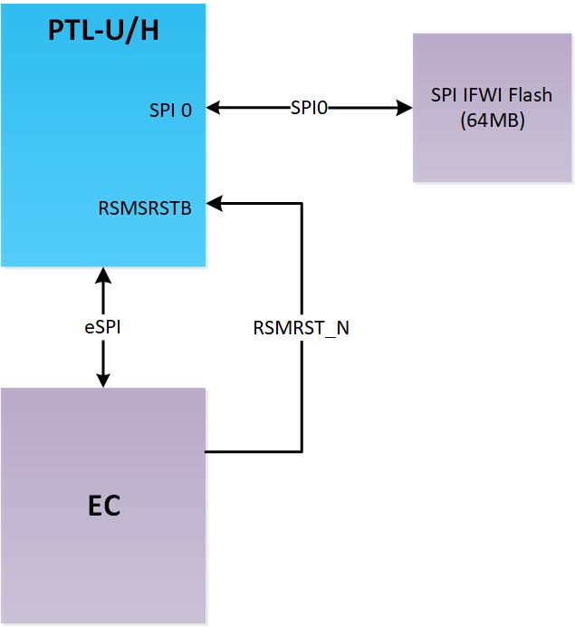
Master Attached Flash Sharing(MAF)
MAF is one of the Flash sharing Mechanism where PCH is the master which access flash over PCH SPI0 Controller and EC sharing the same flash will access over eSPI.
MAF will be default configuration.

Slide 115
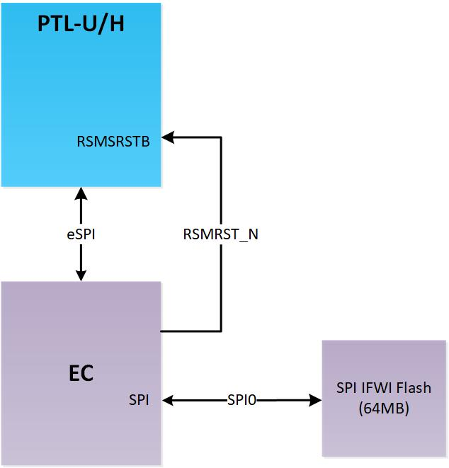
Slave Attached Flash Sharing(SAF)
SAF is one of the Flash sharing Mechanism where EC is the master which access flash over its SPI Controller and PCH sharing the same flash will access over eSPI.
MEC1723 Microchip Embedded Controller can support SAF mode flashing.
Rework is required on RVP to support SAF.

Slide 116
NIST-193 Firmware Recovery
NIST193 firmware resiliency support on platform mainly focuses on recovery part.
Recovery architecture aims at providing,
Single Platform Root Of Trust for Recovery
Unified Recovery flows across all Platform and SOC devices
Alternate storage media (non-SPINOR) for storing the Recovery image
Platform recovery architecture has following key components,
A Primary firmware that resides on the SPINOR flash.
A Recovery firmware image that resides on alternate storage media (M.2 SSD). In this architecture, storage media acts as the storage for Recovery image.
Root Of Trust for Recovery (EC) that recovers the system using the recovery image.
RVP-1, 3, 4 | RVP-2
Gen4 SSD (P5-8) | Gen5 SSD (P1-4)
TOP PLACEMENT
BOTTOM PLACEMENT

Slide 117
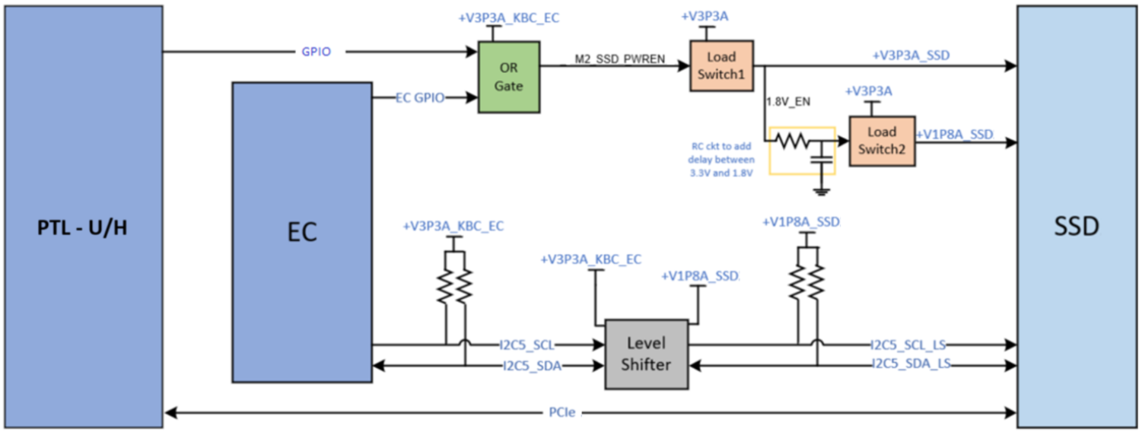
NIST-193 Recovery Feature block diagram

Slide 118
EC GPIO & PTL-UH GPIO mapping
Sahu, Shubham Kumar (EC GPIO)
Usha (SOC GPIO)

Slide 119
EC and PTL-UH SOC GPIO allocation table
Link for latest PTL-UH RVP SOC & EC GPIO mapping is as follow:
SOC GPIO mapping
Link: https://intel.sharepoint.com/:f:/r/sites/ccgptlplatformpdtprogrammanagement/PTLUPH%20RVP%20documents/Misc_Docs/Platform_GPIO_Map?csf=1&web=1&e=aCBchj
EC GPIO mapping
Windows
https://intel.sharepoint.com/:f:/r/sites/ccgptlplatformpdtprogrammanagement/PTLUPH%20RVP%20documents/Misc_Docs/Platform_GPIO_Map/Windows_MEC1723_EC_GPIO?csf=1&web=1&e=y2skhg
Chrome
https://intel.sharepoint.com/:f:/r/sites/ccgptlplatformpdtprogrammanagement/PTLUPH%20RVP%20documents/Misc_Docs/Platform_GPIO_Map/Chrome_MEC1727_EC_GPIO?csf=1&web=1&e=XaRGqA

Slide 120
Chrome Support
George, Priyan

Slide 121
PTL UH RVP Chrome Strategy
PTL UH RVP supports Chrome requirements through Chrome RVP BOM SKU.
BOM SKU will be supported in LP5 T3 and DDR5 SKUs.
Will use onboard Chrome specific Microchip EC - MEC1727N-B0-I/SZ.
Onboard EC implementation Similar to LNL RVP.
MECC AIC supported in LP5x SKU.
H1 AIC based on H1DT chip will be plugged on TTK3/H1 AIC connector.
New H1 AIC based on H1D3C controller developed for PTL Chrome RVP.
Will have both micro servo and CCD based debug support (over Type C Port-0) .
Type C subsystem implementation through PD AIC and TCSS modules.
TCPC to PD Controller Architecture as POR for BOM harmonization.
PD AIC based on Realtek 20V SPR PD will enable USB C Port 0 and Port 1.
Realtek based 40G re-timer based TCSS Type-C AIC supported on Port-2.
Port-3 supports HDMI TCSS module.
Gothic bridge/other CFP PD controller-based modules will be POC.
ISH based sensor support.
FPS support through adapter board. (Plan to have 5 to 10 setups for feature checkout)

Slide 122
PTL UH RVP - Chrome
Chrome Audio support
Default Support is SNDW and I2S.
SNDW supported through Onboard CODEC (ALC722).
I2S support through AIC. REX DB with ALC5682 is planned as delta validation.
HDA supported through rework. ALC256 planned from IP enabling using Gen4 card limited to few RVPs.
The Key features supported by H1DT AIC are listed below:
Supports H1DT Security chip communication with EC & SOC over I2C.
EC and CB flashing through CCD and Servo.
Closed chassis debugging.
Access UARTs of EC, SOC, ISH, TPM and FPS.
Verified boot.
Security features.
Scan Matrix keyboard is Supported on H1DT AIC. BRYA/REX keyboards are compatible.
Access device GPIOs like power button, cold reset, warm reset, lid etc.

Slide 123
PTL UH RVP – Chrome continued…
Other Chrome deltas:
100MHz Flash topology support through rework.
Dediprog header disabled by default. (Work around through TTK3 header).
I2C based touch panel enabled by default. (SPI based touch panel enablement need feature rework).
For WWAN, default implementation is PCIe based. (USB3 based implementation need feature rework).
For memory, Pre power on boards will be socketed and Upcoming builds will be Soldered down (alpha and beta).

Slide 124
Debug & Validation
Jadhav, Aniket

Slide 125

PTL-UH SoC Debug Port Capabilities
SoC Debug Architectural Overview
NOTE :
*Trace is supported, but minimum BW, so nearly unusable
**Typically, only used for BIOS Trace during early development
***Need to enable USB2.DbC using BIOS or FIT setting

Slide 126

USB2/USB3 DbC port mapping & RVP RefDes Details – closed chassis debug
NOTE : J* - RefDes are subject to change.

Slide 127



Traditional XDP/LTB support on PTL-UH RVP – open chassis debug
XDP : PTL-UH RVP supports traditional XDP probe over MIPI60 header for JTAG functionality. Make sure to use adaptor card for compatibility with MIPI60 header
Lauterbach(LTB) : Lauterbach Trace32 is used as the open chassis debug tool and connected via MIPI-60. The supported features are :
Run-control
Trace extraction and analysis
Streaming trace via MIPI PTI (Intel Processor Trace)
CrashLog extraction and analysis
Custom Scripts (CScripts)
Adaptor card
Link for adaptor details : https://designintools.intel.com/product_p/itpmipi602itp60v2.htm

Slide 128
MIPI60/Touch Panel Header VISA support – open chassis debug
Observe VISA data with a logic analyzer on the Touch Panel Header
Calibrated TLA + THC Rework on RVP + High/Low-speed adaptor + New VISA Cable for Touch Panel + GPIO enabled in BIOS menu
Observe VISA data with a logic analyzer on the MIPI60 Header
Calibrated TLA + PCH Rework on RVP + High/Low-speed adaptor + GPIO enabled in BIOS menu.
Note : (MTL_M Debug VISA cable cannot be used for VISA over THC panel connector)​
Notes:
VISA to Pins
2 byte-lanes, 1b of clock on each lane (16b of data, 2b of clock)
Using VISA clock
VISA to Pins (Async)
Bypass the flops and sample the signals using LA
Async mode is recommended when working with LA
Touch Panel (VISA) to Pins (Sync)
2 byte-lanes, 1b of clock on each lane (16b of data, 2b of clock)
Using VISA clock
Touch Panel (VISA) to Pins (Async)
Bypass the flops and sample the signals using LA
Async mode is recommended when working with LA

Slide 129
Additional Tools and Cables
MIPI60-to-LAI HS Adapter(For VISA only):
https://wiki.ith.intel.com/display/PEVH/MIPI60-to-LAI+High-Speed+Adapter
MIPI60 to LAI Adapter:
https://wiki.ith.intel.com/display/PEVH/MIPI60-to-LAI+Adapter
LNL VISA Debug Cable:
https://wiki.ith.intel.com/display/PEVH/LNL+VISA+Debug+Cable
Lauterbach Tools and License details :
https://sharepoint.amr.ith.intel.com/sites/VTG/VTG TPV Enabling/External TPV Information/Lauterbach/Ordering and Pricing
Intel® Silicon View Technology Closed Chassis Adapter (also known as SVTCCA or BSSB) from below given link :
https://designintools.intel.com/ProductDetails.asp?ProductCode=ITPXDPSVT
Closed Chassis Debug Technologies (BSSB, DbC etc)
https://securewiki.ith.intel.com/display/ccd/CCD+Technologies
MIPI60 Lauterbach Connector and interface details
http://goto/IntelDPS
Lauterbach details
http://goto/lauterbachpricing

Slide 130

SINAI2/NEVO connector
PTL-UH RVP Supports SINAI2 connector (Merged AVMC + SINAI) for Margining customers.
PTL also supports Nevo ( which is the Low-Cost SINAI) Low-cost version of Sinai2 - Full compatibility to Sinai2 drivers, SW and automation. For SINAI & audio connectors concurrent usage, please make sure to use cable solution for SINAI.
Connector IPN | Description
D10221-001 | CONN,MISC,100 P,SM 5MM
Assembly P/N | Description
H90193-001 | NEVO KIT A602-2420

Slide 131


BOX STRESS TOOL (BST)
BST is an AIO integrated solution used for Voltage measurements, Voltage drive/margining, GPIO's manipulations, I2C master controller and Thermal Diodes measurements capabilities.
BST hooks on to RVP 100pin Nevo connector with use of NTB adapter for ADC, DAC , GPIO’s , ISENSE and I2C Controller functions.
For SoC Thermal Diodes measurements and BST onboard VR’s auxiliary use case, dedicated cables are available as part of BST Kit.
IPN | Description
M37664-001 | BST FAB B Kit
IPN | Description
K87826-001 | NTB Adapter
IPN | Description
M37665-001 | NTB FAB B Kit
Nevo to BST Adapter ( NTB FAB B )
BST Test Card

Slide 132
Processor Secure Storage(PSS)
Processor Secure Storage or PSS is a RFID based solution used in RVP to store board related information like Board SL No, Board ID.
IPJ-P6005-X2BT is the PSS IC is used. It is a UHF (860-960MHz) Gen2 RFID IC with 8K non-volatile memory and I2C interface. This IC operates as a standard I2C EEPROM and it can also be accessed wirelessly.
The board related details stored is read over I2C lines from the SOC.

Slide 133
Debug Hooks Supported on PTL RVP
SINAI2/NEVO/BST
SAS Header
Thermal INTEC Connector
SMP Probe Points
PM Side Band Header
KB & Mouse ( PS2)
uAB serial debug port
DediProg SF600 programmer
PORT 80
PSS Support

Slide 134
TTK3 support on RVP
Any query related to TTK tool, please use the following contacts:
HW: sapir.buzaglo@intel.com
SW: adi2.levy@intel.com
Link for TTK collateral is as follow:
TTK3 Releases
TTK Wiki
Prabha, Abhijith

Slide 135


BIOS programming using TTK3 Connector
TTK3 header is a 50 pin receptacle which can also accept 20 pin dediprog header or TTK3 HW to program the IFWI. Please insert the dediprog header as shown below. Make sure that the notch marked matches with the notch of the dediprog header.
If using TTK3, make sure the latest version of the TTK3 GUI (1.4.5, link) is installed in the host machine. With latest GUI, TTK3 FW update will happen while connecting TTK3 HW for the first time. Note: Without latest GUI version, longer flashing time is expected!

Slide 136

TTK Programming Frequency Selection – Mandatory for PTL!
PTL UH RVP is having Flash0 POR frequency as 80MHz. As tradeoff to this, TTK/TPM path max frequency is limited to 14MHz in the RVP.
While using TTK3 for flashing, the frequency of operation must be set to 12MHz for reliable operation.
In the host PC with TTK3 GUI, open: C:\SVShare\user_apps\TTK3_Configurations.xml
Modify SPI_Frequency to 12 in the below placeholder;

Slide 137

Dediprog/SF600 Frequency Selection – Mandatory for PTL!
PTL UH RVP is having flash0 POR frequency as 80MHz. As tradeoff to this TTK/TPM path max frequency is limited to 14MHz in the RVP.
While using Dediprog/SF600 for flashing, the frequency of operation must be set to 12MHz for reliable operation.
In the Dediprog software: Config -> Mischellaneous Settings → select frequency 12MHz.

Slide 138
Power Delivery Implementation Details
P, Manas

Slide 139
PTL-UH RVP – Power Sources to boot PTL-UH RVP boards
PTL-UH design supports three different power sources to boot RVP boards,
AC Adapter:
Main AC Adapter : An adapter with 230W capability is selected to support power numbers of PTL-UH platform. It should be connected to Main AC Brick- Primary power jack on RVP.
Auxiliary AC Adapter : Auxiliary adapter is required for supporting PL4 current number along with standard/main AC adapter in PTL H in the absence of battery pack while performing performance related validation. This adapter is same as the standard adapter (IPN: J82210-001). Auxiliary AC adapter powers few of the CPU rails during its operation.
Note : PTL-UH board will not boot with Auxiliary AC adapter alone.
Type C Adapter:
PTL-UH RVP has 4-Type C ports. Two On-board Type-C ports supports EPR voltages up to 48V and Type-C port on each TCSS module supports SPR mode Only on the board (except for GBR Module). All these Type-C ports can be used for powering the platform. By default, the highest priority is given to standard AC adapter.
Battery Pack:
PTL-UH supports battery pack of 3S3P configuration (11.4V Nominal) and has a capacity of 99Whr. 3S3P battery pack IPN: K71137-001
Recommendation: Use standard AC adapter for all validations. Only on need basis, use Type C adapter or battery pack.

Slide 140
PTL-UP RVP – Power Source Priority
Available Sources | Priority Given To
Standard AC Adapter + Battery Pack | Standard AC Adapter
Type C Adapter + Battery Pack | Type C Adapter
Standard AC Adapter + Type C Adapter | Standard AC Adapter
Standard AC Adapter + Type C Adapter + Battery Pack | Standard AC Adapter
SPR Type-C Adapter + EPR Type-C Adapter + Battery Pack | EPR Type-C Adapter
Adapter EPR1 Type-C Adapter + EPR 2 Type-C | Adapter with higher power capability
Standard AC Brick Adapter + Auxiliary AC Adapter + Battery Pack | Not recommended to use as default
Note:
Smooth/seamless transition from Type-C adapter to AC adapter and vice versa is not supported if battery is not connected.
Type C adapter should provide minimum power of 180W (36V @ 5A) without Battery to boot the system for H-4Xe (45W) Silicon

Slide 141



PTL-UH RVP SoC rails overview (POR)
PTL-UH +LP5
PTL-UH +DDR5 (SODIMM)
PTL-UH +LP5 CAMM
IMVP 9.3 VR
Discrete VR
Load Switch
LDO
Notes:
Diff memory technology different power delivery solutions
Soc power solution is for the superset design

Slide 142
PTL-UH RVP IMVP rail overview
Processor | PTL VCCCORE + VCCGT + VCCSA + VCC_LP_ECORE | Remarks
Processor Base Power – U 15W | 2+1+1+1
Processor Base Power – H 28W | 3+2+1+1
Processor Base Power – H 45W | 4+2+1+1
RVP Platform PD U/H– 45W | 4+2+1+1 | Super set design to support U/H
There are Four SVID rails in PTL-UH, namely
Rail | VCCCORE | VCCGT | VCCSA | VCC_LP_ECORE
Phase Count | 4 | 2 | 1 | 1
ICCMax (A) | 140 | 80* | 40* | 35
ICCMax.App (A) | 105 | 61 | 35 | 24
IPL2/TDC (A) | 67 | 32 | 26 | 13
DCLL (mΩ) | 3.3 | 0 | 5.5 | 5.8
ACLL (mΩ) | 3.3 | 3.5 | 5.5 | 5.8
FVM Support | ✓ | ✓ | ✓ | ✕
* Indicates VR capability, Actual ICCMax is VCCGT=97A and VCCSA=54A respectively which is supported through FVM
Notes:
VCCGT ICCMAx 97 and VCCSA ICCMAx 52

Slide 143
PTL-UH RVP power rail overview
VR / Power Gated Rail name | Voltage (in V) | RVP1 T3 Memory Down/Skt | RVP2 T3 LP5 CAMM | RVP3 T4 LP5 Memory Down/Skt | RVP4 DDR5 SODIMM
+V1P5_RTC | 1.50 | ✓ | ✓ | ✓ | ✓
+V3P3A | 3.30 | ✓ | ✓ | ✓ | ✓
+V5A | 5.15 | ✓ | ✓ | ✓ | ✓
+V1P8A | 1.80 | ✓ | ✓ | ✓ | ✓
+VCCPRIM_3P3 | 3.30 | ✓ | ✓ | ✓ | ✓
+VCCPRIM_VNNAON | 0.77 | ✓ | ✓ | ✓ | ✓
+VCCST | 0.77 | ✓ | ✓ | ✓ | ✓
+VCCPRIM_IO | 1.25 | ✓ | ✓ | ✓ | ✓
+VIN_BULK_DRAM | 5.15 | ✕ | ✓ | ✕ | ✓
+VDD1_MEM | 1.80 | ✓ | ✕ | ✓ | ✕
+VDD2_CPU/ +VDD2H_MEM | 1.065 | ✓ | ✓(1.05V) | ✓ | ✓ (1.1V)
+VDD2L_MEM | 0.92 | ✓ | ✕ | ✓ | ✕
+VDDQ_CPU/ +VDDQ_MEM | 0.52 | ✓ | ✓(0.53V) | ✓ | Merged with VDD2_CPU
+VCCCORE | SVID | ✓ | ✓ | ✓ | ✓
+VCCGT | SVID | ✓ | ✓ | ✓ | ✓
+VCCSA | SVID | ✓ | ✓ | ✓ | ✓
+VCC_LP_ECORE | SVID | ✓ | ✓ | ✓ | ✓
Notes:
As per mem technology

Slide 144

PTL-UH RVP1 power flow overview at platform level
Notes:
Call out Pg 6 for each sku

Slide 145
PTL-UH RVP– Key PD Sub-systems
Battery Charger:
A Buck-Boost NVDC charger is used to support the overall system power needs and to charge the 3S3P battery pack. The battery charger works seamlessly with both standard AC adapter and Type-C adapter. PTL Platform can support direct 28V Battery charging operation as well.
Discrete VRs:
PTL RVP has discrete on-board voltage regulators to generate the rails required for powering the Non-SVID SoC and platform components. Further, Load switches and corresponding power sequencing for the RoP PD sub system.
IMVP 9.3 VRs:
PTL U/H CPU requires four different SVID rails (VCC_CORE, VCCGT, VCCSA and VCC_LP_ECORE). VCC_LP_ECORE is new VR compared to MTL-UH with IMVP9.3 SVID protocol compliant. An IMVP 9.3 controller from Richtek (RT3645BEN-01A-AAHR045-E3) is used in PTL UH design is used to generate the SVID rail.
PTL UH RVPs will be design for super set configuration (H 45W) to support U15/H28/H45 silicon. If any changes needed in the tuning other than POR target values, these VR registers can be programmed via Engineering EC binary using AADVARK/Richtek Bridgeboard.
Notes:
Programming thru external I2C host possible e.g. AADVARK

Slide 146

PTL-UH RVP – Power Map
Link:PTL_UH_RVP1_Power_Map.xlsx

Slide 147

PTL-UH RVP System State overview
Panther Lake supports the following system states and detailed voltage rail information is presented in next slide. By default, all the SKU supports pseudo –G3 state
DSx is not supported.
Notes:
All Legacy Power states supported

Slide 148



PTL-UH RVP– Sequencing Block Diagram
1
Battery charger
VSYS/VBATA
2
SoC
Primary rails
2a
BC_ACOK
1a
2b
RSMRST_PWRGD_N
PG3 logic
4
PRIM_VR_EN
5
EC
PM_RSMRST_N
ALL_SYS_PWRGD
3
BAT_LOW
IMVP VR
10
IMVP_VR_READY/PCH_PWROK/SYS_PWROK
11
PLTRST
Power sequencing logic
8
6c
Platform S rails
PM_SLP_S3
9
6b
7
Memory rail
PM_SLP_S4
MEMORY_PWRGD
6a
PM_SLP_S5
LINK: PTL_UH_RVP_Detailed_Power_Sequence_Diagram

Slide 149
PTL-UH RVP– Power Sequence
Primary Rail Order (Fixed Rails)
+V3P3A/+V5A
+V1P8A
+VCCPRIM_3P3
+VCCPRIM_IO
+VCCPRIM_VNNAON
Memory Rail Order (Fixed Rails)
+VDD1_MEM
+VDD2H_CPU/ +VDD2H_MEM
+VDD2L_MEM
+VDDQ_CPU/ +VDDQ_MEM

Slide 150

PG3 Logic Overview
Pseudo G3 state wake events:
Adapter insertion
Power button press
RTC wake event from EC
System enter PG3 state:
System enters PG3 state only with Battery pack/Virtual battery
EC drives EC_PG3 signal enables the PG3 mode, which intern drives PRIM_VR_EN Low

Slide 151
PTL-UH RVP– Power States Map
VR / Gated Rail name | Enable | Voltage (in V) | S0 (active) | S0 | S0iX | S3 | S4 | S5 | PG3 | G3
+V1P5_RTC | +VRTC_BATT (coin cell battery) | 1.50 | ON | ON | ON | ON | ON | ON | ON | ON
+VBATA | PRIM_VR_EN | 3S topology, 9V-13.05V | ON | ON | ON | ON | ON | ON | OFF | OFF
+V3P3A | PRIM_VR_EN | 3.30 | ON | ON | ON | ON | ON | ON | OFF | OFF
+V5A | PRIM_VR_EN | 5.15 | ON | ON | ON | ON | ON | ON | OFF | OFF
+V1P8A | V5A_V3P3A_VR_PWRGD | 1.80 | ON | ON | ON | ON | ON | ON | OFF | OFF
+VCCPRIM_3P3 | V1P8A_PWRGD | 3.30 | ON | ON | ON | ON | ON | ON | OFF | OFF
+VNNAON | VCCPRIM_3P3 | 0.77 | ON | ON | ON | ON | ON | ON | OFF | OFF
+VCCIO | VNNAON_VR_PWRGD | 1.25 | ON | ON | ON | ON | ON | ON | OFF | OFF
+VDD1_MEM | PM_SLP_S4_N | 1.80 | ON | ON | ON | ON | OFF | OFF | OFF | OFF
+VDD2H_CPU | VDD1_VR_PWRGD | 1.065 | ON | ON | ON | ON | OFF | OFF | OFF | OFF
+VDD2L_MEM | VDD2H_VR_PWRGD | 0.92 | ON | ON | ON | ON | OFF | OFF | OFF | OFF
+VDDQ_CPU | VDD2L_VR_PWRGD | 0.52 | ON | ON | ON | ON | OFF | OFF | OFF | OFF
+V5S | PM_SLP_S3_N | 5.18 | ON | ON | ON | OFF | OFF | OFF | OFF | OFF
+V1P8S | PM_SLP_S3_N | 1.80 | ON | ON | ON | OFF | OFF | OFF | OFF | OFF
+V3P3S | PM_SLP_S3_N | 3.30 | ON | ON | ON | OFF | OFF | OFF | OFF | OFF
+VCCST | VCCST_EN | 0.77 | ON | ON | ON | OFF(Except Crash log) | OFF | OFF | OFF | OFF
+VCCCORE | ALL_SYS_PWRGD | 0-1.52V | SVID | SVID | 0V (boot) | OFF | OFF | OFF | OFF | OFF
+VCCGT | ALL_SYS_PWRGD | 0-1.52V | SVID | SVID | 0V (boot) | OFF | OFF | OFF | OFF | OFF
+VCCSA | ALL_SYS_PWRGD | 0-1.52V | SVID | SVID | 0V (boot) | OFF | OFF | OFF | OFF | OFF
+VCC_LP_ECORE | ALL_SYS_PWRGD | 0-1.52V | SVID | SVID | 0V (boot) | OFF | OFF | OFF | OFF | OFF

Slide 152
PTL-UH RVP1– Voltage Margining Feature
Voltage Rail | VR Controller | Nominal Voltage | Supported Voltage Range | Voltage Margining Support
+V3P3A | TPS51285ARUKT | 3.3V | 2.7V to 4V | Supported With AVMC | Supported With Sinai2/Nevo
+V5A | TPS51285ARUKT | 5.15V | 4.5V to 5.5V | Not Supported | Not Supported
+V1P8A | RT6220AGQUF | 1.8V | 0.6V to 3V | Supported With AVMC | Supported With Sinai2/Nevo
+VCCPRIM_VNNAON +VCCPRIM_VNNAON_FLTR | TPS51219RTER | 0.77 | 0.5V to 1V | Supported With AVMC | Supported With Sinai2/Nevo
+VCCPRIM_IO | TPS51396A | 1.25 | 0.6V to 1.7V | Supported With AVMC | Supported With Sinai2/Nevo
+VDD1_MEM | RT5795AG | 1.8V | 0.5V to 3V | Supported With AVMC | Supported With Sinai2/Nevo
+VDD2_CPU +VDD2H_MEM | RT8231 | 1.065V | 0.75V to 3V | Supported With AVMC | Supported With Sinai2/Nevo
+VDD2L_MEM | RT5795AG | 0.92V | 0.5V to 3V | Supported With AVMC | Supported With Sinai2/Nevo
+VDDQ_CPU / +VDDQ_MEM | RT5795A | 0.52V | 0.45V to 1V | Supported With AVMC | Supported With Sinai2/Nevo
Note: IMVP rails can be margined through SVID
Notes:
AVMC : Analog Validation Margining Card

Slide 153
PTL-UH RVP – Power Measurement
PTL- UH design is single board approach for both PI and PnP board.
Sense lines from sense resistors are routed to multiple 2x7 headers which are on the Bottom side of the board
Spider card needs to be used along with RVP to do power measurement using NI DAQ setups.
PTL-UH design has 7 system meter to measure critical SoC/Platform rails as per PnP requirement. Addition to this, 2 more system meter is incorporated for the core rail voltage measurement via Remote sense lines specifically for IVE PnP team through PAC Pro.
Additionally, PTL RVP also supports Energy Telemetry measurement via System Meter.
LINK
PTL_UH_RVP1_T3_2x7_HDR_MAPPING.xlsx
PTL_UH_RVP3_LP5X_T4_2x7_HDR_MAPPING.xlsx
PTL_UH_RVP4_DDR5_T3_SODIMM_2x7_HDR_MAPPING.xlsx
Power Meter Mapping

Slide 154

PTL-UH RVP – Cost Optimization
For the cost optimization, in PTL-UH we have replaced the most of the Non-critical PMRs to Copper Shunts for the NON-PnP SKUs
As an indication, in the schematics Text “PMR” is added as shown below to indicate that these PMRs will be replaced with Cu-Shunt resistors in NON-PnP SKUs
Details of the PMRs which are replaced with Cu Shunts for each RVP is provided below
LINK:
PTL_UH_RVP1_T3_PMR_STUFFING.xlsx
PTL_UH_RVP3_T4_PMR_STUFFING.xlsx
PTL_UH_RVP4_T3_DDR5_PMR_STUFFING.xlsx

Slide 155
PTL UH RVP – debug hooks
PTL-UH design supports virtual battery implementation via Switch setting
DLVR TP Signals are routed to 2x7 header for monitoring.
PTL-UH design supports coin-cell less design implementation through rework, default configuration is coin cell-based implementation.

Slide 156
Quick Start
V, Manjunatha

Slide 157
Quick Start
Required Peripherals:
MCP socket and MCP
Heat sink assembly for MCP
Memory DRAM IC’s or Module (SKU dependent)
Mobile 19V AC Brick
Keyboard, Mouse (USB)
M.2 SSD
External display (e.g eDP Panel)
SF600 programmer for BIOS programming
uAB cable for debug log

Slide 158
Board Bring up Steps
Make sure all peripheral’s mention in previous foil is available before starting board bring up. Considered LP5x T3 board reference designators are used in below steps provided.
Step 0:
Please go to the PTL RVP Rework tracker to know all applicable rework by searching based on RVP Work Order (WO).
Rework Portal Link : (https://intellabs.service-now.com/rework)
Step 1:
Place the processor (RefDes:U4E1) with socket and the hardware assembly (make sure to align the chip to the pin 1 marking).
Step 2:
Assemble the LP5x memory or DDR5 SODIMM or LPCAMM Module based on the RVP SKU.
Step 3:
Verify presence of RTC coin cell in Battery Holder (RefDes:XJ2B2).
Step 4:
Insert SSD – PCIe based SSD in M.2 socket 3 (RefDes: J8E1 [M.2 SSD Gen4 - # 1] or J8P2 [M.2 SSD Gen5 - # 2 ]).

Slide 159
Board Bring up Steps
Step 5:
Connect eDP display (RefDes: J5A1)). If initial silicon does not support graphics, then use PCIe slot connector(RefDes: J6C1) with the help of external graphics card.
Step 6:
Connect a USB keyboard and mouse on default USB ports (RefDes: J1E1 & J1G1).
Step 7:
Insert DediProg (RefDes: J1H1) and follow steps to flash IFWI image (EC+BIOS merged image).
Step 8:
Connect the AC brick ((RefDes: J2A1) or battery pack or Type C adapter (Along with PD AIC) to provide power to board.
Step 9:
As the system boots, press F2 to enter the BIOS setup screen.
Check time, date, and configuration settings. The default settings should be sufficient for most users with the exception of Intel Speed Step Technology. This feature is disabled by default and can be enabled in setup.
Save and exit the BIOS setup. The system boots and is ready for use.

Slide 160
SF600 programming
Can be programmed in Single I/O mode as well as quad mode for more speed.
Connect DediProg SF600 to header at RefDes: J1H1 on PTL-UH LP5x T3 RVP board
SET IO MODE: Launch the DediProg tool and confirm the settings from config → miscellaneous settings → Single IO option → Enable single IO. Default is single I/O
SET FREQUENCY: Launch the DediProg tool and confirm the settings from config → miscellaneous settings → Select Clock → 12MHz. Ideal frequency for RVP programming is 12MHz.
DediProg tool version details “SF7.4.20.12”.
Tool Link :
For PTL, no separate images for BIOS & EC. It will be a single merged IFWI image.
Go to “file” and select the .bin file.
Execute the batch operation to erase and program the chip.
DEDIPROG

Slide 161



SPI through Dediprog SF600 ..cont
Note:
For SF600 programmer and top side connector of Adaptor Card which connect to programmer: Pin 1 at top left.
Adaptor Card B & Cable
Pin 1
Pin 1
Top view of 2x10 connector on Motherboard (J1H1)
Notes:
Check for Port0 or 1 start.

Slide 162
Jumpers on PTL-UH RVP1 SKU
Jumper Description | Ref des | Default
+V3P3_MUX_RTC | J2B1 | (2-3)
SPD_SMB_DATA | J2H2 | (1-2)
SPD_SMB_CLK | J2H3 | (1-2)
HDR_V1P8A | J3H2 | (2-3)
COINLESS_MODE_PU | J4B1 | (2-3)
TOP SWAP OVERRIDE GPP B14 STRAP | J4B4 | (2-3)
MIPI60_PRESENT1 | J4C1 | (2-3)
BUF_RXD | J4H2 | (1-2)
GPPC_D12_NOREBOOT | J5A2 | (2-3)
H_PECI | J5H1 | (2-3)
DAC_EXIT_GPIO | J6H1 | (2-3)
+V3P3S_VAL_J | J6H4 | (1-2)
PO_SW_ON_AUTO | J8A5 | (1-2)
DNX_FORCE_RELOAD_HDR | J8A6 | (2-X)
FUSA_DIAGTEST_EN | J8B2 | (2-3)
SRTC_RST | J8B3 | (2-X)
+V1P8A_PDAIC | J8F1 | (2-X)
+V3P3A_VAL_R | J8F2 | (2-3)
+V3P3A_PD_USBC | J8F3 | (2-X)
SMB_CLK_S3 | J8H1 | (1-3)
SMB_DATA_S3 | J8H1 | (2-4)
CATERR_LED_DRV | J9D1 | (2-X)
Note: This setting is subjected to be changed w.r.t. SKUs as per ref des and functionality.

Slide 163
Switch on PTL-UH RVP1 SKU
Ref Des | Switch Description | Default
SW1G1 | EC_UART_FLASH_PROG PMC_GPIO_BOOT_HALT PROCHOT_EC_N BOOTHALT_N | (1-8OFF), 2-7OFF), 3-6OFF), 4-5OFF))
SW1G2 | PCH_SPI_SEL PCH_SPI_SEL PM_RSMRST_EC_N RSMRST_PWRGD_EC_N | (1-8ON), 2-7OFF), 3-6OFF), 4-5OFF))
SW1J1 | EC_SPI_CS0_SW_N | (1-8OFF), 2-7OFF), 3-6ON), 4-5OFF))
SW1J2 | SMC_RST_N SMC_LID EC_PG3 PRIM_VR_EN_SLG_OUT_R | (1-8OFF), 2-7OFF), 3-6OFF), 4-5OFF))
SW1N1 | TCSS1_EC_PD_I2C_VD1_ADDR TCSS1_EC_PD_I2C_VD2_ADDR TCSS1_EC_PD_I2C_VD3_ADDR TCSS1_A2D_I2C1_ADDR | (1-8ON), 2-7OFF), 3-6OFF), 4-5OFF))
SW1P1 | TCSS1_TCPC_PD_MODE_I2C2_ADDR TCSS1_TCPC_MODE TCSS2_TCPC_PD_MODE_I2C2_ADDR TCSS2_TCPC_MODE | (1-8OFF), 2-7OFF), 3-6OFF), 4-5OFF))
Ref Des | Switch Description | Default
SW1P2 | TCSS2_EC_PD_I2C_VD1_ADDR TCSS2_EC_PD_I2C_VD2_ADDR TCSS2_EC_PD_I2C_VD3_ADDR TCSS2_A2D_I2C1_ADDR | (1-8ON), 2-7OFF), 3-6OFF), 4-5OFF))
SW1W1 | EC_JTAG_RST_N BIOS_REC PNP_NPNP_SKU SPD_PRSNT_J | (1-8OFF), 2-7OFF), 3-6OFF), 4-5OFF))
SW1W2 | EC_UART_RX_OUT EC_UART_RX_OUT COINLESS_SPI_NOR_CLEAR_SW ESPI_TESTCRD_DET | (1-8ON), 2-7OFF), 3-6OFF), 4-5OFF))
SW2C1 | BT_RF_KILL_SW_N WIFI_RF_KILL_SW_N CAM_SECURE_SW WWAN_DISABLE_N | (1-8OFF), 2-7OFF), 3-6OFF), 4-5OFF))
SW3H1 | BOM_ID2 BOM_ID1 BOM_ID0 | (1-8ON), 2-7ON), 3-6ON), 4-5OFF))
SW3J1 | SAF_G3_DETECT VIRTUAL_DOCK_DET_N VIRTUAL_BATTERY FLIP_TO_TABLET_MODE | (1-8OFF), 2-7OFF), 3-6OFF), 4-5OFF))
SW3V1 | VAL_TP_VCCIA_CORE2_DLVR_IN_DP '+V1P8A VAL_TP_VSSIA_CORE2_DLVR_IN_DN | (1-8ON), 2-7OFF), 3-6ON), 4-5OFF))
Note: This setting is subjected to be changed w.r.t. SKUs as per ref des and functionality.

Slide 164
Switch on PTL-UH RVP1 SKU Contd…
Ref Des | Switch Description | Default
SW4B1 | IMVP_CONFIG0 IMVP_CONFIG1 DEBUG_TRACE_PNP | (1-8OFF), 2-7ON), 3-6OFF), 4-5OFF))
SW4V1 | VCC_VCCPRIM_IO_SENSE_DP '+VCC1P5_RTC_VAL VSS_VCCPRIM_IO_SENSE_R_DN VSS_VCCPRIM_IO_SENSE_DN | (1-8ON), 2-7OFF), 3-6ON), 4-5OFF))
SW4V2 | VAL_TP_VCCIA_CORE3_DLVR_IN_DP '+VDD2_CPU VAL_TP_VSSIA_CORE3_DLVR_IN_DN | (1-8ON), 2-7OFF), 3-6ON), 4-5OFF))
SW4V3 | VAL_TP_VCCATOM0G3_DP +V3P3A_VAL_R VAL_TP_VSSATOM0G3_R_DN VAL_TP_VSSATOM0G3_DN | (1-8ON), 2-7OFF), 3-6ON), 4-5OFF))
SW4W1 | MIC_PRIVACY_SW_IN BATT_ID_R VAL_VDDQ_VAL_VR_MARGIN_INPUT VCC1P5_RTC_VAL_MARGIN_INPUT | (1-8OFF), 2-7OFF), 3-6ON), 4-5OFF))
SW5V1 | VAL_TP_VCCATOM2G0_NORTH_DP +VDDQ_CPU VAL_TP_VSSATOM2G0_NORTH_DN | (1-8ON), 2-7OFF), 3-6ON), 4-5OFF))
Ref Des | Switch Description | Default
SW6A1 | CLKREQ0_PEG_SLOT_SW_N PEG_SLOT_PRSNT012_N X8X4_PEG_SEL_PROCHOT_N X8X4_PEG_DGPU_PWR_OK_LS | (1-8ON), 2-7OFF), 3-6ON), 4-5ON))
SW7B1 | X8_PCIE_SLOT_PWR_EN_SW PEG_SLOT_PWR_EN_3P3_N X4_PCIE_SLOT_PWR_EN_SW X4_PCIE_SLOT_PWR_EN_3P3_N | (1-8OFF) , 2-7ON), 3-6OFF), 4-5ON))
SW7B2 | X4_CLKREQ1_SW_N X4_CLKREQ_PRSNT_SW_N X1_CLKREQ2_SW_N X1_CLKREQ_PRSNT_SW_N | (1-8ON), 2-7OFF), 3-6ON), 4-5OFF))
SW7M1 | CLKREQ1_X4_GEN5_M2_SSD_N CLKREQ1_X4_GEN5_DT_CEM_SLOT_N CLKREQ1_GEN5_BIF_HDR_CEM_N | (1-8ON), 2-7OFF), 3-6OFF), 4-5OFF))
SW7P1 | X8_PEG_SEL_PROCHOT_N X4_PEG_SEL_PROCHOT_N X8_PEG_DGPU_PWR_OK_LS X4_PEG_DGPU_PWR_OK_LS | (1-8ON), 2-7OFF), 3-6ON), 4-5OFF))
SW7V1 | VAL_TP_VCCR_RIGHT_DLVR_OUT_DP VAL_TP_VCCINFVNN_RING_DLVR_OUT_DP VAL_TP_VSSR_RIGHT_DLVR_OUT_DN VAL_TP_VSSINFVNN_RING_DLVR_OUT_DN | (1-8ON), 2-7OFF), 3-6ON), 4-5OFF))
SW9U1 | PD_AIC_EC_PD_I2C_VD1_ADDR1 PD_AIC_EC_PD_I2C_VD2_ADDR1 PD_AIC_EC_PD_I2C_VD3_ADDR1 | (1-8ON), 2-7OFF), 3-6OFF), 4-5OFF))
Note: This setting is subjected to be changed w.r.t. SKUs as per ref des and functionality.

Slide 165
LED indication on PTL-UH RVP
LED functionality | Ref Des RVP1 LP5x T3 | Ref Des RVP3 LP5x T4 | Ref Des RVP4 DDR5
PWR GD LED | DS9C2 | DS9C2 | DS9C2
C10 GATE LED | DS1J3 | DS1J3 | DS1J3
CAPS LOCK | DS2G1 | DS2G1 | DS5H1
CATERR | DS9C1 | DS9C1 | DS9C1
CHGR LED | DS2H3 | DS2H3 | DS1J1
SLP_S0 | DS9C3 | DS9C3 | DS9C3
SLP_S3 | DS9C5 | DS9C5 | DS9C5
SLP_S4 | DS9C7 | DS9C7 | DS9C7
SLP_S5 | DS9C6 | DS9C6 | DS9C6
CS INDICATION | DS1J1 | DS1J1 | DS1J4
DNX PROG | DS8A1 | DS8A1 | DS8A1
ME LED | DS9C4 | DS9C4 | DS9C4
M.2 BT LED1 | DS2B2 | DS2B2 | DS2B2
M.2 BT LED2 | DS2B1 | DS2B1 | DS2B1
M.2 WLAN LED1 | DS1A2 | DS1A2 | DS1A2
LED functionality | Ref Des RVP1 LP5x T3 | Ref Des RVP3 LP5x T4 | Ref Des RVP4 DDR5
ME PWR GATE LED | DS1G1 | DS1G1 | DS2G1
NUM LOCK | DS2H1 | DS2H1 | DS5H2
PCIE LINK DOWN LED | DS2B3 | DS2B3 | DS2B3
PG3 LED | DS9H1 | DS9H1 | DS8H1
SCROLL LOCK | DS2H2 | DS2H2 | DS1J2
WWAN LED | DS6G1 | DS6G1 | DS6G1
MIC_MUTE_LED | DS4H1 | DS4H1 | DS2H1
Digit 0 | DS6H1 | DS6H1 | DS6H1
Digit 1 | DS6J1 | DS6J1 | DS6H2
Digit 2 | DS6J2 | DS6J2 | DS6J1
Digit 3 | DS6J3 | DS6J3 | DS6J2
POWER BUTTON LED | DS1J2 | DS1J2 | DS1J5
CPU_C10_LED | DS3H1 | DS3H1 | DS1J6

Slide 166
PTL SOC Straps
GPIO #​ | When Sampled​ | Termination​ | HVM Strap​ | Pin Strap Usage​ | Polarity​ | RVP Default​
xxgpp_d_12 | PCH_PWROK | 20K PD | No | No Reboot | No reboot if sampled high | 0​
xxgpp_b_14 | PCH_PWROK | 20K PD | No | Top swap override | Top Swap is enabled if sampled high | 0
xxgpp_b_23 | RSMRSTB | 20K PD | No | “RTC” PLL (POR) or XTAL | Default RTC PLL distribution source 1 = 38.4MHz XTAL (Survivability usage only) 0 = “RTC” PLL @76.8MHz. This is the POR, and the default. *This pin strap is for survivability usage only and expected to be further qualified with the “Personality Strap’ aka “A0 only Strap” outside of GPIO prior to being used by iSClk. | 1​
xxgpp_c_2 | RSMRSTB | 20K PD | No | TLS Confidentiality Enable | TLS conf enabled if sampled high | 1
xxgpp_c_5 | RSMRSTB | 20K PD | No | eSPI Disabled (previously called "EC-less Platform") | ESPI is disabled if sampled high | 0
xxgpp_c_15 | RSMRSTB | 20K PD | No | XTAL Input Mode[0] | XTAL input mode 0: XTAL attached - default 1: Single-ended crystal input HVM/BI testing to pull-up this strap to select Single-Ended | 0
xxgpp_b_4 | RSMRSTB | 20K PD | No | Flash descriptor security override (commonly referred as FDO strap) | Security measures defined in the Flash Descriptor is overriden if sampled high | 0
xxgpp_e_6 | RSMRSTB | 20K PU | No | JTAG ODT Disable | JTAG ODT is disabled if sampled low | 1
xxgpp_e_9 | RSMRSTB | None | Yes | RTCPLL Pre Divider Enable (HVM use only) | RTCPLL Pre Divider Enable 0 – Bypass pre-divider (functional; 32.768KHz input) 1 – Enable /125 pre-divider (HVM; 4MHz input) *This strap is qualified by DFXTESTMODE | 1
xxgpp_e_10 | RSMRSTB | None | Yes | XTAL Input Frequency *HVM/BI mode only | Single-ended reference clock divider select 0 – Divider Bypass (functional) - default 1 – Divide by 4 (100MHz HVM mode) *This strap is qualified by DFXTESTMODE | 0
Notes:
Note: Reference designator are w.r.t RPL-P LP4x RVP

Slide 167
PTL SOC Straps(contd)
GPIO #​ | When Sampled​ | Termination​ | HVM Strap​ | Pin Strap Usage​ | Polarity​ | RVP Default​
xxgpp_f_2 | RSMRSTB | 20K PU | No | M.2 CNV modes / Integrated CNV Enable/Disable | M.2 CNV modes 0 = Integrated CNV enable 1 = Integrated CNV disable | 1
xxgpp_f_19 | RSMRSTB | 20K PD | No | Skip RTC Clock Stabilization Delay (IOTG Boot Time Reduction) | Skip RTC Clock Stabilization Delay (IOTG Boot Time Reduction) 0 = No bypass (default) 1= Bypass/Skip 95ms RTC clock stabilization delay | 1
xxgpp_h_0 | RSMRSTB | 20K PD | No | eSPI Flash Sharing Mode | Master attached flash sharing (MAFS) if sampled low, else slave attached flash sharing (SAFS) | 0
xxgpp_h_1 | RSMRSTB | 20K PD | No | Enable/Disable SPI Flash Descriptor Recovery | Flash Descriptor Recovery for NIST SP800-193 0 - Flash descriptor recovery disable - default 1 - Flash descriptor recovery enable | 0
xxgpp_h_2 | RSMRSTB | 20K PD | No | SPI Flash Descriptor Recovery Source - Internal/External | Flash Descriptor Recovery Source for NIST SP800-193 0 - Flash descriptor recovery internal source - default 1 - Flash descriptor recovery external source | 0
xxspi0_io_2 | RSMRSTB | 20K PU | No | Consent Strap | Consent strap is enabled if sampled low | 1
xxspi0_io_3 | RSMRSTB | 20K PU | No | Personality Strap (A0 only, disabled by RevID) | Personality strap is enabled if sampled low | 1
xxdbg_pmode | RSMRSTB | 20K PU | No | DFXTESTMODE active | Assert DFXTESTMODE to enable other straps to take effect if sampled low | 1
Notes:
Note: Reference designator are w.r.t RPL-P LP4x RVP

Slide 168

SOC POR Retention HW Assembly Guide
Assembly Instructions for PTL- H12Xe, Retention Hardware N30664-001 / N30664-02 is available at following mention Wiki link:
https://wiki.ith.intel.com/display/PEVH/Panther+Lake+H12Xe+%28PTL-H12Xe%29+Validation+Heatsink

Slide 169

SOC 1xTDP Retention HW Assembly Guide
Assembly Instructions for PTL- H12Xe, Retention Hardware N30664-001 / N30664-02 is available at following mention Wiki link:
https://wiki.ith.intel.com/display/PEVH/Panther+Lake+H12Xe+%28PTL-H12Xe%29++-+1xTDP

Slide 170

LP5 Socket Assembly Guide
315B LP5 memory hardware user manual is available at following mention Wiki link:
https://wiki.ith.intel.com/display/PEVH/LPDDR5+Multi+Package+Sockets+-+315BGA/

Slide 171

LP5x CAMM Assembly Guide
LP5x CAMM POR Retention and Socket assembly instructions is available at following Wiki link:
https://wiki.ith.intel.com/display/PEVH/LPDDR5X+CAMM2+16-64GB

Slide 172
Troubleshooting
In case any issue arise:
Reverse assembly steps.
Verify correct Pin 1 orientation for all components.
Verify socket is fully seated on the board.
Inspect SoC Packages for damage to top caps and solder balls.
If solder ball damage is present, replace SoC Package.
Damaged solder balls will appear shiny compared to neighboring undamaged balls when the SoC Package is visually inspected under a light or microscope.
Inspect socket for physical damage.
Clean BGA on SoC Packages and FGA (ball pattern) on the board with Alcohol Wipes.
Clean Sockets with clean, dry air (Deionized air).
Contact MTEG Mechanical Team for assistance: ben.singer@intel.com.

Slide 173
Troubleshooting - Boot
In case any issue arise :
Ensure the correct BIOS and IFWI is in use.
Ensure the LPDDR retention HW was assembled correctly- refer the use manual here
For the next steps, feel free to use the Troubleshooting chart appears next slide:
Try to power off and power on the board a few more times (without dis-assembling the retention)
To ensure the socket is activated (shall be activated multiple times at the vendor before deploying), load and unload the retention 3 times to compress the socket (follow step #5 in slide #11 )
Add a thin layer of 1mil thickness Kapton tape (non- conductive) approximately were shown

Slide 174

Troubleshooting - chart

Slide 175
RVP DAC
WW14’22
CCG-CPE-CPS-BA RVP Team
Video for DAC+Nest+KVM: https://intel.sharepoint.com/:f:/r/sites/ccgcpecpssmartkvm/Shared%20Documents/General/Videos?csf=1&web=1&e=ardovI

Slide 176

PURPOSE
Debugging
Remote debug
Validation
Nest
Voltage probing,
LEDs, LCD display,
Power seq flow,
Power cycling,
Flashing FW
Captures, Triggers, GUIs, LCD display of board hygiene data.
View system state of remote RVP.
View system logs
Change Power seq. flow or timing.
Set/Reset GPIOs.
Set/Reset switches or Jumpers
Functionality emulation
DAC works with Nest setup to provide connectivity.
Helps in easy sharing of debug logs.
Complete RVP solution.
GOAL
- Goal is to enable “ Remote debug and accessibility” of deployed RVP to validation customers.
.

Slide 177

BLOCK DIAGRAM

Slide 178






CABLE INTERFACE TO RVP
RVP INTERFACE
DAC INTERFACE

Slide 179

CABLE INTERFACE TO RVP
DAC
RVP
* Above picture depicts connection interface of DAC RVP

Slide 180

Fab-1 DAC
uUSB
Push Button
INDICATION LED’s
MAX 10
RVP Connector
LAN
LCD DISPLAY
POWER -IN

Slide 181








USAGE MODEL
Enhancer for CSF
Enhancer for NEST
Facilitate complete remote debug.
Decreases customer issue resolution time
Makes RVP nest as a complete package to user:
Allows user to use Nest as well as debug or root cause any issue in Nest promptly
Remote
RVP ( Remote locations )
DAC
DAC
System Under Test
Any BIOS, OS
Debug/Flash
Module
D
E
M
K
USB
IP Device
Host
One Cloud
(access control & abstraction)
E
USB
CSF Lead
Remote Login
Internet

Slide 182
UNIQUE DAC FEATURES
Single integrated Solution
Integrating use cases of existing hardware debug tools like TTK3, Dediprog, Tera term, Glider card etc., along with newly added features.
RVP Nest
Eliminates LA
VR Design checkout
Interface level HW debug
Eliminates the requirement of Logic Analyzer or other HW lab peripherals in order to debug the power sequencing issues
Power sequencing debug can be done with DAC, DAC allows to set trigger at any point in power sequencing and capture the waveform
RTD3 flow for interfaces like WWAN, WLAN, graphics card etc., can be debugged, Power signals and sideband signals for interfaces can be captured and analyzed.
Makes RVP Nest use and maintenance completely automated.
Can be integrated with RVP NEST

Slide 183
Important Link:
RVP Health DAC One stop (It has all required collateral's related to DAC):
https://goto/rvpdac
2. RVP Health DAC Demo Video:
https://intel.sharepoint.com/:v:/r/sites/ccgcpecpsrvpdaconestop/Shared%20Documents/DAC_DEMO_REV1p0_Meeting_Recording.mp4?csf=1&web=1&e=8g4Sdg&isSPOFile=1
3. Any Question/Clarifications:
Sharma, Deepak deepak.sharma@intel.com

Slide 184

UCP-SQUID
ww9’22

Slide 185






UCP-SQUID
Problem Statement (Customer Pain Points):
RVPs have many devices to program
Different devices needs different tools and different GUI’s
Customers don’t know how to identify given RVP SKU
Customers don’t know what are the programmable devices in the given RVP
Costly solution- different tool for different devices
Solution>UCP-SQUID:
A single programmer tool with single GUI to configure all programmable devices on RVP
UCP-SQUID GUI identifies the RVP the UCP is plugged into and provide all info related to RVP including list of rework, list of programmable devices etc., same GUI to be used to program all RVP devices.
UCP tool and GUI can be used across all RVP programs
Cheaper solution- One tool to program all devices

Slide 186
RVP NEST Overview

Slide 187

Enhancing RVP Usage during PO & beyond
With Nest
@ Anywhere
Institutionalize cloud managed early access to latest stable silicon & reworked boards
Pool of 10-30 boards with centrally managed rework & handling for stable deployment
24x7 availability, full system, JTAG, pre-install OS, cloud managed reservation for target config.
Multiple Teams
RVP Nest (remote)
ERB Nest (remote)
Today
@ PO Lab & remote
@ Remote (self arranged, remote JTAG access)
Ingredient/Platform Teams
Platform Power On
@ PO Lab
with 100-200 boards
time shared
@ Factory ➔ SRR (BA)
with 5-10 boards
Silicon PO Team
RVP Team
Silicon PO on RVP
ERB with N-1
Prepare volume build
Broader availability
(500+ boards)
Phase 1
Phase 2
Phase 3
PO-8
weeks
ERB POE
PO - 5
PO
(Silicon Power On Entry)
PO+1
weeks
PO+2
weeks
PO Exit
PO+3 to 4
weeks
PPO Exit PO+4 to 6
weeks
PO+10 to 12
weeks
time

Slide 188





Setups
Lab
Nest Remote
System Under Test
Debug/Flash
Module
System Under Test
Any BIOS, OS
Any BIOS, OS
Debug/Flash
Module
D
E
D
E
M
K
USB
M
K
USB
KP
Host
IP Device
Host
One Cloud
(access control & abstraction)
E
USB
Remote Login
Local login
Internet
Features
Direct visual access to target’s display in all states
Keyboard mouse interaction in all states
Same setup reused for all OS/platforms with no additional effort
Ability to probe with scope/LA/DMM
Features
Direct visual access to target’s display in all states
Keyboard mouse interaction in all states
Same setup reused for all OS/platforms with no additional effort
Ability to probe with scope/LA/DMM*
Generic solution for all users
High cost per user
Generic solution for all users who do not need probing
Higher HW BOM with zero recurring expense across generations
Low cost per user
Ready to scale across OS/platforms. Best for on-demand use
Legend
Port
SW
Adapter
* LA/Scope probing planned in next phase

Slide 189

GUI Application on HOST: Developed by RVP DAC Team
Simple, Light weight Python based windows GUI application
- This picture depicts the GUI window on launching the RVP DAC utility.
Features
--Live Display
POST CODEs
Power Management signal status
-- Capture Power Sequence & Interface level debug
Helps to debug if hard boot failures are observed
-- Functional Emulation
SMC_LID, Virtual battery, Virtual DOCK, BIOS_RECOVERY etc.;
-- DEBUG Logs
EC and BIOS logs does not need separate USB cable to RVP
-- BIOS SPI Flash Programming
-- Other Functions
Power/Reset Button Toggle
Clear CMOS

Slide 190
RVP NEST support capabilities
Each RVP NEST setup has
Dedicated host
IFWI flashing tool (e.g. TTK3)
BIOS serial cable
Intel SmartKVM
G3 Power cycle option through PDU
Flashed with latest BKC and silicon
Upon request
Setups can be made fully loaded GC or DC configs
ITP-XDP debug tools shall be connected
Change OS to Ubuntu/Centos/SVOS
Peripherals/3PE shall be connected
Debug Acceleration Card (DAC) can be connected to platform
Support post PRQ
Optional/Feature Reworks will be supported

Slide 191

Advantage – RVP NEST!!
24x5 technical support with remote access to RVPs from various sites.
RVPs managed/maintained by HW experts (RVP team).
Available with latest update on reworks, HW & Silicon QDF’s.
Early access to Silicon and Platforms for pre-checks.
Scaling possibilities for adhoc validation needs.
Better organized and planned/scheduled usage of RVP.

Slide 192
Important links
Overview of RVP NEST, To reserve and access platform
goto/rvpnest
For details, feel free to reach
Banu, Naznin; Sekar, Sathiya Seelan

Slide 193
Backup

Slide 194
Rev History
WW26’24
First Rev of PTL RVP TOPS
WW02’25
Updated RVP team contacts
Added PTL LPCAMM RVP board pictures & labels
Added Synaptic Sabre AIC camera as ULP option along with Altek M1.
Provided Assembly instruction links to the PTL SOC, LP5x & LP5 CAMM & added troubleshooting guide.

Slide 195
EC Error Code Indication
Error Type | Error Code | Caps Lock LED | Scroll Lock LED | Num Lock LED
No Error | 0 | Off | Off | Off
RSMRST_PWRGD_N | 1 | Off | Off | Flash
PM_SLP_S5_N | dsa2 | Off | Flash | Off
PM_SLP_S4_N | 3 | Off | Flash | Flash
PM_SLP_S3_N | 4 | Flash | Off | Off
PM_SLP_M_N | 5 | Flash | Off | Flash
ALL_SYS_PWRGD | 6 | Flash | Flash | Off
PLT_RST_N | 7 | Flash | Flash | Flash
DOCK_SYS_PWRGD_N | 8 | On | On | Flash
SUSWARNB | 9 | On | Flash | On
Note: KSC Thermal Shutdown is indicated by flashing of Num _Lock and Caps _ Lock LEDs alternatively.

Slide 196

Header for SPD programming on PTL-UH LP5x T3/T4 RVP
There are multiple way to program SPD onboard chip.
Aardvark tool can be used for programing SPD. Aardvark tool’s user manual for programing detail will be mentioned on their site & link as follow:
https://www.totalphase.com/support/articles/200468316-Aardvark-I2C-SPI-Host-Adapter-User-Manual
Refdes for header on PTL-UH LP5x T3 RVP is as follow:
JA: J9J2
JB: J2H3
JC: J2H2
Refdes for header on PTL-UH LP5x T4 RVP is as follow:
JA: J9J2
JB: J2H3
JC: J2H2

Slide 197
SPI through Dediprog SF600
DediProg’s SF600 programmer is used for programming the SPI Flash on the RVP platform.
QUAD I/O mode of programming is for faster speeds along with Dual I/O mode as well as Single I/O mode.
Latest version of the DediProg firmware can be downloaded from the DediProg’s website

Slide 198
SPI through Dediprog SF600 ..cont
Note:
For SF600 programmer and top side connector of Adaptor Card which connect to programmer: Pin 1 at top left.
Adaptor Card B & Cable
Pin 1
Pin 1
Top view of 2x10 connector on Motherboard (J1C1)
Notes:
Check for Port0 or 1 start.

Slide 199
SPI through Dediprog SF600 ..cont
STEPS FOR PROGRAMING
Location: Identify the position of SPI connector for programming the BIOS on board. Note: Make sure the AC power is off before continue.
Connect Dediprog: Connected Dediprog cable to Dediprog Header, J4C1. Ensure orientation is correct i.e. Pin 1 of header is connected to Red strap of cable.
Launch Dediprog Software: launch Dediprog software from Start->Dediprog->SF600->Dediprog Engineering after installed.
Dediprog Software: Make sure the program is able to detect correct type of SPI. In this example, W25R256JVEIQ is used. Note: SPI can be damaged if program with different algorithm. Good practice to restart the program when different board is used. Verify that “Application Memory Chip” is selected.

Slide 200


SPI through Dediprog SF600 ..cont
Load File: After blank check operation is completed without problem, click on File button. Find and open the file. If the suffix is .bin, select Data Format: Raw Binary. Finally click Ok button.
Batch: Click on Batch button.

Slide 201
PTL UH RVP – D-PHY over C-PHY in RVP3
C-PHY and D-PHY signals are coming from the silicon as multiplexed together.
The routing followed in RVP3 SKU is based on C-PHY guidelines.
An effort was made to make use of the C-PHY signals to arrange in such away that D-PHY can also be electrically feasible.
The SI team has done the simulation for this taking C-PHY signals as loosely coupled differential.
Even though D-PHY interface can work, The legacy AICs like CRD G3, CRD D1 D-PHY cannot be supported in RVP3.
This is due to pinout difference of CRD connector for C-PHY is different from legacy AICs
This can be considered as a POC and if any team is interested to know more about this, Kindly contact the RVP team.
Notes:
SKU strategy similar like LNL –One SKU C-PHY rest all are D-PHY

Slide 202

PTL-UH Type-C Architecture
Port Configuration
PTL-UH → 4 Ports
PD Controller & EC:
CFP based PD controller support
Detecting attach/orientation of cable
Connects VCONN/VBUS to connector
Provides UFP/DFP roles and USB Power delivery protocol.
Makes decisions on USB PD policy along with help of OS.
Re-timer:
Boosts signal strength/condition the high speed signals.
AUX and LSx signals cannot be muxed inside the SoC due to different signal characteristics
LSx (UART) Signals are used for FW loading
Vpro Over Type-C dock:
SMLink0 is used for Ethernet communication overType-C on SBU Lines
Connected to CSME over Re-timer SMBUS

Slide 203
Routing lengths on the PTL-UH RVP
Below are the specific routing lengths for each of the TCPx ports (EV validation)
TCP Port | RVP1 - PTL-UH LP5x T3 RVP | RVP2 - PTL-UH dTBT CAMM T3 RVP | RVP3 - PTL-UH DDR5 SODIMM T3 RVP | RVP4 - PTL-UH LP5x T4 RVP
TCP0 | Single HB Retimer (15dB channel – 210mm) | Modular TCSS AIC (Short channel < 90mm - Within PDG) | Cascaded HB Retimer (Within PDG) | Modular TCSS AIC (Short channel < 90mm - Within PDG)
TCP1 | Single HB Retimer (PDG Max) | DP UHBR20 input to Barlow Ridge (Within PDG) | Cascaded HB Retimer (Within PDG) | Modular TCSS AIC (Long channel < 120mm - Within PDG)
TCP2 | Modular TCSS AIC (Long channel < 120mm - Within PDG) | DP UHBR20 input to Barlow Ridge (Within PDG) | Modular TCSS AIC (Long channel < 120mm - Within PDG) | Single HB Retimer (PDG Max)
TCP3 | Modular TCSS AIC (Short channel < 90mm - Within PDG) | DP UHBR20 input to DP MUX Retimer (Long channel – 212mm) | Modular TCSS AIC (Short channel < 90mm - Within PDG) | Single HB Retimer (17dB channel – 225mm)
BACK

Slide 204
PTL-UH RVP System State overview
PTL-UH supports the following system states and detailed voltage rail information is presented in next slide. By default, all the SKU supports pseudo –G3 state.
DSx is not supported.
S0
(active)
All Rails powered
C10/S0ix
Low Power/
Low latency state
DDR memory Powered
PRIMARY well Powered
Deep SLEEP well powered
RTC well powered
S3
(Sleep)
S4
(Hibernate)
PRIMARY well Powered
Deep SLEEP well powered
RTC well powered
S5
(Shutdown)
PG3
RTC well powered
RTC
(G3)
RTC well powered.

Slide 205
Modular TCSS- EEPROM
Modules includes an EEPROM connecting to EC (Embedded Controller) I2C, pre-programmed with values indicating the module type.
EEPROM address is fixed based on TCP port on RVP.
EEPROM is pre-programmed from factory and can be programmed using crocodile clip or EC I2C1 header using Aardvark.
EEPROM programming details is provided in goto/tcssmodule wiki link.
EC I2C address set on RVP for EEPROM
TCP0 --> 0101 0100 - 0x54 TCP1 --> 0101 0101 - 0x55 TCP2 --> 0101 0110 - 0x56 TCP3 --> 0101 0111 - 0x57

Slide 206


TBT Modules – HBR/GBR Flash Programming
HBR retimer SPI Flash on TBT modules (103/104/105/900/700/701) can be programmed using the crocodile clip and dediprog(S08 Testclip) .
Default HBR flash is pre-programmed from factory.
No header available on modules for HBR/GBR flash programming.

